Slide 1
Fiscal Sustainability
Stein Helgeby
Address to Parliamentary Library seminar series

Slide 2
Australian Government gross debt (as a share of GDP)
Medium term
Debt since COVID-19
War debt
All other debt
Source: Fiscal Sustainability, PBO report 01/2021, April 2021 and Beyond the Budget, PBO report to be released

Slide 3
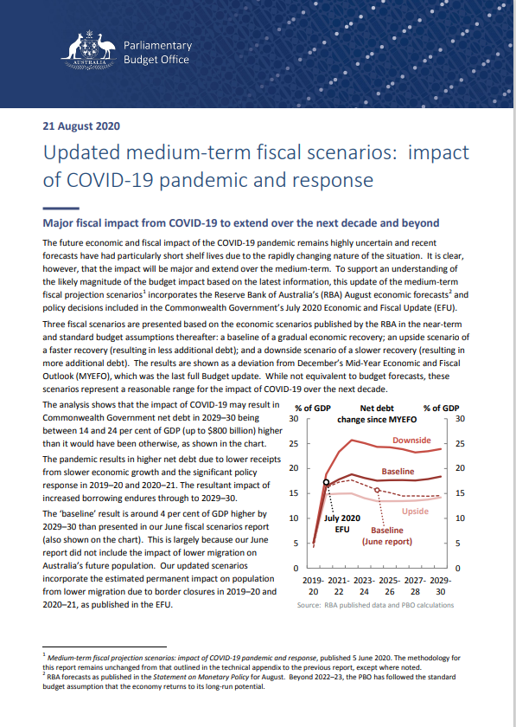
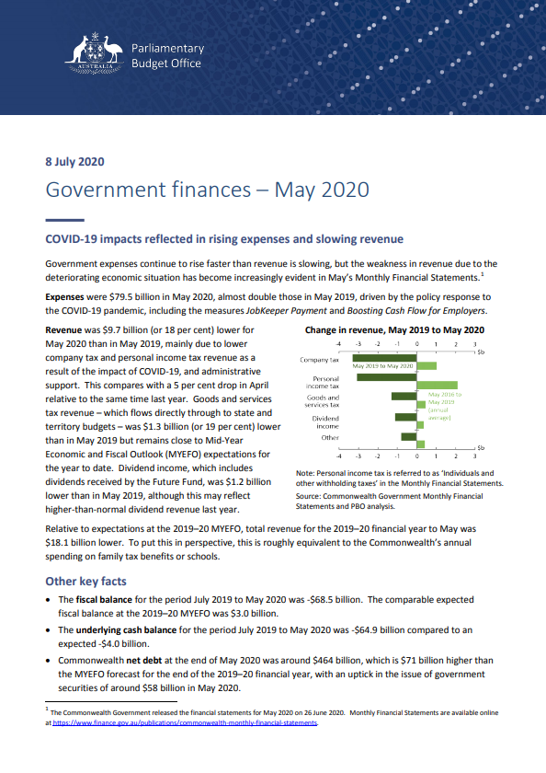
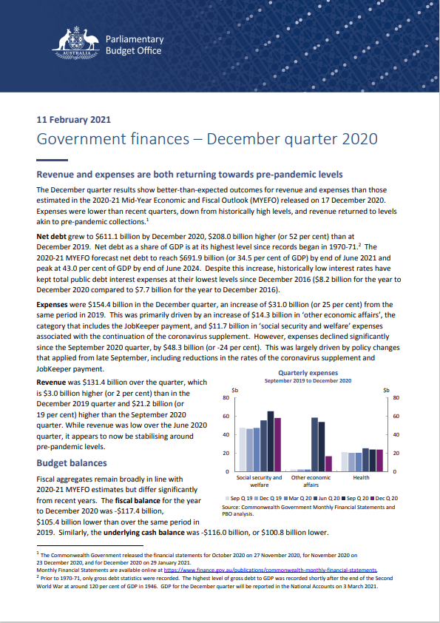
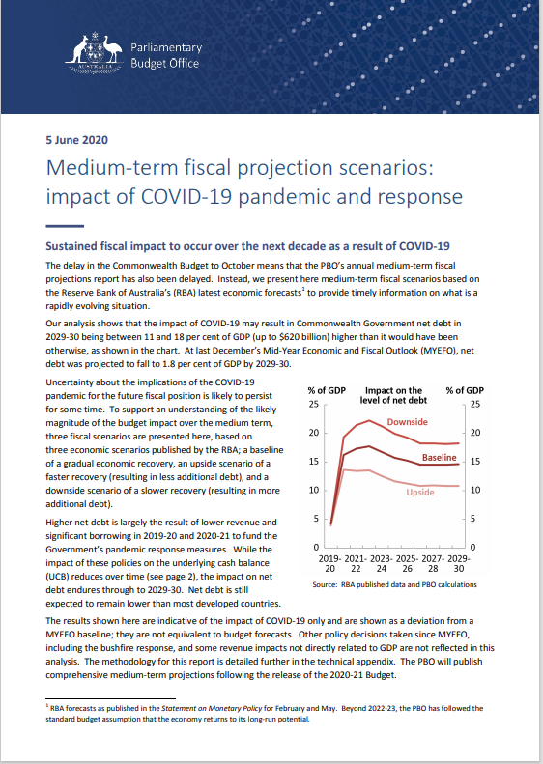
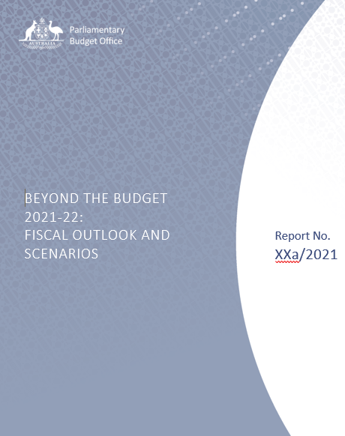
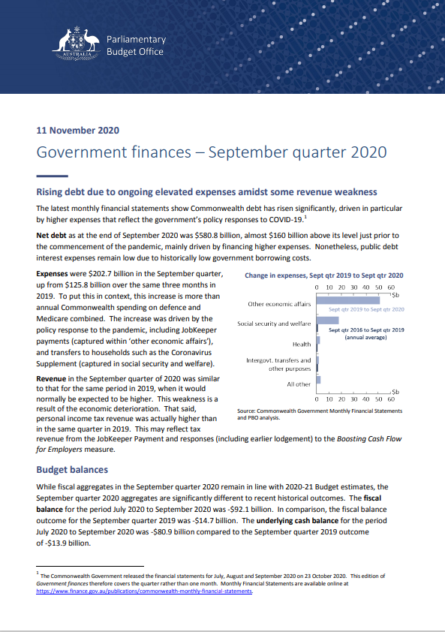
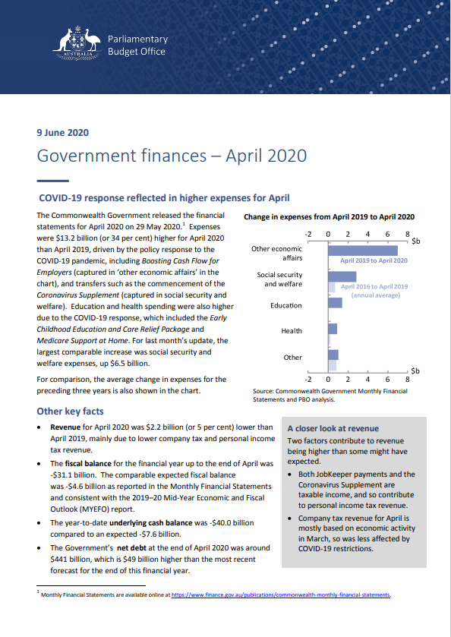
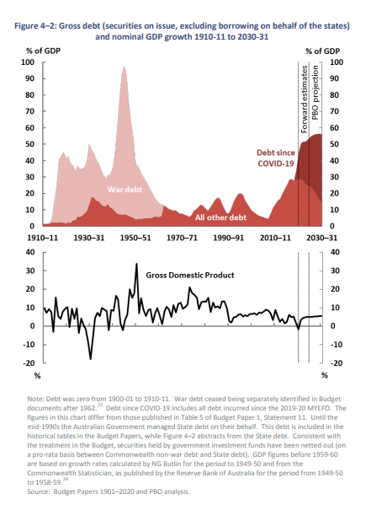
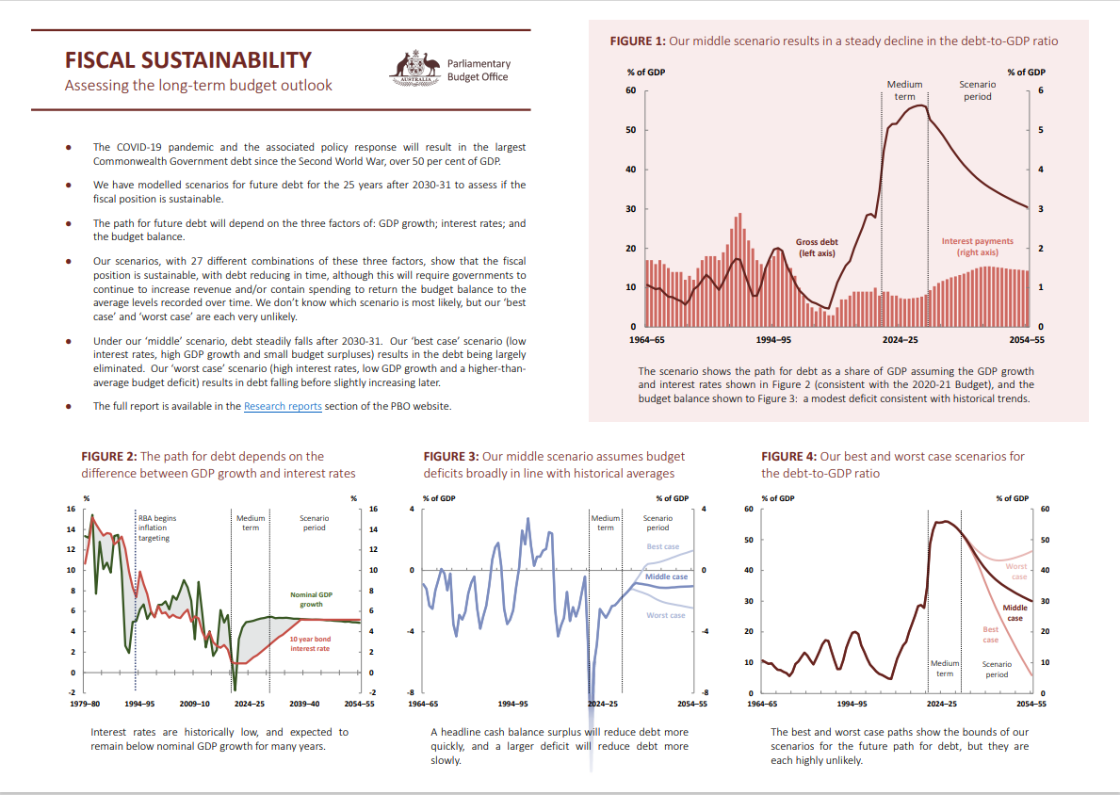

Slide 4
Sustainability
A sustainable position is:
one which can be maintained indefinitely, without the need for dramatic responses.

Slide 5
Fiscal sustainability
A fiscally sustainable position is where:
the government can pursue similar borrowing and repayment approaches over the long term
and
taxation and spending can operate within reasonable and expected bounds

Slide 6
Fiscal sustainability
A fiscally sustainable position is where:
the government can pursue similar borrowing and repayment approaches over the long term
and
taxation and spending can operate within reasonable and expected bounds.
Sustainable is familiar
Sustainability = confidence

Slide 7
Fiscal sustainability: limitations and caveats

Slide 8
Fiscal sustainability: limitations and caveats
Is the concept too narrow? Extended external reporting e.g. Workplace safety Pollution and water usage Biodiversity Institutional frameworks

Slide 9
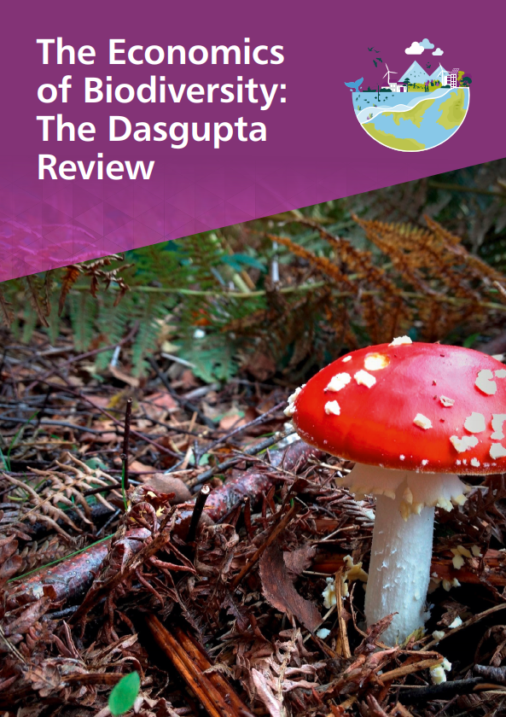
Fiscal sustainability: limitations and caveats
Is the concept too narrow? Extended external reporting e.g. Workplace safety Pollution and water usage Biodiversity Institutional frameworks

Slide 10
Fiscal sustainability: limitations and caveats
Is the concept too narrow? Extended external reporting e.g. Workplace safety Pollution and water usage Biodiversity Institutional frameworks
Sustainable may not be desirable

Slide 11
Fiscal sustainability: limitations and caveats
Is the concept too narrow? Extended external reporting e.g. Workplace safety Pollution and water usage Biodiversity Institutional frameworks
Sustainable may not be desirable
Adaptation

Slide 12
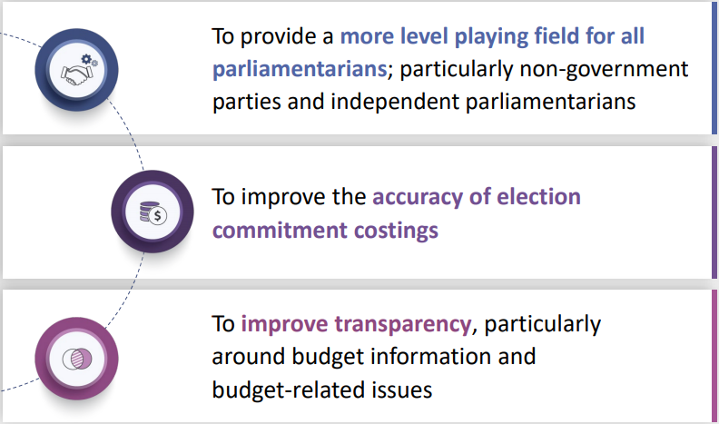
The PBO’s purpose

Slide 13
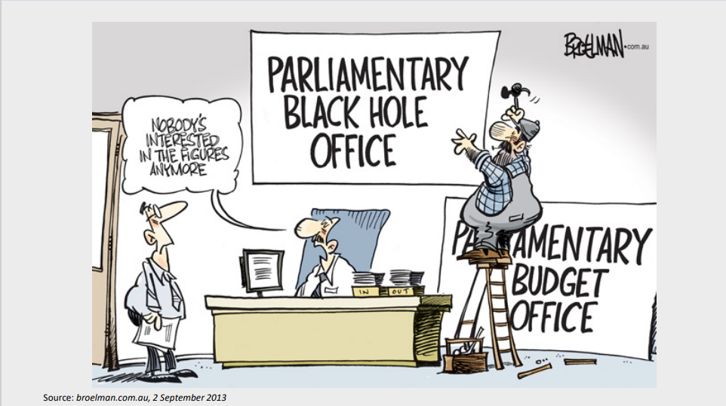

Slide 14
The budget ‘forward estimates’ period
Table 1.1: Budget aggregates
 | Actual |  | Estimates |  |  |  |  |  | Projections
 | 2019-20 |  | 2020-21 | 2021-22 | 2022-23 | 2023-24 | 2024-25 |  | 2025-26 | 2026-27 | 2027-28 | 2028-29 | 2029-30 | 2030-31 | 2031-32
Underlying cash balance ($b) | -85.3 |  | -161.0 | -106.6 | -99.3 | -79.5 | -57.0
Per cent of GDP | -4.3 |  | -7.8 | -5.0 | -4.6 | -3.5 | -2.4
Net operating balance ($b) | -92.3 |  | -154.5 | -92.7 | -90.2 | -70.2 | -55.7
Per cent of GDP | -4.7 |  | -7.5 | -4.3 | -4.1 | -3.1 | -2.3
Source: 2021-22 Budget, p.7

Slide 15
Looking beyond the forward estimates
Table 1.1: Budget aggregates
 | Actual |  | Estimates |  |  |  |  |  | Projections
 | 2019-20 |  | 2020-21 | 2021-22 | 2022-23 | 2023-24 | 2024-25 |  | 2025-26 | 2026-27 | 2027-28 | 2028-29 | 2029-30 | 2030-31 | 2031-32
Underlying cash balance ($b) | -85.3 |  | -161.0 | -106.6 | -99.3 | -79.5 | -57.0
Per cent of GDP | -4.3 |  | -7.8 | -5.0 | -4.6 | -3.5 | -2.4
Net operating balance ($b) | -92.3 |  | -154.5 | -92.7 | -90.2 | -70.2 | -55.7
Per cent of GDP | -4.7 |  | -7.5 | -4.3 | -4.1 | -3.1 | -2.3

Slide 16
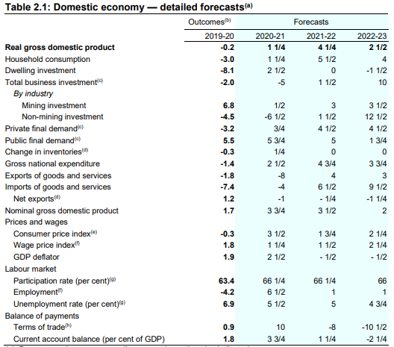

Slide 17
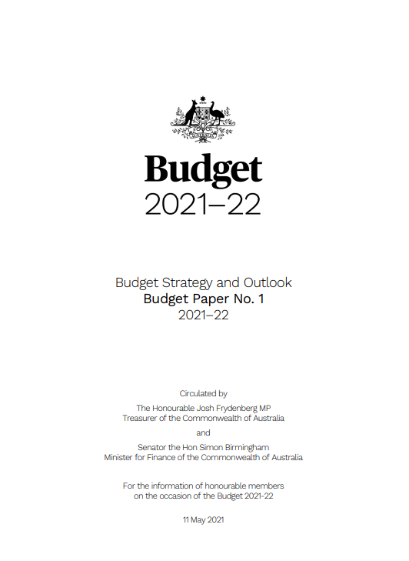
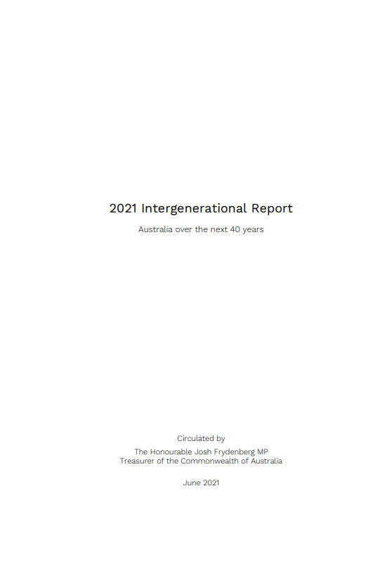
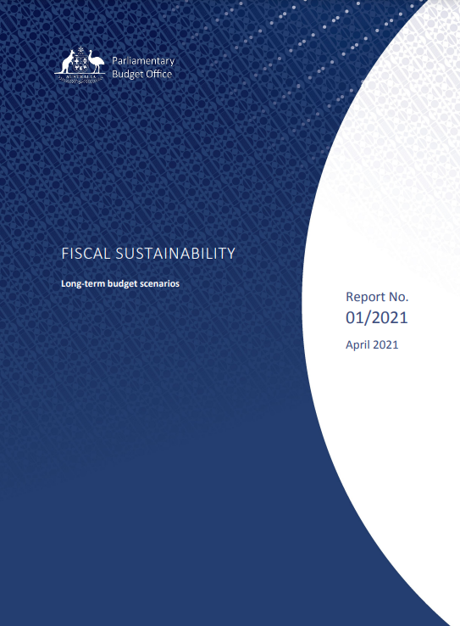
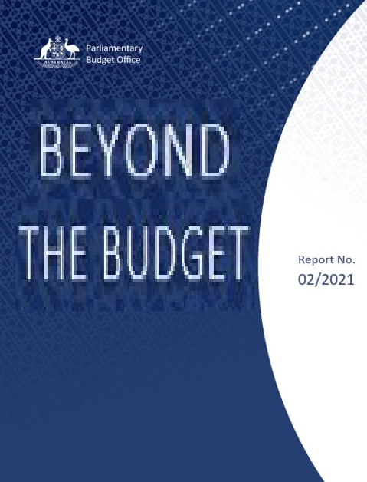
2020
2025
2030
2031
2061
BUDGET
MEDIUM-TERM
LONG-TERM
Forecasts
Projections
Scenarios
Budget trends
Fiscal sustainability

Slide 18
The budget in a nutshell The reconciliation table
Source: 2021-22 Budget, p.79

Slide 19
The budget in a nutshell The reconciliation table
Source: 2021-22 Budget, p.79

Slide 20
The budget in a nutshell The reconciliation table
Source: 2021-22 Budget, p.79

Slide 21
The budget in a nutshell The reconciliation table
Source: 2021-22 Budget, p.79

Slide 22
The budget in a nutshell The reconciliation table
Source: 2021-22 Budget, p.79

Slide 23
Budget variations over time
Parameter variations

Slide 24
Budget variations over time
Parameter variations
Policy decisions

Slide 25
Budget variations over time
Parameter variations
Policy decisions
Total variation

Slide 26
Budget variations over time
Parameter variations
Policy decisions
Total variation

Slide 27
The budget is also shaped by gradual policy changes … like welfare payment reforms
Global financial crisis
Female JobSeeker
recipients
Parenting payment exemptions removed
Unemployed women
Partner allowance closed for new claims
Unemployed men
Male JobSeeker recipients
Increases in age pension age
Tightened disability pension eligibility
Source: JobSeeker Payment: Understanding economic and policy trends affecting Commonwealth expenditure, PBO Report no. 03/2020
Notes:
Note that it’s not necessarily a large part of commonwealth expenditure

Slide 28
…and changes to tobacco taxation growth in tobacco prices
%
Series of increases raise excise around 50%.
%
Growth in relative price of tobacco
Excise rate increases around 13%.
Eight 12.5% annual rate increases.
Introduction of GST and ‘per stick’ regime.
25% excise rate increase.
Source: ABS National Accounts; ABS National, state and territory population; ABS Consumer Price Index
Note: Consumption per capita calculated as yearly chain volume divided by the 18+ population. Relative tobacco price is tobacco price inflation less CPI inflation.

Slide 29
… leading to behavioural changes
%
Series of increases raise excise around 50%.
%
Growth in relative price of tobacco
Excise rate increases around 13%.
Eight 12.5% annual rate increases.
Introduction of GST and ‘per stick’ regime.
25% excise rate increase.
Growth in per capita household tobacco consumption
Source: ABS National Accounts; ABS National, state and territory population; ABS Consumer Price Index
Note: Consumption per capita calculated as yearly chain volume divided by the 18+ population. Relative tobacco price is tobacco price inflation less CPI inflation.

Slide 30
Fiscal sustainability linkages
Fiscal sustainability
Debt – to – GDP
Interest rates
Economic growth
Budget policy
Population
Participation
Productivity

Slide 31
Fiscal sustainability linkages
Fiscal sustainability
Debt – to – GDP
R
G
B
Interest rates
Economic growth
Budget policy
Population
Participation
Productivity

Slide 32
Fiscal sustainability linkages
Fiscal sustainability
Debt – to – GDP
R
G
B
Interest rates
Economic growth
Budget policy
structural
cyclical
Population
Participation
Productivity

Slide 33
The debt-to-GDP ratio over 25 years
Medium term
Debt since COVID-19
War debt
War debt
All other debt
Note: Debt refers to face value of AGS issued.
Source: Fiscal Sustainability, PBO report 01/2021, April 2021 and Beyond the Budget, PBO report to be released

Slide 34
The debt-to-GDP ratio over 120 years
Medium term
Debt since COVID-19
War debt
All other debt
Note: Debt refers to face value of AGS issued.
Source: Fiscal Sustainability, PBO report 01/2021, April 2021
and Beyond the Budget, PBO report to be released

Slide 35
Reducing the debt-to-GDP ratio: post WW2
Gross debt
Medium term
Period | 1945-46 to 1950-51
R – Interest rate | 3.0
G – GDP growth | 16.1
B – Budget balance | -0.9
Note: GDP growth refers to nominal GDP growth. Interest rate calculated as nominal interest payments over gross debt. Budget balance refers to the headline cash balance excluding interest payments.
Source: Fiscal Sustainability, PBO report 01/2021 and Beyond the Budget, PBO report to be released

Slide 36
Reducing the debt-to-GDP ratio: the late ‘80s
Gross debt
Medium term
Period | 1945-46 to 1950-51 | 1985-86 to 1990-91
R – Interest rate | 3.0 | 13.7
G – GDP growth | 16.1 | 11.5
B – Budget balance | -0.9 | 2.6
Note: GDP growth refers to nominal GDP growth. Interest rate calculated as nominal interest payments over gross debt. Budget balance refers to the headline cash balance excluding interest payments.
Source: Fiscal Sustainability, PBO report 01/2021 and Beyond the Budget, PBO report to be released

Slide 37
Reducing the debt-to-GDP ratio: 1996-2007
Gross debt
Medium term
Period | 1945-46 to 1950-51 | 1985-86 to 1990-91 | 1995-96 to 2007-08
R – Interest rate | 3.0 | 13.7 | 9.1
G – GDP growth | 16.1 | 11.5 | 6.9
B – Budget balance | -0.9 | 2.6 | 2.4
Note: GDP growth refers to nominal GDP growth. Interest rate calculated as nominal interest payments over gross debt. Budget balance refers to the headline cash balance excluding interest payments.
Source: Fiscal Sustainability, PBO report 01/2021 and Beyond the Budget, PBO report to be released

Slide 38
Reducing the debt-to-GDP ratio: next decade
Gross debt
Medium term
Period | 1945-46 to 1950-51 | 1985-86 to 1990-91 | 1995-96 to 2007-08 | 2021-22 to 2031-32
R – Interest rate | 3.0 | 13.7 | 9.1 | 1.8
G – GDP growth | 16.1 | 11.5 | 6.9 | 4.7
B – Budget balance | -0.9 | 2.6 | 2.4 | -2.1
Note: GDP growth refers to nominal GDP growth. Interest rate calculated as nominal interest payments over gross debt. Budget balance refers to the headline cash balance excluding interest payments.
Source: Fiscal Sustainability, PBO report 01/2021 and Beyond the Budget, PBO report to be released

Slide 39
Reducing the debt-to-GDP ratio: next 40 years
Gross debt
Medium term
Scenario period
PBO ‘middle’ scenario
Period | 1945-46 to 1950-51 | 1985-86 to 1990-91 | 1995-96 to 2007-08 | 2021-22 to 2031-32 | 2032-33 to 2060-61
R – Interest rate | 3.0 | 13.7 | 9.1 | 1.8 | 4.1
G – GDP growth | 16.1 | 11.5 | 6.9 | 4.7 | 5.1
B – Budget balance | -0.9 | 2.6 | 2.4 | -2.1 | 0.4
Note: GDP growth refers to nominal GDP growth. Interest rate calculated as nominal interest payments over gross debt. Budget balance refers to the headline cash balance excluding interest payments.
Source: Fiscal Sustainability, PBO report 01/2021 and Beyond the Budget, PBO report to be released

Slide 40
The IGR projects higher debt levels than the PBO over the long term
Gross debt as a per cent of GDP
2021 Intergenerational Report
Source: Beyond the Budget, PBO report to be released

Slide 41
The IGR projects higher debt levels than the PBO over the long term
Gross debt as a per cent of GDP
2021 Intergenerational Report
13%
PBO middle scenario
Source: Beyond the Budget, PBO report to be released

Slide 42
The IGR projects higher debt levels than the PBO over the long term
Gross debt as a per cent of GDP
2021 Intergenerational Report
(no policy change)
13%
PBO middle scenario
(familiar policy change continues)
Source: Beyond the Budget, PBO report to be released

Slide 43
Previous fiscal consolidations
% of GDP
Headline cash balance
% of GDP
Fiscal consolidations
Economic downturns
Source: Fiscal Sustainability, PBO report 01/2021

Slide 44
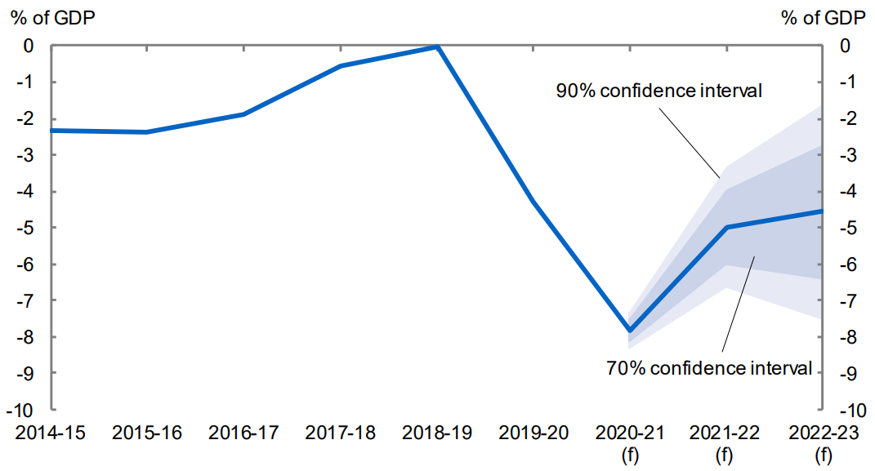
Confidence intervals are one way of showing uncertainty
Underlying Cash Balance
Source: 2021-22 Budget Paper 1

Slide 45
We use fiscal scenarios to explore uncertainty
Fiscal sustainability
Debt – to – GDP
R
G
B
Interest rates
Economic growth
Budget policy
High
3
x
3
x
3
Mid
Low
= 27 scenarios

Slide 46
By varying each assumption in turn we can project a range of scenarios for debt
Gross debt
Downside scenario
Middle scenario
Upside scenario
Source: Beyond the Budget, PBO report to be released

Slide 47
The PBO is developing a fiscal sustainability dashboard which explores debt scenarios
PBO Fiscal Sustainability Dashboard
Updated for 2021-22 Budget
Gross debt
Interest rates
Downside
%
%
Middle
Middle scenario
Inflation targeting
Upside
Middle scenario
GDP growth (productivity component)
Upside
%
%
PBO Projections
5 year average
Middle
Downside
Range of scenarios
Budget balance
Upside
% GDP
% GDP
Middle
Downside
Note: Interest rates are 10 year bond rates. Budget balance is headline cash balance.
Source: Beyond the Budget, PBO report to be released

Slide 48
The dashboard can vary depending upon the assumptions chosen
PBO Fiscal Sustainability Dashboard
Updated for 2021-22 Budget
Gross debt
Interest rates
Downside
%
%
Middle
Inflation targeting
Upside
Middle scenario
GDP growth (productivity component)
Upside
%
%
PBO Projections
5 year average
Low interest scenario
Middle
Downside
Range of scenarios
Budget balance
Upside
% GDP
% GDP
Middle
Downside
Note: Interest rates are 10 year bond rates. Budget balance is headline cash balance.
Source: Beyond the Budget, PBO report to be released

Slide 49
Productivity is key to ensuring GDP growth returns to historical levels
Source: ABS National Accounts

Slide 50
Productivity is key to ensuring GDP growth returns to historical levels
IGR trend growth = 1.5%
Source: ABS National Accounts

Slide 51
Productivity is key to ensuring GDP growth returns to historical levels
What if future productivity growth was 0.9%?
Source: ABS National Accounts

Slide 52
A low productivity scenario increases long run debt levels
PBO Fiscal Sustainability Dashboard
Updated for 2021-22 Budget
Gross debt
Interest rates
Downside
%
%
Middle
Inflation targeting
Upside
Low productivity scenario
GDP growth (productivity component)
Upside
%
%
PBO
Projections
5 year average
Middle scenario
Middle
Downside
Range of scenarios
Budget balance
Upside
% GDP
% GDP
Middle
Downside
Note: Interest rates are 10 year bond rates. Budget balance is headline cash balance.
Source: Beyond the Budget, PBO report to be released

Slide 53
However, usually interest rates move with GDP, which reduces debt levels
PBO Fiscal Sustainability Dashboard
Updated for 2021-22 Budget
Gross debt
Interest rates
Downside
%
%
Middle
Inflation targeting
Upside
Low productivity, low interest scenario
GDP growth (productivity component)
Upside
%
%
PBO
Projections
5 year average
Middle scenario
Middle
Downside
Range of scenarios
Budget balance
Upside
% GDP
% GDP
Middle
Downside
Note: Interest rates are 10 year bond rates. Budget balance is headline cash balance.
Source: Beyond the Budget, PBO report to be released

Slide 54
Only in our downside scenario does debt rise above medium term levels
Gross debt
Downside scenario
PBO 27 scenarios
Middle scenario
PBO Projections

Slide 55
Only in our downside scenario does debt rise above medium term levels
Gross debt
Debt level at end of medium term
Downside scenario
PBO 27 scenarios
PBO Projections

Slide 56
Fiscal sustainability linkages
Fiscal sustainability
Debt
Interest rates
Economic growth
Budget policy
Population
Participation
Productivity

Slide 57
Fiscal sustainability linkages
Policy and growth
Fiscal sustainability
Debt
Interest rates
Economic growth
Budget policy
Population
Participation
Productivity

Slide 58
Fiscal sustainability linkages
Growth and interest rates
Fiscal sustainability
Debt
Interest rates
Economic growth
Budget policy
Population
Participation
Productivity

Slide 59
Our dashboard focuses on key variables
PBO Fiscal Sustainability Dashboard
Updated for 2021-22 Budget
Gross debt
Interest rates
Downside
%
%
Historical values
Middle
Middle scenario
Inflation targeting
Upside
Middle scenario
Productivity growth
Upside
%
%
PBO Projections
5 year average
Middle
Downside
Range of scenarios
Budget balance
Upside
% GDP
% GDP
Middle
Historical values
Downside
Note: Interest rates are 10 year bond rates. Budget balance is headline cash balance.
Source: Beyond the Budget, PBO report to be released

Slide 60
Fiscal sustainability has its limitations
Fiscal sustainability is limited by:
Scope
Desirability and constraints
Adaptation

Slide 61
Fiscal sustainability has its limitations...
Fiscal sustainability is limited by:
Scope
Desirability and constraints
Adaptation
Multiple forms of fiscal sustainability are possible, but unsustainability is always problematic
Fiscal systems sit within a broader policy context

Slide 62
PO Box 6010 Parliament House CANBERRA ACT 2600
Phone: 02 6277 9500
Email: pbo@pbo.gov.au

