Slide 1
Social Assistance in OECD countries: Assessing three decades of change
Peter Whiteford, Crawford School of Public Policy, the Australian National University and Jonathan Bradshaw, University of York
peter.whiteford@anu.edu.au; jrb1@york.ac.uk

Slide 2
Overview
Motivation and Background
  Updating Social Assistance in OECD Countries (Eardley et al., 1996a,b
  Trends in receipt of income support in Australia: Puzzles and Challenges
  How does the Australian social security system affect the distribution of income (Spending= Av. No Recipients X Av. Benefit Level)
  Economic Inclusion Advisory Committee
What was the situation in the 1990s?
What is the situation now?
  How Australia compares
Safety nets and labour market change
Methodological issues in comparative research (cf. L.P Hartley)
Notes:
The past is a foreign country

Slide 3
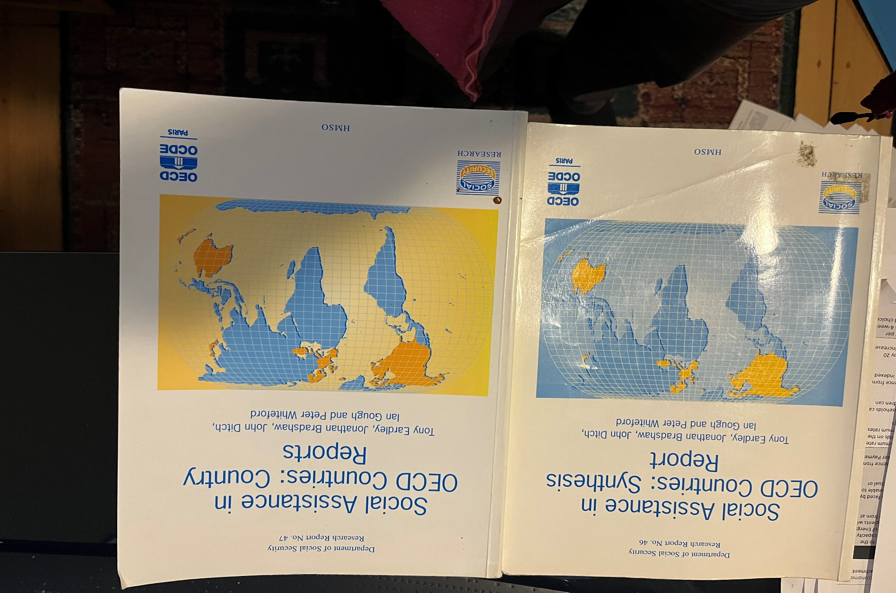
Notes:
https://eprints.whiterose.ac.uk/73427/

Slide 4
Background
“The first comprehensive study on social assistance in OECD countries was undertaken by Eardley and colleagues [Eardley, Bradshaw, Ditch, Gough and Whiteford] (1996; see also Gough et al. 1997) and is still the major reference, even though it describes the situation in 1992.” (Bahle, Pfeifer and Wendt, 2010, 251.)
  Funded by UK Department of Social Security for 18 countries (EU 12, plus Nordic and English-speaking), plus OECD for 6 further countries. Ian Gough supported by Nuffield Foundation.
  This assessment used a wide range of data collected for then 24 OECD countries. Undertaken between October 1993 and 1995 by 5 researchers at York and Bath (+2), with national experts and validated by national administrations.
  Two volumes published by UK Department of Social Security and OECD, and Journal of European Social Policy (JESP) article.
Notes:
By the end of 1993, there were 623 websites, according to a study by Massachusetts Institute of Technology
https://en.wikipedia.org/wiki/List_of_websites_founded_before_1995#:~:text=.cybergrass.com.-,1993%20websites,of%20Technology%20researcher%20Matthew%20Gray

Slide 5
Definitions of social assistance
“This study is concerned with the ways in which developed societies provide a guarantee of minimum resources to citizens or residents who lack sufficient income from other sources. Such forms of protection are often described as constituting a “safety net”, through which people should not have to fall.
… Not all OECD countries have such a general safety net, but where they do, a substantial part of the safety net is normally provided through cash benefits or services available to applicants only where they cannot provide for themselves - that is, through some form of assessment of the resources already available to them.”
Eardley, Bradshaw, Ditch, Gough and Whiteford, 1996.
“For the purposes of these reviews, social assistance is defined as:
Those means-tested benefits, in cash or in kind, which have eligibility criteria which are designed to target the receipt of benefits on individuals or households that are clustered within the lower segment of the income distribution, or below some threshold which approximates a similar target.
OECD, 1998
Notes:
Significant problems of definition
Only programs of “last resort”?
Minimum pensions make issues complicated
Only income-tested programs?

Slide 6
Classification of Means-Tested Schemes
Notes:
All groups – e.g. Universal Credit in UK
Specific groups – orphans, widows, people with disability

Slide 7
Measures used in classifying social assistance regimes (Eardley et al, 1996)
Inputs
  extent and salience (expenditure and number of beneficiaries)
Programme structures
  Centralisation or local variation
  Rights or discretion
  Individual entitlements or wider family obligations
  Liberal or tough means-testing and work-testing
Outcomes
  Benefit levels (national currency, PPP adjusted)
  Replacement rates

Slide 8
Identifying social assistance regimes
8 assistance regimes:
  Selective welfare systems (Australia and New Zealand)
    “Selectivity in Australasia is sui generis.”
  The public assistance state (United States)
  Integrated safety nets (Great Britain, Ireland and Canada)
  Dual social assistance models (Germany, France, Belgium and Luxembourg)
  Citizenship-based but residual (Nordics* and the Netherlands)
  Rudimentary assistance (Southern Europe and Turkey)
  Decentralised, discretionary relief (Norway*, Austria and Switzerland)
  Centralised, discretionary assistance (Japan)
Notes:
Dual models - These countries provide categorical assistance schemes for specific groups, but have supplemented these with newer programmes providing a general basic safety net.
Residual - A tradition of full employment and universal welfare provision has relegated social assistance to the margins of social programmes in these countries - or rather, it did.
The USA exhibits an extensive set of means-tested benefits, arranged in hierarchy of acceptability and stigma. Assets tests are generally tough, but there are in-built earnings disregards and work incentives in every scheme. Benefits are variable but tend to be low both in comparison with other countries and in relation to domestic poverty lines.

Slide 9
Typology of extent and generosity of social assistance in 1992
Standardised benefit levels as % of mean | Recipients as % of population
 | >10% | 3-10% | <3%
>120% | Ireland, Australia | Finland, Iceland, Netherlands, Denmark, Sweden | -
80-120% | UK, New Zealand, Canada | Norway, Luxembourg, France, Austria, Belgium | Switzerland, Japan
<80% | USA | Germany, Italy | Spain, Portugal, Greece

Slide 10
Assessing 30 years of change
Radical retrenchment underway in New Zealand (1991), later in USA (1996), Canada (from 1993), Germany (2003-2005).
Expansion under “New Labour” in UK from 1997; then system redesign and then austerity from 2014.
“Policy drift” in Australia from 1990s onwards – “in the long run, indexation is what matters” + invisible targeting.
Activation and its implications? Labour market change and new forms of work.
What other patterns of retrenchment or expansion, and cycles?
International migration and temporary workers
There are now 27 EU countries and 38 OECD countries. Where do they fit?
Break-up of Soviet Union. Crises – 1997 Asian Financial Crisis, 2008-09 Global Financial Crisis, COVID (2020 to ?), 2022 energy crisis.
Conditional cash transfers and role of development Banks and IMF, ILO Social Protection Floor from 2012.

Slide 11
Issues in updating Eardley et al.
Benefit levels and comparisons with insurance benefits – OECD Benefits and Wages database https://www.oecd.org/social/benefits-and-wages/
OECD Tax-Benefit Web Calculator https://www.oecd.org/els/soc/benefits-and-wages/tax-benefit-web-calculator/ ; OECD Tax-Benefit Data Portal https://www.oecd.org/social/benefits-and-wages/data/
Spending levels – OECD SOCX https://www.oecd.org/social/expenditure.htm
Numbers of recipients – OECD SOCR https://www.oecd.org/els/soc/recipients-socr-by-country.htm - but how comparable?
Subsequent literature – 400+ studies plus others not citing original work.
Nelson, K., Fredriksson, D., Korpi, T., Korpi, W., Palme, J. and O. Sjöberg. 2020. The Social Policy Indicators (SPIN) database. International Journal of Social Welfare. 29 (3). 285-289. https://doi.org/10.1111/ijsw.12418
Van Mechelen, N., Marchal, S., Goedemé, T., Marx, I., & Cantillon, B. (2011). The CSB-Minimum Income Protection Indicators dataset (CSB-MIPI) (WP 11/05). Antwerp: University of Antwerp.

Slide 12
OECD sources
OECD Tax-Benefit Web Calculator https://www.oecd.org/els/soc/benefits-and-wages/tax-benefit-web-calculator/ for unemployment insurance, social assistance and wage levels. Also, for unemployed with no contribution history.
OECD Tax-Benefit Data Portal https://www.oecd.org/social/benefits-and-wages/data/ for adequacy of minimum benefits (relative to median disposable incomes).
OECD Social Benefit Recipients Database https://www.oecd.org/social/social-benefit-recipients-database.htm
OECD (2023), Pensions at a Glance 2023: OECD and G20 Indicators, OECD Publishing, Paris, https://doi.org/10.1787/678055dd-en for levels and coverage of basic and targeted pensions.

Slide 13
Recipients of social assistance, 2018
% of working-age population
Notes:
The Social benefits Recipients database, covering the main income replacement benefits in 41 EU and OECD countries provides a unique source of comparable information on the number of individuals receiving income replacement benefits across countries. SOCR data can be used to monitor programme participation and coverage rates, and provides contextual information for interpreting spending statistics and indicators of work incentives and benefit adequacy. It also sheds light on the dynamics of social benefit receipt in the context of the economic crisis in recent years. It currently covers twelve years (2007-2018) for most OECD and EU countries.

Slide 14
Twenty years of … (Neglect? Drift?)
Benefit replacement rates for the short-term unemployed are among the lowest in the OECD
Since 2000, the real value of the single rate of unemployment payments have risen by just under 14%
  Real minimum wages have risen by 23%
  Real average wages after tax have risen by 27%
  Real median disposable incomes have risen by 46%
  Average incomes of the poorest 20% have risen by 47%
  Real single pension rates by 53% (wage indexation and Harmer Review)

Slide 15
Level of minimum income benefits as % of median equivalised household net income, OECD countries, single person, 2023

Slide 16
Change in minimum income benefits as % of median equivalised household net income, OECD countries, single person, 2001 to 2023

Slide 17
Trends in income support payments as % of median household disposable income, Australia, 2001 to 2023

Slide 18
Generosity of social assistance (%of OECD average) in 1992 and 2023
 | 1992 | 2023
<120% | Ireland, Australia, Finland, Iceland, Netherlands, Denmark, Sweden | Belgium, Iceland, Denmark, Luxembourg, Netherlands, Spain
80%-120% | United Kingdom, New Zealand, Canada, Norway, Luxembourg, France, Austria, Belgium, Switzerland, Japan | Ireland, Finland, Switzerland, Greece, Italy, Japan, Austria, New Zealand, Australia, France
Less than 80% | USA, Germany, Italy, Spain, Portugal, Greece | United States, Sweden, Norway, Portugal, United Kingdom, Canada, Germany, Türkiye
Notes:
Note: Countries in red have improved their position; countries in bold and underlined have become less generous. Note different measures of generosity

Slide 19
The importance of housing costs
“Housing costs are particularly problematic in comparative research” (page 9)
“Housing costs are especially difficult to take into account in comparative research. Costs vary within countries and between countries according to tenure and the size, age and location of the dwellings. In some countries rents may be controlled for those persons occupying dwellings before a certain date. …There are also significant differences between countries in tenure distribution at different income levels. Nevertheless, housing costs cannot be ignored. In many countries, help with housing costs is a critical element in the benefit package, and even where such support does not exist, variations in housing costs mean that real income levels differ substantially before and after taking account of housing.” (1996a, p. 124)
“There is no simple solution to these problems …” p. 126

Slide 20
Gross housing costs as % of average wage, 1992

Slide 21
Housing benefits as % of housing costs (10% and 20% of average wage), selected OECD countries, 2023
Notes:
OECD models

Slide 22
Can poor people afford housing?
“The 20% of AW used approximates the average level of housing consumption across the OECD. … Any assumption other than fixed housing costs for those in-work and out-of-work would make interpretation of replacement rates difficult” https://www.oecd.org/els/soc/methodology.pdf
Assuming gross rents equal 10% of the average wage, after-housing incomes are negative in Bulgaria, Hungary, Italy, Romania, the Slovak Republic, Turkey and the USA.
At 20%, they are also negative in Canada, Greece, Germany, Croatia, Lithuania, Poland and Portugal (and deeper for countries above).
In Australia, AHC incomes would be around $30 per week.
Notes:
Quality suffers also homelessness increases.

Slide 23
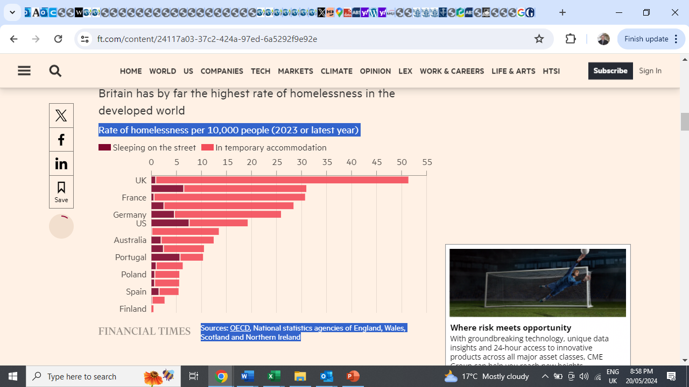
Can poor people afford housing?
Notes:
Sleeping on the street or in temporary accommodation
Australia 1.94 per 10,000 people
USA 7.54 per 10,000 people

Slide 24
Labour market change and social assistance

Slide 25
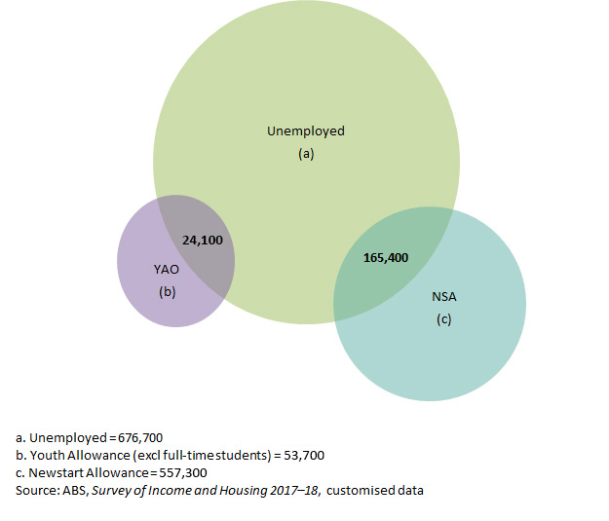
Recipients of job seeker payments and the unemployed (aged 15 to 64 years), 2017–18 Source: Vandenbroek, 2019

Slide 26
Labour force status of jobseeker payment recipients aged 25 to 64, Australia, 1996-97 to 2017-18

Slide 27
Income support receipt of unemployed people, Australia, 1996-97 to 2017-18
Notes:
The proportion of ABS unemployed receiving Newstart/Jobseeker has halved from 55% to 27%

Slide 28
What sort of safety net?
Most unemployed Australians don’t receive income support
Most people receiving JobSeeker Payment are not unemployed
Is targeting by exclusion the best way to support the poorest?
How many people have never worked?
How many people have uninterrupted careers?
Is there a right benchmark of adequacy?

Slide 29
Issues and Conclusions
More questions than answers!
Methodological questions:
  Housing costs.
  Comparing adequacy
  Comparing labour markets
What are outcomes? Benefit levels or poverty rates and poverty gaps?

Slide 30
Additional Material

Slide 31
Defining adequacy
The concept of ‘adequacy’ is one of the core values of the Australian social security system. The McClure Review (2015) defined ‘adequacy’ as providing ‘income support recipients with sufficient support to ensure a basic standard of living in line with community standards.’
Measures used in the Harmer Review (2009)
  The purchasing power of payments (trends in their real value since the 1980s).
  Value relative to earnings (both Male Total Average Weekly Earnings (MTAWE) and the National Minimum Wage, also since the 1980s).
  Budget standards – that specify the detailed costs of purchases needed to sustain an adequate living standard.
  Income poverty measures (1/2 median, the Henderson Poverty Line).
  International comparisons with levels in other Organisation for Economic Co-operation and Development (OECD) countries.
  Wellbeing outcomes (These included the way in which pensioners themselves perceived their own level of wellbeing. The second was a measure that identified the extent to which particularly poor outcomes occurred among different populations – deprivation standards and financial stress).

Slide 32
Change (%) in real median equivalised household disposable income, 1995 to 2012 (or nearest year)
Source: Estimated from OECD Income Distribution database, http://stats.oecd.org/index.aspx?queryid=46022

Slide 33
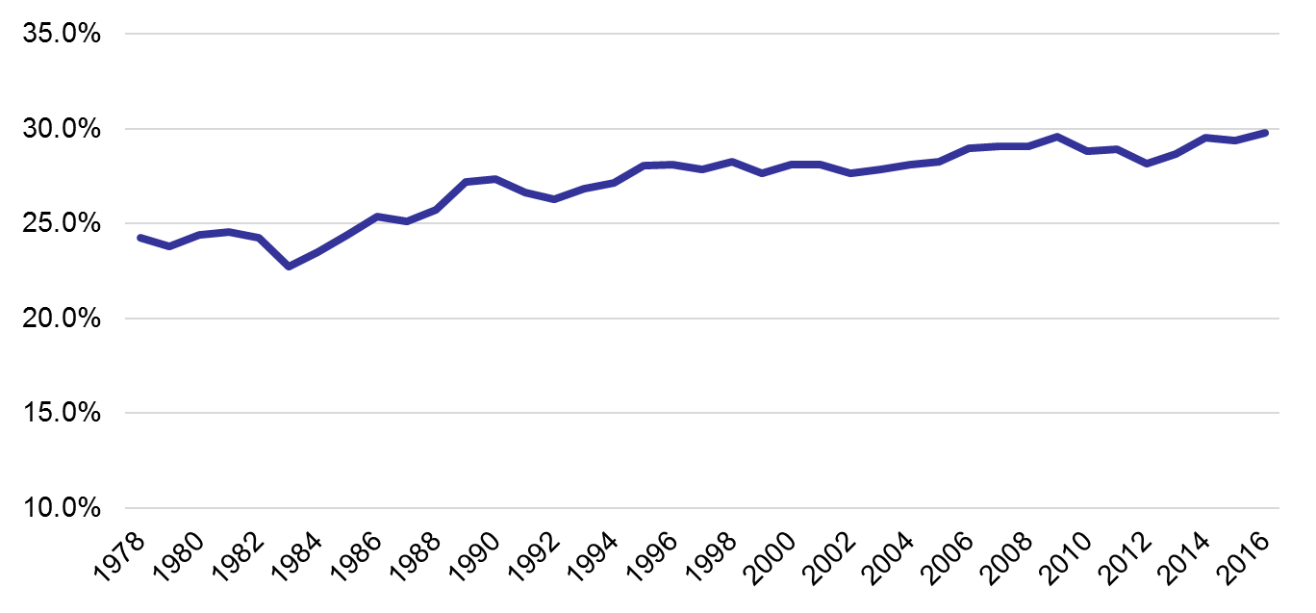
Trends in share of full-time jobs, not low paid, for women, Australia 1978 to 2016

Slide 34
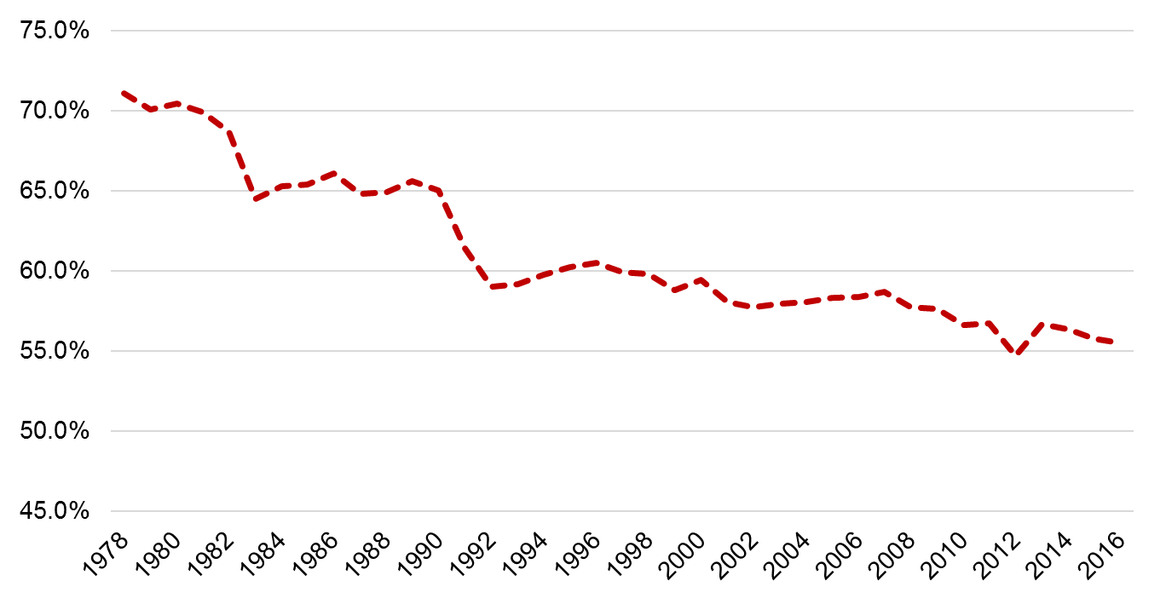
Trends in share of full-time jobs, not low paid, for men, Australia, 1978 to 2016

Slide 35
Temporary employment to population ratio, OECD countries, by type of employment, 2013

