Slide 1
Reforming Parlt Workplaces
ASPG (ACT Chapter)
27 June 2024
Marian Sawer
School of Politics and International Relations
The Australian National University

Slide 2
Theoretical framework – feminist institutionalism
Brings a gender dimension to new institutionalist concepts concerning inner life of institutions and institutional trajectories:
• Resilience of institutional norms and practices despite new entrants
• Gendered logic of appropriateness governing behaviour
• Opportunities for change created by critical junctures
We use these concepts to help us understand recent and ongoing parliamentary reforms

Slide 3
Institutional continuity – resistance to codes of conduct
• Path dependence:
– embedded norm of
parliamentary privilege
self-regulation
accountability for conduct only at ballot box
• Logic of appropriateness: normalisation of ritualised conflict

Slide 4
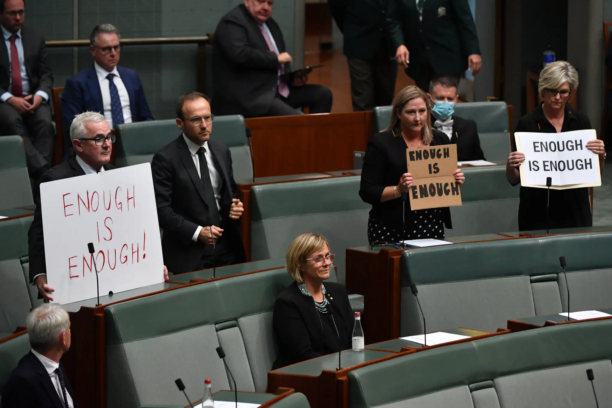
Critical juncture, critical actors
• Exogenous shock #MeToo, #March4Justice
– critical juncture
– loss of public trust
• Critical actors – Higgins, Jenkins,

Slide 5
Timing and sequence
• Timing, sequence
– pre-existing international standard gender-sensitive parliament
– pre-existing models independent oversight

Slide 6
Norms and policy borrowing
Norms
– Alignment with sociocultural standards
Respect@Work positive duty
– Legitimacy of policy borrowing from UK
– Institutional isomorphism, copying institutions believed to work

Slide 7
Nested newness
Parliamentary privilege still an issue (see delays over IPSC)
Remembering the old, forgetting the new
– Westminster adversarialism

Slide 8
Reforming parliamentary workplaces – Australia, Canada, New Zealand and the UK
Dr Maria Maley
School of Politics and International Relations
Australian National University
27 June 2024
maria.maley@anu.edu.au

Slide 9
Toxic Parliaments And What Can Be Done About Them
https://link.springer.com/book/10.1007/978-3-031-48328-8

Slide 10
Viewing parliament as a workplace demands standards and regulation of conduct
Three core elements to reforming toxic parliaments:
1. Norms or rules, codes of conduct
2. Enforcement architecture
3. Proactive and preventive action
advice, professionalisation and responsibility to change culture

Slide 11
Beginning of modern standards regimes in Westminster
Canada | UK | New Zealand | Australia
2014 | 2018 | 2020 | 2023-2024….

Slide 12
Canada
Moved early
Workplace Harassment and Violence Prevention policy (2014, 2021)
Code of Conduct for Members of the House of Commons: Sexual Harassment Between Members (2015)
mandatory pledge by MPs not to sexually harass other MPs
No independent grievance body or commissioner to investigate, make findings and decide sanctions
Process for handling complaints is internal to parliament and not independent of MPs
Dominance by political parties - Whips, Prime Minister’s Office

Slide 13
UK
Codes of conduct
Independent Complaints and Grievance Scheme (ICGS)
Parliamentary Commissioner for Standards
Committee on Standards – makes decisions about the conduct and sanctioning of MPs
Lay members
Independent Expert Panel – no MPs – appeals, sanctions

Slide 14
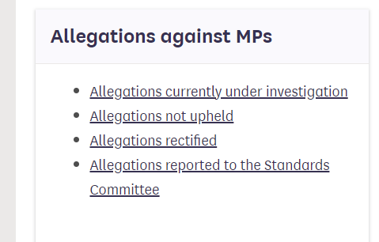
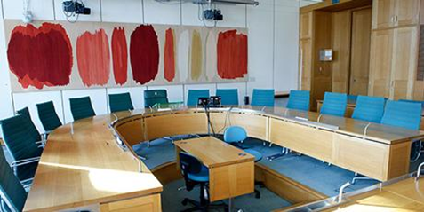
Features of the UK standards regime
Parliamentary Commissioner for Standards website
High independence from MPs, but parliamentary sovereignty seen as important
Parliamentary Commissioner for Standards does not make decisions tabled in the House, these are decided by the Committee on Standards
When sanctions tabled in the House there is no debate or amendment
Transparency

Slide 15
Challenges in the UK standards regime
Sanctions and fairness
Slowness of investigations – ICGS
Limited HR support
Complexity

Slide 16
New Zealand
2019 Francis Review
2020 Behavioural statements for the parliamentary workplace
Difficulty in gaining consensus across the parliament
2023 Commissioner for Parliamentary Standards
No agreement on sanctions yet
In her first year, no formal complaints had been received
Underdeveloped HR support

Slide 17
Australia 2021 - 2024
Set the Standard 2021 – strong commitment to implement all 28 recommendations
No rules, no structures, no leadership institutions
Parliamentary Leadership Taskforce
Single focus, public reporting, high accountability
Three Codes: everyone, parliamentarians, staff
Joint Select Committee on Parliamentary Standards
Endorsed by both Houses in Feb 2023

Slide 18
Australia
Independent Parliamentary Standards Commission
Enforce codes, receive complaints, investigate, apply sanctions
Multi-member commission
Appeals to a panel of other commissioners
Independent central HR body – Parliamentary Workplace Support Service (PWSS)
Independent statutory agency October 2023
Derives its authority from an Advisory board external to parliament which must approve any mandatory policies and practices
Lack of legitimacy and ability to enforce?

Slide 19
Features, issues
Coherence
Parliamentary Leadership Taskforce:
Cross-party, cross-chamber, executive and legislative members
Consultation and consensus building
Future?
Independent Parliamentary Standards Commission….?
Scope of conduct assessed
Procedure – how will reports be handled in parliament?
Sanctions, transparency
Members of Parliament (Staff) Act problems

