Slide 1
Identifying opportunities to minimize the risk of poverty
What keeps me up at night?
Presented by A. Abigail Payne
Ronald Henderson Professor &
Melbourne Institute Director

Slide 2

Poverty = State
Getting to that State involves Risk &Vulnerability

Slide 3

Can we use data to support bold policy that addresses cost of living issues, poverty, and entrenched disadvantage??
Simple Answer: Yes!
Harder question: How?
My talk
Work the Melbourne Institute is doing
Making use of the data not simply at a national level
Cost of living
Poverty
Community Profiles
Making sense of what we learn

Slide 4
Policy Innovation ➔ evidence-based opinions
What drives our opinions?
Beliefs
Facts ➔ Evidence Driven
Notes:
If we assume that decisions on policy are based on opinions … then we must question what, in its essence, forms these opinions?
CLICK
It is some combination of beliefs and facts.
… In this room, each of us has a set of beliefs. But should we solely rely on these beliefs to enact policy?
I think not .. We also need facts … if I were a scientist .. I would be thinking about facts as being “true or false”.
For instance, think about gravity. If I jump off a building today, tomorrow, or next week, we know with certainty what will happen.
But as an economist, or more broadly social scientist … our “facts” require assumptions, testing, and hypotheses.
When we consider what is “evidence-based opinion” this is where we should be demanding not just information – but rigorous analysis that will drive our understanding of the facts we need to form defensible opinions.
To illustrate my point further .. Let’s start with observations we have made through our work

Slide 5
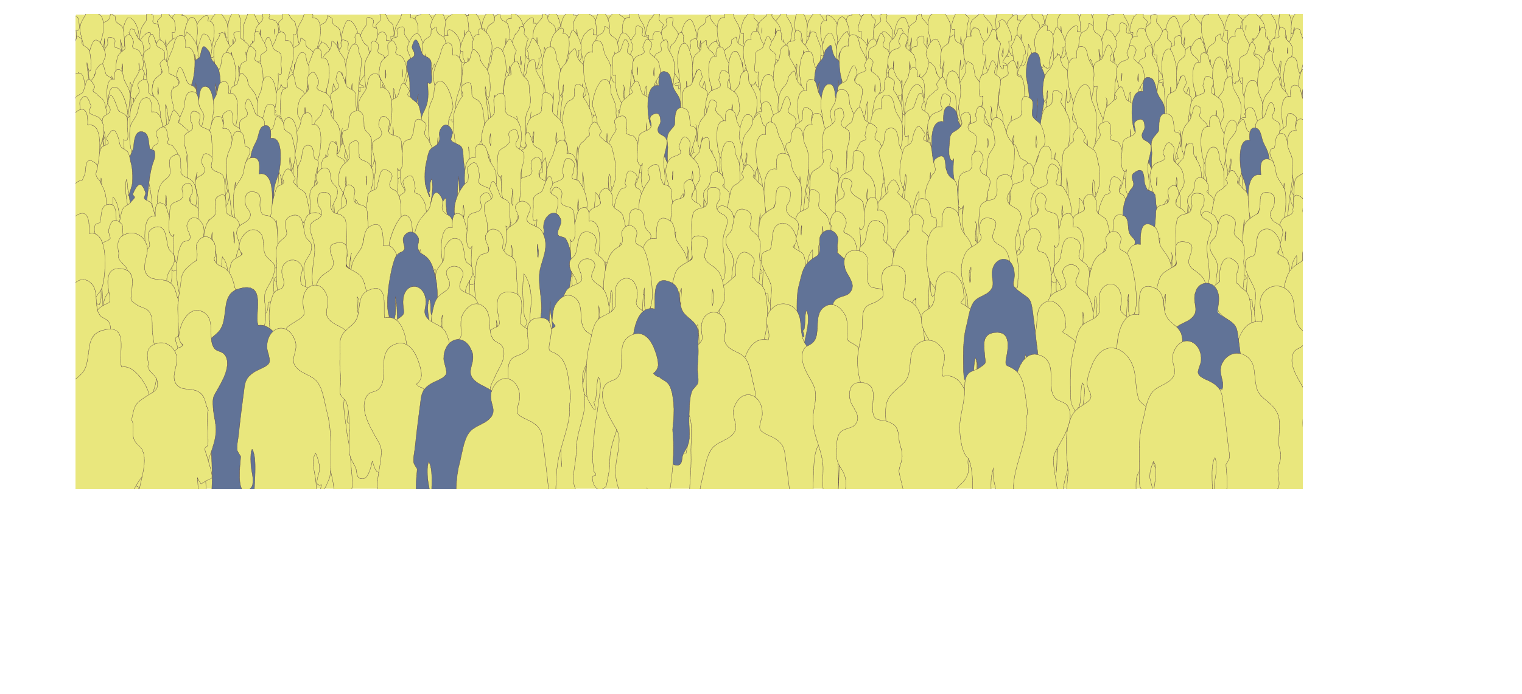


Beauty of data … from observation to evidence-based insight
Starting point: Community & some in poverty today
+ those in poverty 5 years ago
Add in a range of information ..
Age,
Employment,
Household structure
Schooling/Training
Use of community services
Government subsidies
And so on….
Notes:
Let me use this picture to illustrate what we could be building … Imagine a residential community. Now assume that some of the residents are living in poverty. What information might we be able to gather if we utilize the information that is collected on a regular basis? First .. We might be able to observe who was living in poverty a few years ago .. This little bit of information would create four potential groups … those who have not recently faced poverty; those who faced it a few years ago but now are doing better; those who faced poverty a few years ago as well as today … and those who recently have entered a state of poverty.
For each of these groups … what more might you want to know? Maybe age, employment situation, household structure, and on and on … by working together .. Which we are starting to do, we can not only capture a range of information but capture this in a way that we can observe what happens over time … and then we can start exploring how policy and practice shapes these observations.

Slide 6

What the Melbourne Institute is doing
Building shared data environments
Working with government, service providers, communities
Analysis & TRANSLATION
My Recent work has focused on:
Creating data to inform and analyse (Taking the Pulse of the Nation)
Understanding the drivers of poverty / how we prevent poverty
Creating Community indicators

Slide 7
My beliefs (based on analysis)
Cost of living is a real issue for many
Poverty rates are too high
Despite educational/training opportunities, there is more we can do to support our youth
We should find opportunities to prevent poverty
food, utilities, medical needs, housing costs
Community level analyses are critical for addressing these challenges

Slide 8
Cost of Living Pressures
MI-Roy Morgan Taking the Pulse of the Nation

Slide 9
Current Perspectives on Making Ends Meet

Slide 10
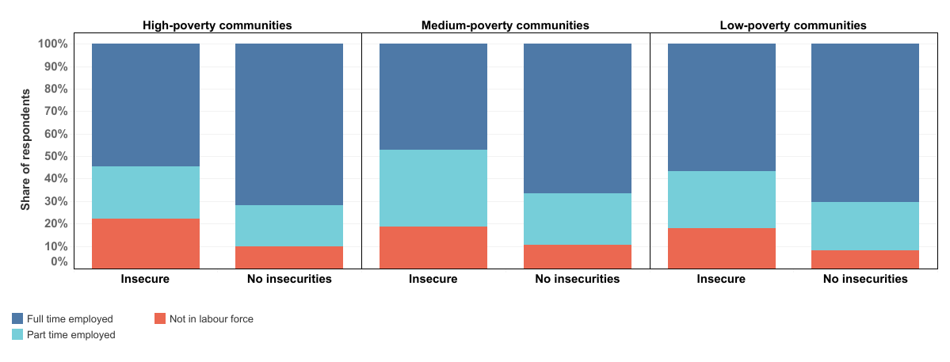
Employment is correlated with identifying basic challenges

Slide 11
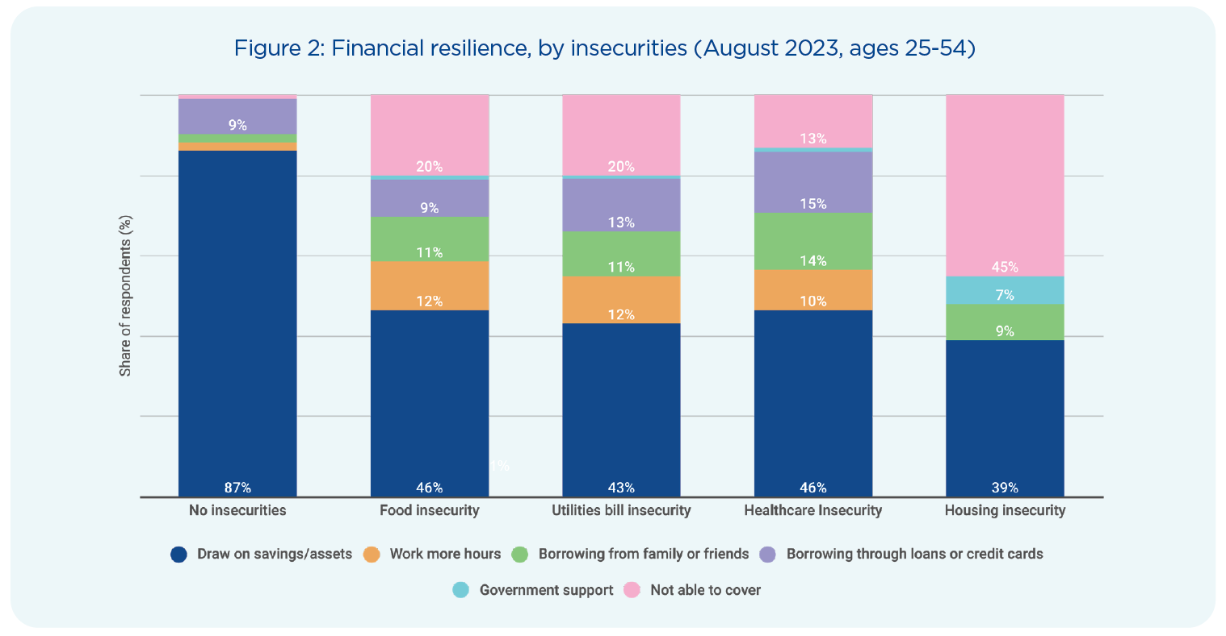
How would you cover an unexpected expense?
Notes:
From RI w/ Ferdi, Ana (Oct 2023)

Slide 12
Turning to Poverty
Breaking Down Barriers Analyses

Slide 13
Poverty Rates in Australia have increased
Notes:
Author Created

Slide 14
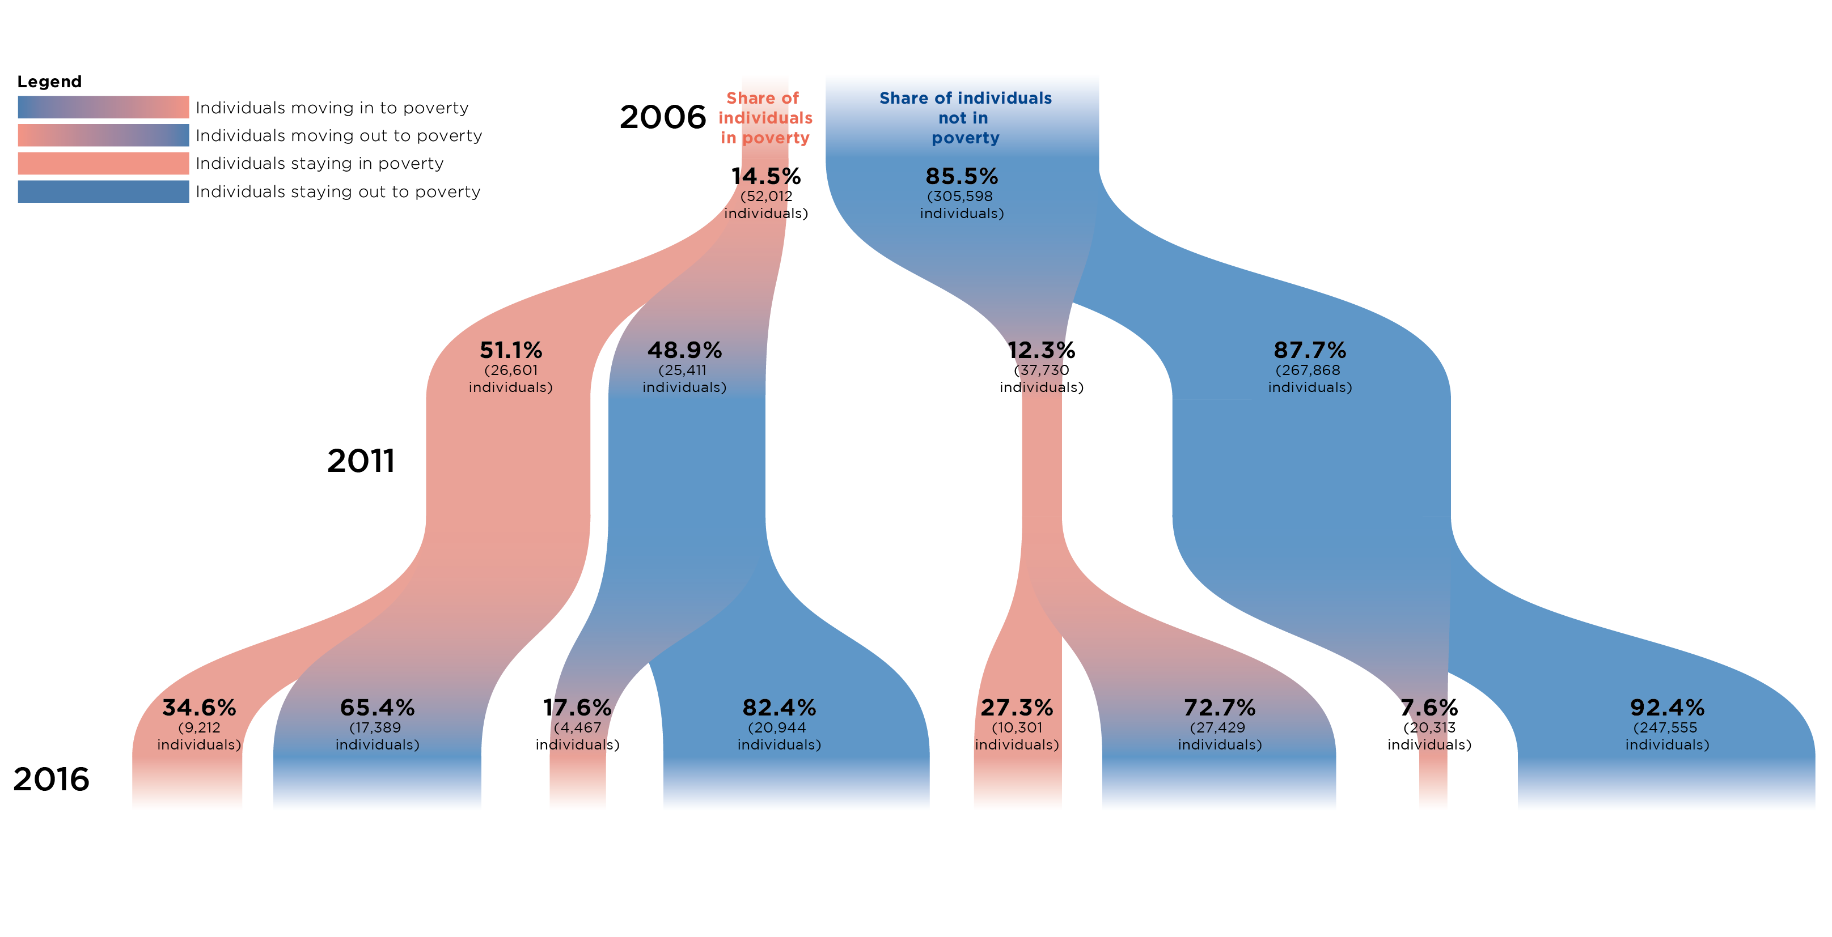
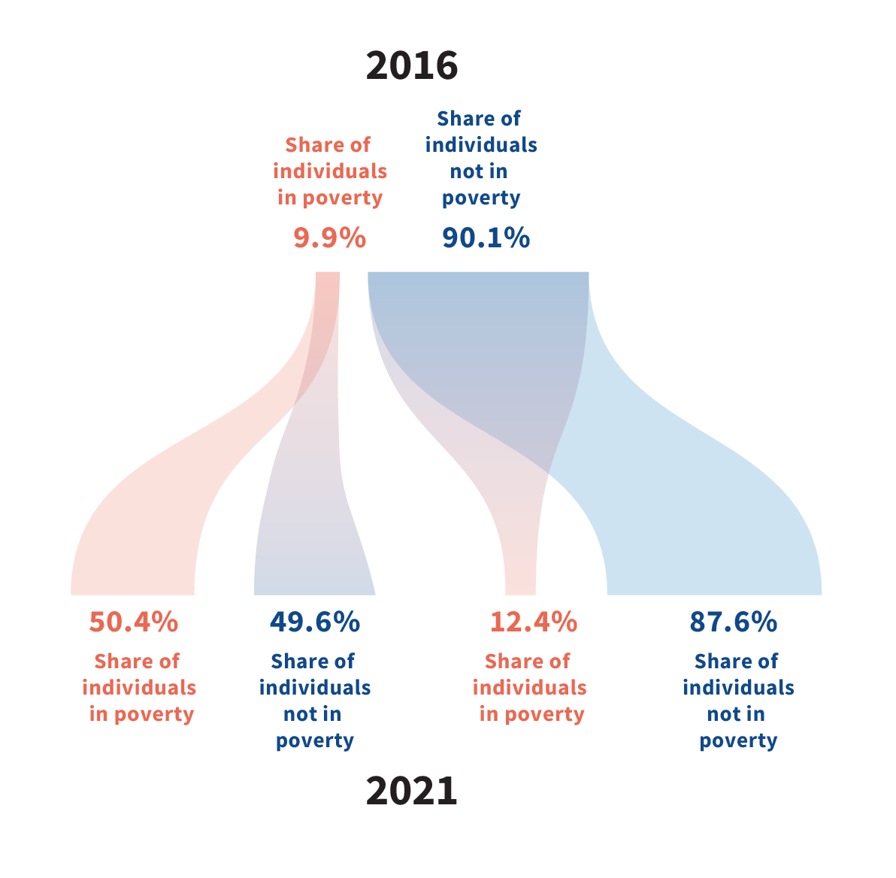
Cycles of Poverty
Notes:
From BDB #3

Slide 15

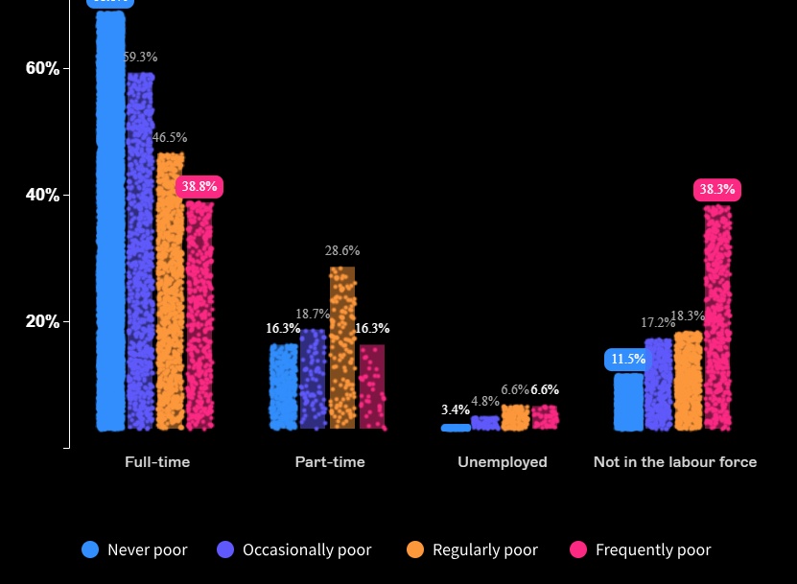
Child Poverty & Outcomes
If you grow up poor, you are more likely to have challenging financial outcomes as a young adult
Children Growing Up Poor
Employment as Young Adults
Notes:
From Visualisation from BDB #1

Slide 16
Not simply about growing up poor, however
81% YR 12+
8% YR 11
87% YR 12+
6% YR 11
Educational attainment remains low
Historically, high proportion of young adults not employed / partially employed
Notes:
One observation we have focused on is simply educational attainment. While in other countries reaching year 12 or beyond is the aspiration, we start with a minimum standard of year 10 (more or less).
The figure on your right depicts educational attainment by age and gender. While we are at a point where the majority of youth reach year 10 – should we be encouraging year 12 or beyond. As these figures demonstrate – 19% of males and 13% of femals today have a year 11 or less education.

Slide 17
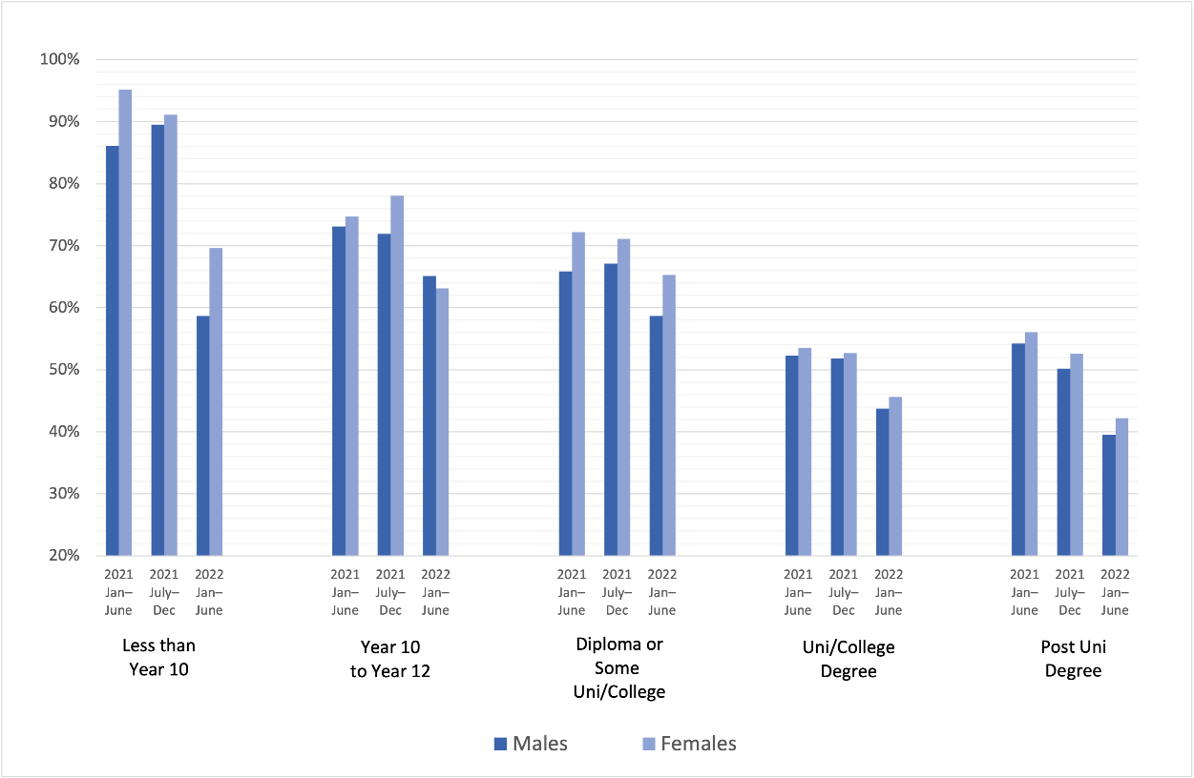
Individuals with less education report higher levels of financial stress

Slide 18
What is happening in your community?
Should we promote one size fits all solutions?

Slide 19
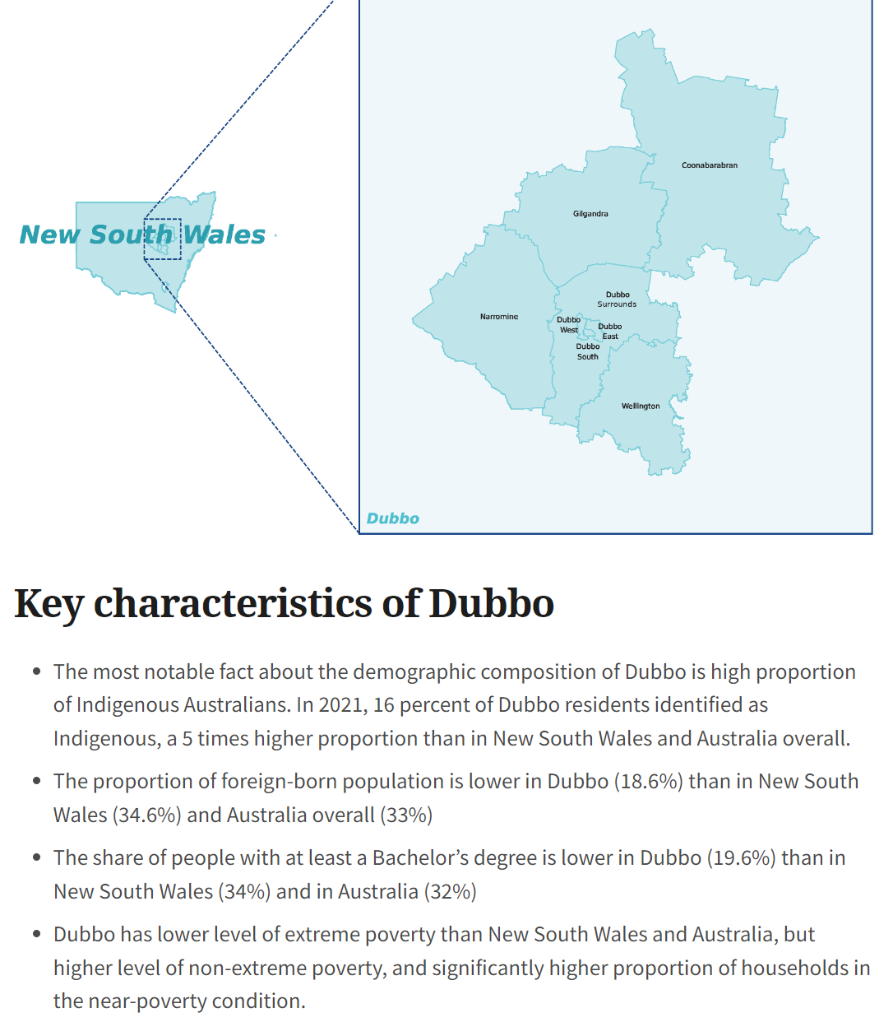
At a community level … Visualisations to inform and provide a starting point

Slide 20
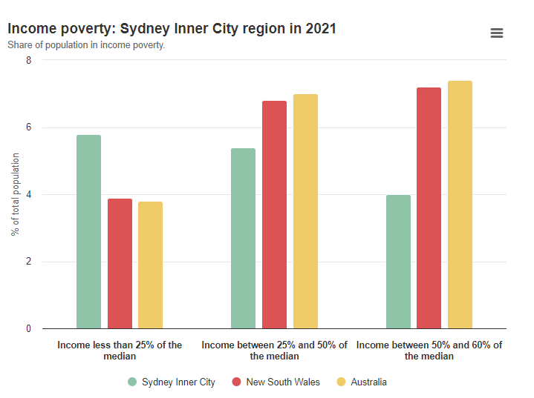
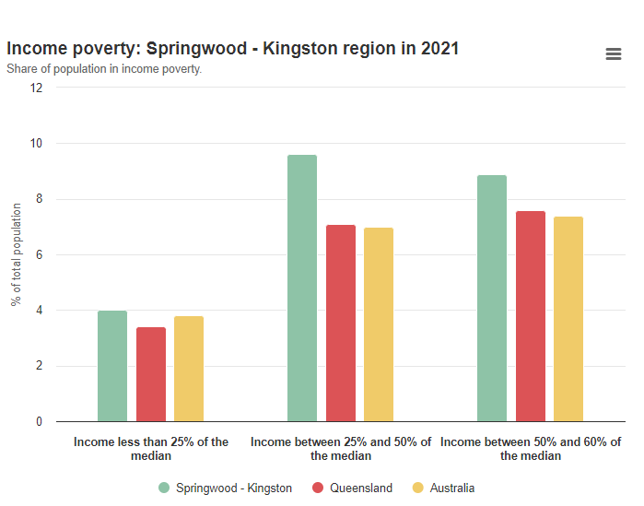
80% of Communities Report Poverty > 12%
Notes:
From Community Profiles

Slide 21
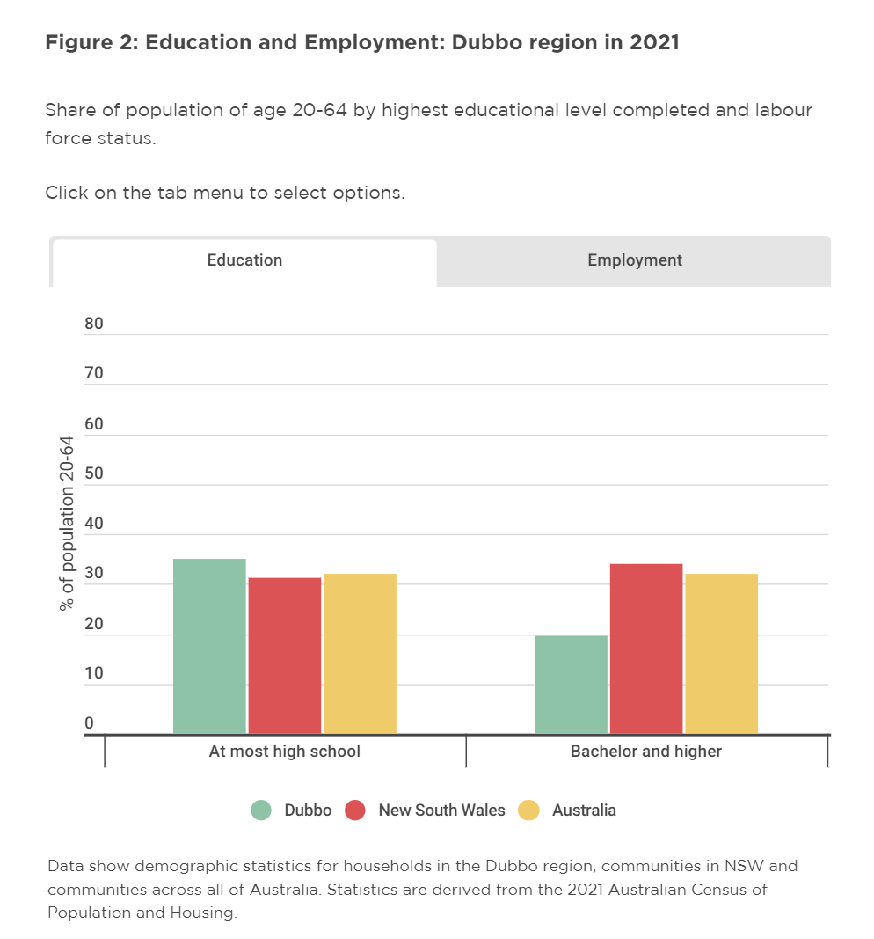
Interactive figures for communities

Slide 22
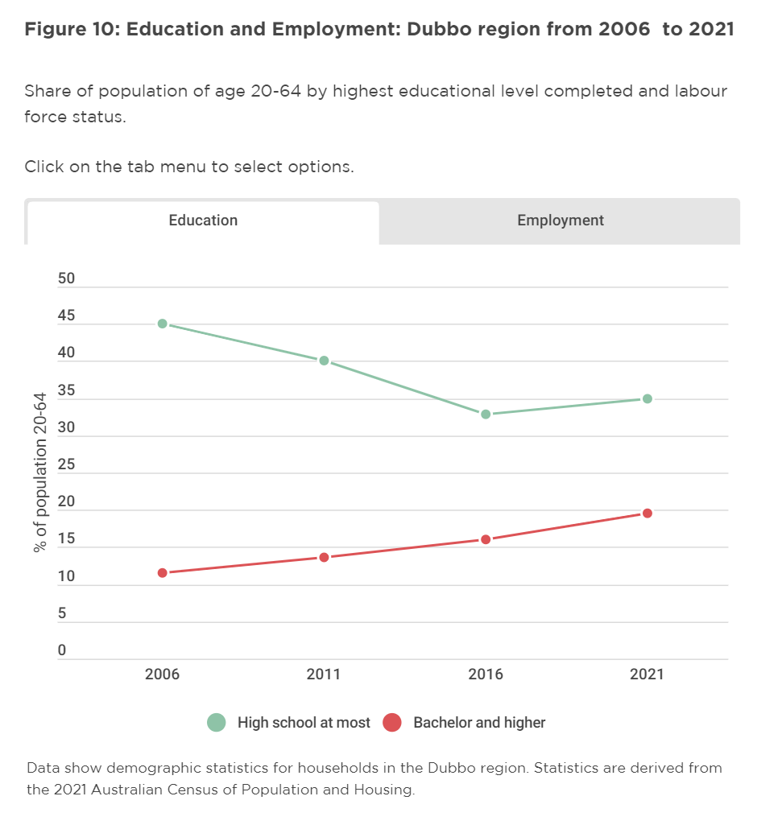
Depicting changes over time

Slide 23
My beliefs (based on analysis)
Cost of living is a real issue for many
Poverty rates are too high
Despite educational/training opportunities, there is more we can do to support our youth
We should find opportunities to prevent poverty
food, utilities, medical needs, housing costs
Community level analyses are critical for addressing these challenges

Slide 24
Thank you

