Slide 1
The Positive Duty in the Sex Discrimination Act: supporting safe, inclusive and respectful workplaces
Presentation to the Parliamentary Library
13 March 2023

Slide 2
Why was the positive duty introduced?

Slide 3
Respect@Work Inquiry
National Inquiry into Sexual Harassment in Australian Workplaces:
Commenced 2018
18-month process
10,000 people surveyed
60 public consultations
460 submissions
Included global research and economic modelling
Additional data from the AHRC’s periodic national surveys into workplace sexual harassment. Most recently in 2018 and 2022.

Slide 4
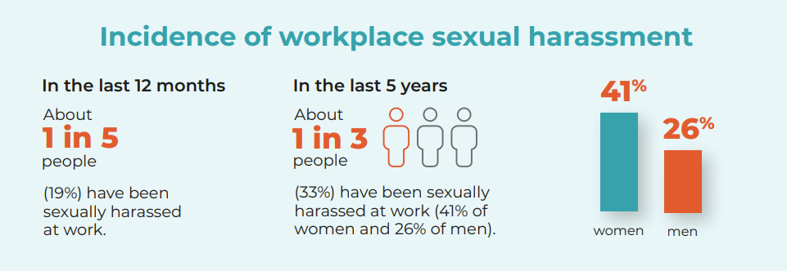
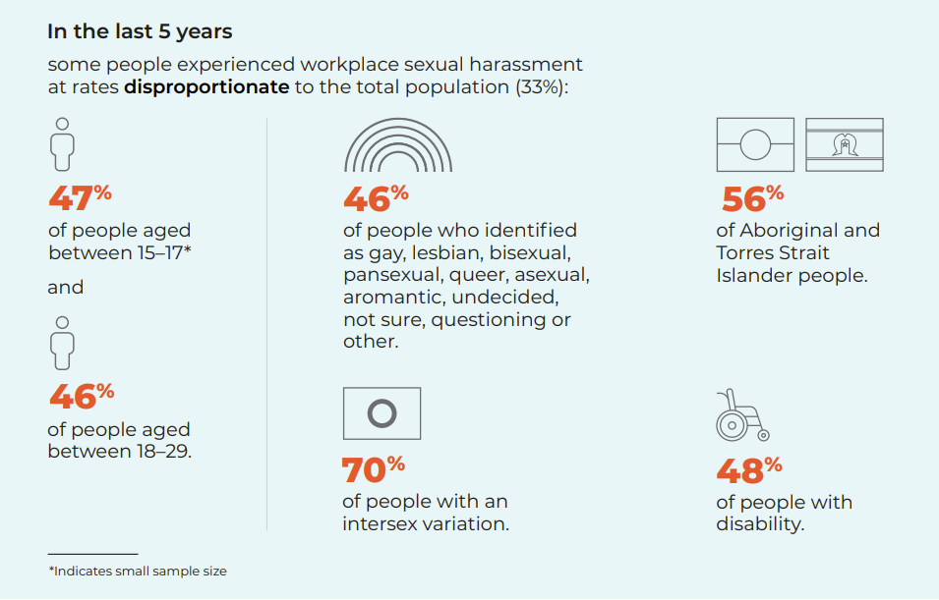
Most workplace sexual harassment occurs across 4 key industry groups.
Almost half of incidents (46%) of sexual harassment in the workplace in the last 5 years were from 4 industry groups:
Retail Trade (14%)
Health Care and Social Assistance (14%)
Education and Training (9%)
Accommodation and Food Services (9%).

Slide 5
Who engages in the sexual harassment of others at work?
Most people who sexually harass their colleagues or while working are men.
Overall, 77% of people who experienced work-related sexual harassment were harassed by a man.
91% of women who told the Commission they experienced work-related sexual harassment in the last 5 years were harassed by men and 9% were harassed by women
55% of men who told the Commission they experienced work-related sexual harassment in the last 5 years were harassed by men and 44% were harassed by women.

Slide 6
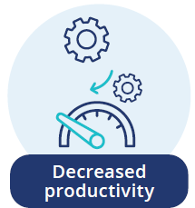
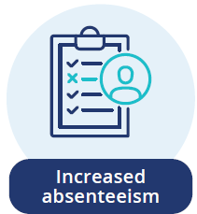
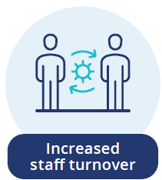
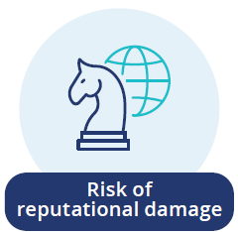
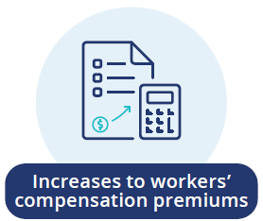
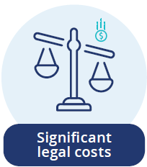
What are the impacts?
Unlawful behaviour covered by the positive duty - including work-related sexual harassment - has a range of negative impacts on organisations and businesses and on workers. They may lead to:

Slide 7
Do people report their experiences?
Only 18% or less than 1 in 5 people make a formal report of their experience of work-related sexual harassment.
When people do report:
40% of those who reported said that no changes occurred at their workplace as a result.
People who reported work-related sexual harassment experienced negative consequences including being ostracized, victimized or ignored by colleagues (13%), resigning (13%) or being labelled a troublemaker (12%)

Slide 8
How is the positive duty different?
“The Sex Discrimination Act no longer requires a person to make a complaint of unlawful behaviour for the organisation or business to be held to account. These changes to the law involve a systemic shift from responding to harm after it happens, to preventing it before it occurs.”
Guidelines for Complying with the Positive Duty under the SDA, p. 5.

Slide 9
Overview of the Positive Duty and AHRC Resources
Gain insights into the positive duty framework and discover valuable resources provided by the AHRC to support organisations in creating inclusive and respectful workplaces.

Slide 10
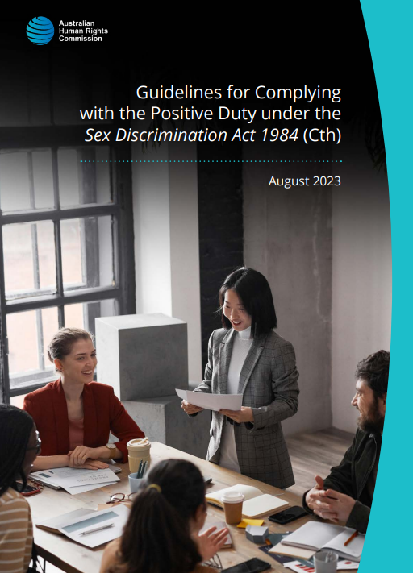
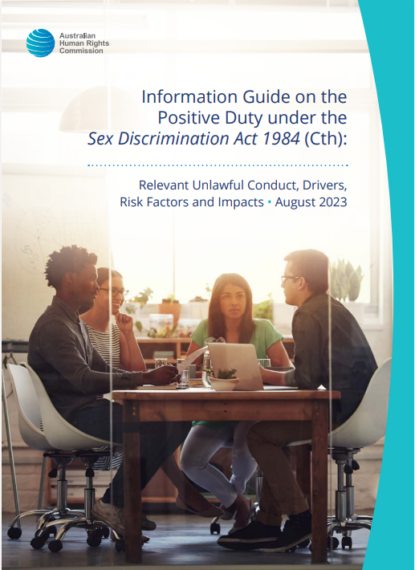
Resources
Guidelines for Complying with the Positive Duty under the Sex Discrimination Act 1984 (Cth):
Helps organisations and businesses understand the positive duty
Provides guidance on how to comply with the positive duty
Includes the 4 Guiding Principles and 7 Standards they are expected to meet
Explains the ‘what’, ‘when’, ‘where’, ‘who’ and ‘how’ of the positive duty.
Information Guide on the Positive Duty under the Sex Discrimination Act 1984 (Cth):
Companion to the Guidelines
Provides additional information to help recognise and understand the unlawful conduct covered by the positive duty
Describes drivers and risk factors for relevant unlawful conduct
Outlines potential impacts on the person experiencing the conduct, others, the workplace, and the wider community.

Slide 11
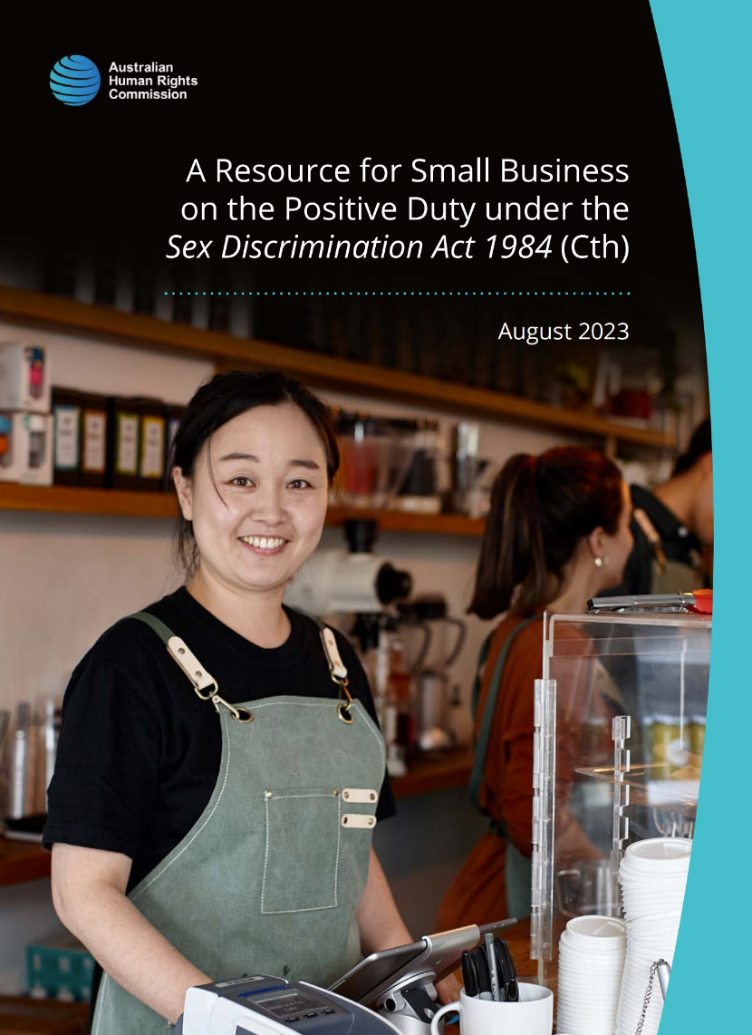
Resources
A Quick Guide for Complying with the Positive Duty under the Sex Discrimination Act 1984 (Cth):
Summary of the Guidelines and the Information Guide
Explains the ‘what’, ‘when’, ‘where’, ‘who’ and ‘how’ of the positive duty.
A Resource for Small Business on the Positive Duty under the Sex Discrimination Act 1984 (Cth):
Promotes understanding in the small business community about the positive duty
Outlines steps small businesses can take to satisfy their obligations
Provides practical case studies.

Slide 12
What is the positive duty in the SDA?
The positive duty requires duty holders to take ‘reasonable and proportionate’ measures to eliminate, as far as possible:
• discrimination on the ground of sex in a work context (‘sex discrimination’) – both direct and indirect discrimination.
• sexual harassment in connection with work
• sex-based harassment in connection with work
• conduct creating a workplace environment that is hostile on the ground of sex
• related acts of victimisation.

Slide 13
Sex-based harassment
Hostile environment
Victimisation
Unwelcome behaviour of a demeaning nature that happens because of a person’s sex in circumstances where a reasonable person would anticipate that the person who is harassed might feel offended, humiliated or intimidated by the behaviour.
A workplace environment is hostile if a person behaves in a way that a reasonable person would expect might be offensive, intimidating or humiliating to someone because of their sex.
Treating or threatening to treat someone badly or unfairly because they report unlawful behaviours; assert their rights under the law; or help someone else to do so.
For example:
• asking intrusive personal questions based on a person’s sex
• making inappropriate comments and jokes based on a person’s sex
• displaying images or materials that are sexist
• verbally abusing or insulting someone because of their sex.
For example:
• behaviour involving gendered stereotypes, such as making women clean the office
• displaying pornographic or sexually explicit posters, photos or images
• sexist, derogatory, suggestive or sexual jokes, banter or nicknames
• sexist, derogatory, suggestive or sexual emails, phone calls or messages.
For example:
• demoting, reducing hours or shifts, excluding or threatening a person because they reported unlawful behaviour
• refusing to purchase from an independent contractor because they reported unlawful behaviour
• intimidating a worker to stop them from reporting unlawful behaviour
• denying someone a promotion because they helped someone else to report unlawful behaviour.

Slide 14
Who must comply?
The positive duty applies to any ‘person conducting a business or undertaking’ (PCBU) or an ‘employer’, as defined in the Sex Discrimination Act (SDA).
These are broad definitions and include sole traders, small, medium and large businesses, as well as the government.
The definition of ‘Commonwealth employee’ in the Sex Discrimination Act includes a person who:
is appointed or engaged under the Public Service Act 1999;
holds a Commonwealth administrative office;
is a member of either House of the Parliament;
is a person employed under the Members of Parliament (Staff) Act 1984; or
is a person who holds a Commonwealth judicial office.
The Sex Discrimination Act deems the Commonwealth to be the employer of ‘Commonwealth employees’.

Slide 15
Who does it cover?
Duty holders must take reasonable and proportionate measures to eliminate, as far as possible, relevant unlawful conduct from being engaged in:
• by themselves
• by their employees, workers and agents
• in some cases, by third parties, such as customers, clients and members of the public, towards their employees and workers.

Slide 16
Satisfying the positive duty
Compliance will look different for different organisations and businesses. In determining compliance, the SDA requires the Commission and the courts to consider:
the size, nature and circumstances of the duty holder’s business or undertaking
the duty holder’s resources, financial or otherwise
the practicability and the cost of the measures to eliminate the conduct
any other relevant matter.
The Commission’s series of resources, including Guidelines, aim to help businesses to understand their obligations and provide examples of practical actions.
The Guidelines set out four Guiding Principles and seven Standards. Together, these provide guidance on how to satisfy the positive duty.

Slide 17
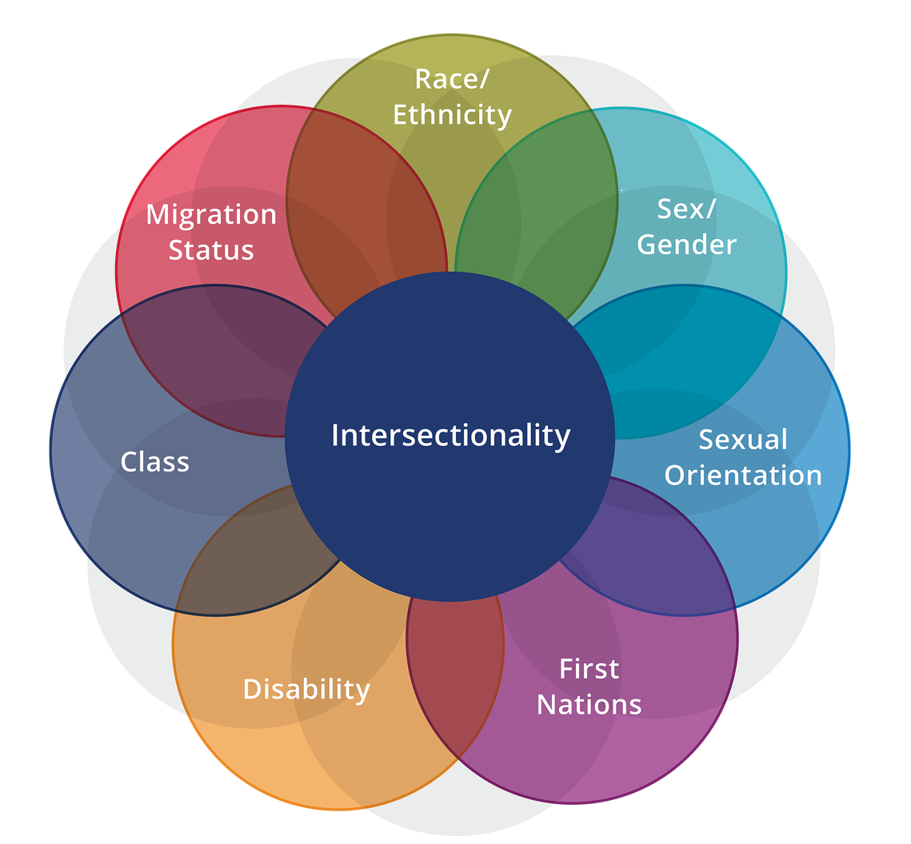
The Guiding Principles
Consultation
Actions taken are informed by those affected by relevant unlawful conduct.
Gender equality
Actions taken should ensure that people of all genders have equal rights, rewards, opportunities and resources.
Intersectionality
Recognising that different aspects of a person’s identity intersect with and impact one another. A person’s experience of unlawful conduct can be compounded by other forms of inequality.
Person-centred & trauma-informed
Ensuring that workplace systems, policies and practices support safety and dignity, and avoid causing further harm.

Slide 18
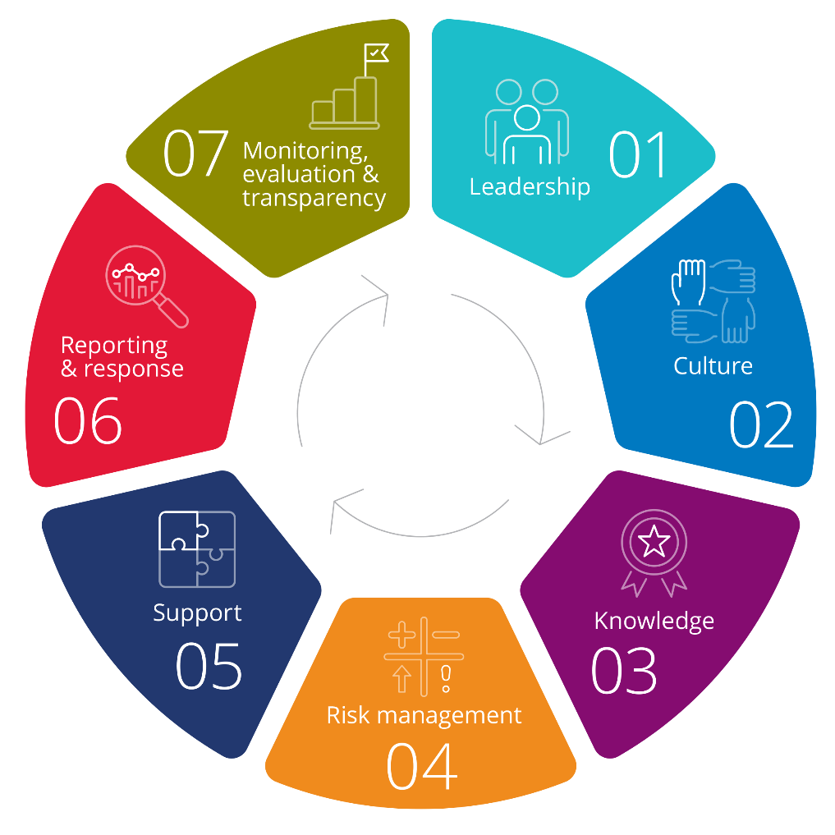
The Standards
The Seven Standards are based on the Prevention and Response Framework in the Respect@Work report.
The Commission expects all duty holders to meet these Standards, while recognising that the way in which they do so is likely to differ.

Slide 20
1: Leadership
Senior leadership is crucial in creating safe, respectful workplaces.
Outcome | Examples of actions to meet
Senior leaders understand their obligations under the Sex Discrimination Act and have up-to-date knowledge about relevant unlawful conduct. | Senior leaders read the Guidelines Senior leaders attend quality education sessions on the applicable laws and their rights and responsibilities. Senior leaders arrange for the organisation to subscribe to relevant updates from regulators and peak bodies on developments in laws relating to relevant unlawful conduct and for this information to be distributed to senior leaders.
Senior leaders are visible in their commitment to safe, respectful and inclusive workplaces that value diversity and gender equality. They set clear expectations and role model respectful behaviour. | Senior leaders take an active interest in learning from, and supporting, relevant committees and groups. This may include diversity and inclusion committees or existing WHS committees.

Slide 21
“The Commission expects organisations and businesses to take a holistic approach to creating safe and respectful workplaces and not feel restricted to the examples contained in these Guidelines.
Creative, innovative and bold strategies to achieve substantive equality and foster positive workplace cultures are strongly encouraged.”
Guidelines (page 12)

Slide 22
The AHRC’s Approach to Compliance and Enforcement
To understand the Commission’s approach to regulating the Positive Duty.

Slide 23
Enforcement – Our Functions
The Commission has compliance and enforcement functions:
to inquire into the positive duty
to ensure compliance with the positive duty
The Commission also has statutory functions:
to promote understanding and acceptance, and public discussion, of the positive duty and
to undertake educational programs and research into the positive duty.

Slide 24
Enforcement – Our Powers
With respect to the positive duty, the
Commission now has the power to:
inquire into compliance,
make findings of non-compliance,
issue compliance notices that can be enforced by courts, and
enter into enforceable undertakings (EU’s) with organisations and businesses.

Slide 25
How to Provide Information
The Commission has a webpage titled Positive Duty online form and resources.
This webpage also links to the Commission’s
Compliance and Enforcement Policy
Online Positive Duty Form
where people can provide information about any concerns with an organisation or business complying with the positive duty.
The webpage also provides information about what the Commission
will do with your information and
will not do with your information.

Slide 26
What we will and will not do with reported information
When someone provides information we will:
analyse it
use it to shape our inquiries into duty holders
use it to decide where to focus our resources to bring about meaningful cultural change
use it in line with our privacy obligations.
We will not
act on a person’s behalf to resolve individual disputes
reply to the informant, unless we need further information, and only if they agree.

Slide 27
Compliance Approach
The Commission has discretion about how it exercises its compliance and enforcement functions.
Strategic use of resources, to provide the greatest benefit for the community and impact for meaningful cultural change.
A leading objective is to improve practices through voluntary compliance measures.
Compliance and enforcement powers can be utilised if efforts to achieve voluntary compliance are not successful.

Slide 28
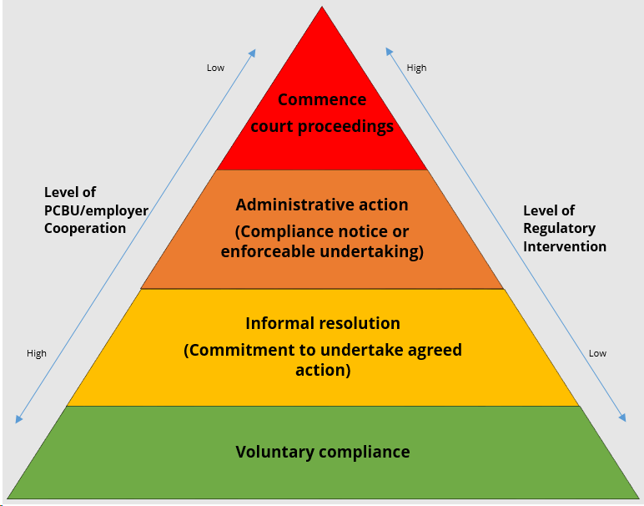
Compliance Approach

Slide 29
Considerations for Engagement
The Commission will consider such things as:
does it align with our strategy and priorities
is it within the Commission’s jurisdiction?
is it in the public interest?
what is the Commission’s resource capability?
will it impact on other government agencies and regulators?
what is the nature and seriousness of the non-compliance?
does it involve vulnerable workers within the community?
what is the compliance posture and history of the organisation or business?
what is the likelihood of activities having a broad impact on meaningful cultural or systemic change?

Slide 30
Voluntary Engagement and Compliance
Preferred regulatory approach is to
work collaboratively to achieve
voluntary compliance
If non-compliance is identified, the
Commission may offer to work with
organisations or businesses on a
voluntary basis (where appropriate).
Co-operative engagement with the Commission will be considered when deciding whether to take enforcement action and, which enforcement action to take.

Slide 31
Commencing Inquiries
The Australian Human Rights
Commission Act 1986 (Cth) gives
the Commission a discretion about
what and how it chooses to conduct
its inquiries.
The Commission can commence an inquiry when it ‘reasonably suspects’ that an organisation or business is not complying with its positive duty obligations.

Slide 32
During an Inquiry
You will receive a written notice setting out the grounds on which the inquiry was commenced.
Before any formal finding of non-compliance, you will be given a reasonable opportunity to make oral and/or written submissions in relation to your compliance.
The Commission may continue to engage with you voluntarily or we may engage utilising our coercive powers.

Slide 33
Power to compel information and documents
The Commission has powers to compel the production of information and documents
And to examine witnesses and
can require a person to attend a
particular place, on a specific date
and time, to answer questions
relevant to a positive duty inquiry.
12 months imprisonment to knowingly:
give false or misleading information, or
produce a document containing false or misleading information

Slide 34
Findings of non-compliance
The Commission:
will notify you, in writing, and
provide reasons for its decision
may provide recommendations
for preventing the repetition or
continuation of the non-compliance
may issue a compliance notice.

Slide 35
Compliance Notice – What is it?
A written notice issued under section 35F of the Australian Human Rights Commission Act 1986 (Cth).
May be issued if you are found to be non-compliant with the positive duty.
The notice will set out details of the failure and specify action/s that you must take or must refrain from taking, to address the failure.

Slide 36
Compliance Notice – Reconsideration & Review
A person to whom a compliance notice is issued, may, in writing:
request that the Commission reconsider the compliance notice
the request must received within 21 days of the notice being given.
The person can also apply to the Federal Courts to seek review of the Notice on the ground that:
there has not been a failure to comply, and/or
the compliance notice itself does not meet certain necessary requirements

Slide 37
Compliance Notices – Failure to Comply
The Commission can apply to the
Court to seek orders to enforce the
compliance notice.
If the Court is satisfied that the
compliance notice has not been
complied with, the Court can make:
an order directing you to comply with the compliance notice
any other order the Court considers appropriate.

Slide 38
Enforceable Undertakings - What are they?
An Enforceable Undertaking (EU) is a legally binding written agreement between an entity or person and a regulator, which is enforceable in court.
The following kind of EU’s can be given:
to take certain action
to refrain from taking certain action or
to take certain action to ensure that you do not or, are unlikely to contravene the positive duty in the future.

Slide 39
Enforceable Undertakings - Considerations
The Commission is not compelled to accept an EU and may consider:
reflects meaningful commitments
will assist with organisational reform
will assist in communicating consequences of non-compliance and opportunities and benefits of compliance
the cooperativeness, history and compliance posture
is it the most appropriate outcome in the circumstances
the benefits of acceptance – to the workplace, the industry and the community

Slide 40
Enforceable Undertakings - Breach
The Commission may apply to the Court for an
order directing you to comply.
The Court can make the following orders:
direct you to comply with the undertaking
direct you to pay an amount to the Commonwealth
direct you to compensate any other person who has suffered loss or damage as a result of the failure to comply with the undertaking
any other order that the court considers appropriate

Slide 41
Thankyou
Questions?

