Slide 1
Opportunities and challenges for Australia in emerging neuro-technologies in health Professor Susan Dodds, FAHA

Slide 2
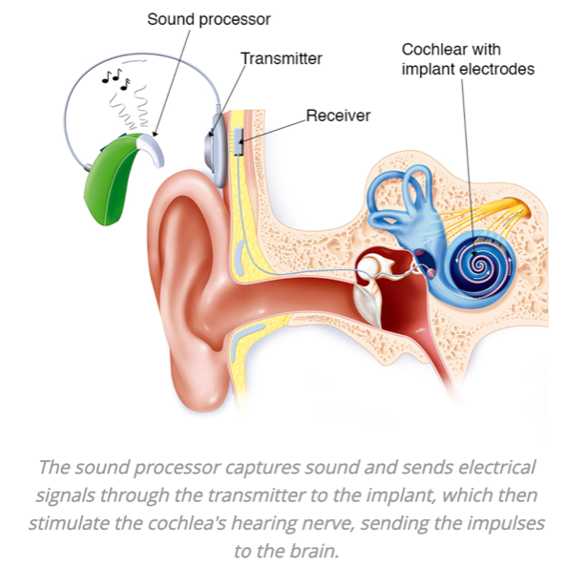
Overview
Cochlear implant
IntroDuction
Current Neurotechnologies in Health
Australian Advances
Challenges and Concerns
Testing, TGA approval, Regulation
Product Liability
Autonomy, Agency and Responsibility
Data Privacy, quality and control
Pathways forward
https://www.healthdirect.gov.au/cochlear-implant

Slide 3
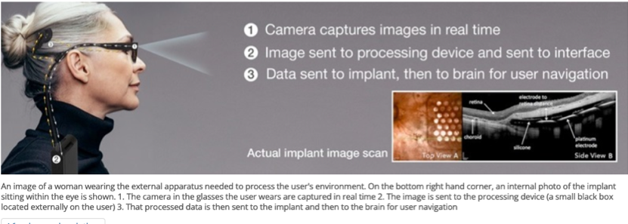
What Are Neuro-Technologies?
Methods and Devices for monitoring or modulate Neural (Brain/ Nervous system) Activity
Wearable – Externally worn
Devices that measure neural and physiological Signals externally – EEG Caps, eye-Tracking Devices 🦘
Devices that send Signals to External Devices via MUSCLE movement or EEG signals –Myoelectric Prostheses/ Brain controlled wheelchairs
Implantable – Direct targeted electrical stimulation to specific nerves/ areas of the brain or Direct monitoring oF brain Activity Via IMPLANT
Cochlear implant 🦘
Deep Brain Stimulation for Parkinsons 🦘
Bionic Eye 🦘
Epilepsy Detection and Prediction Device 🦘
https://www.csiro.au/en/research/technology-space/ai/vision-processing-for-the-bionic-eye

Slide 4
Potential Developments
Devices for monitoring and surveillance of behaviour
Devices to track mental phenomena - neural surveillance
Neural implants to control responses to stimuli - e.g. impulse control
Devices to deliver targeted drugs or stimulus for conditions such as epilepsy
External neurotechnologies that use externally grown brain organoids to study and test development and therapies
Use of eye-tracking and differentiated responses for marketing and mis and disinformation --identifying people wo are susceptible to messages
https://www.lawsociety.org.uk/topics/research/how-will-brain-monitoring-technology-influence-the-practice-of-law

Slide 5
Issues and Concerns
Australia has the opportunity to Bring Research, Regulation and public Deliberation together Alongside CLINICAL Neurotech Advances – to establish Principles and Guardrails
Testing, approval, Regulation
New surgical techniques, new materials
Personalised medicine
Removal
Product Liability
Implants and Neural plasticity
Hardware/ software updates
Interactions with other devices/tech
Autonomy and Agency
Changes in Personality
Agency, Autonomy, Responsibility
Data Privacy, quality and control
Accidental misuse
Ownership of neural data
Getting Hacked –Manipulation

Slide 6
Sources/ Further reading
Australian Institute of International Affairs 2023. Australia’s Potential Role in Global ‘Neurorights’ Conversations. https://www.internationalaffairs.org.au/australianoutlook/australias-potential-role-in-global-neurorights-conversations/ 17/8/2023
Frédéric Gilbert and Susan Dodds, 2020. Is there anything wrong with using invasive and predictive brain devices to prevent convicted offenders from reoffending? In: Nicole Vincent, ed. Neuro-Interventions and The Law: Regulating Human Mental Capacity. Oxford University Press
K. Harrington, 2023 Why Neurotechnology should matter to policymakers The Mandarin 16 Jan 2023 https://www.themandarin.com.au/209594-why-neurotechnology-should-matter-to-policymakers/ -- originally 14 Jan 2023 in Apolitical https://apolitical.co/solution-articles/en/what-is-neurotechnology-and-why-should-it-matter-to-policymakers
A.MacKay 2022. How Brain-Monitoring Tech Advances Could Change the Law. https://neurosciencenews.com/crime-brain-monitoring-21220/
A.MacKay 2022 Neurotechnology, law and the legal profession – Horizon Report for the Law Society (UK) Available at www.lawsociety.law.uk
University of Melbourne https://research.unimelb.edu.au/industry/case-studies/monitoring-epileptic-seizures-with-an-implantable-device
G Willmer 2022 Helping the body and brain to welcome bionic limbs and implants. https://ec.europa.eu/research-and-innovation/en/horizon-magazine/helping-body-and-brain-welcome-bionic-limbs-and-implants
www.lawsociety.law.uk

