Slide 1
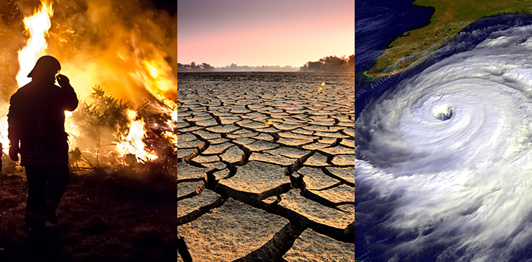
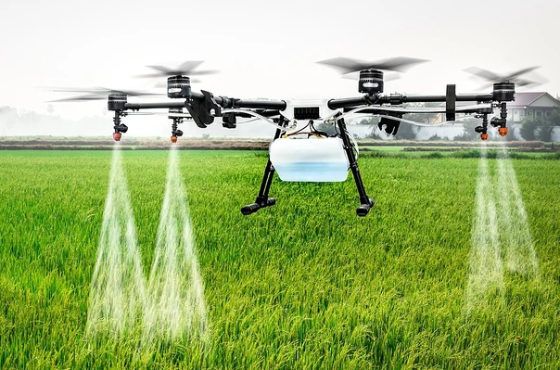
Agriculture, soil and climate change
Brajesh Singh
Western Sydney University
Email: b.singh@westernsydney.edu.ai
NASA

Slide 2
Topics of discussion
Contributions of agriculture to climate change
Impacts of climate change on agriculture productivity and profitability
Climate as a key driver of soil microbiome and consequences for ecosystem services including primary productivity
Potential and emerging solutions
NASA

Slide 3
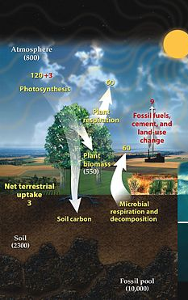
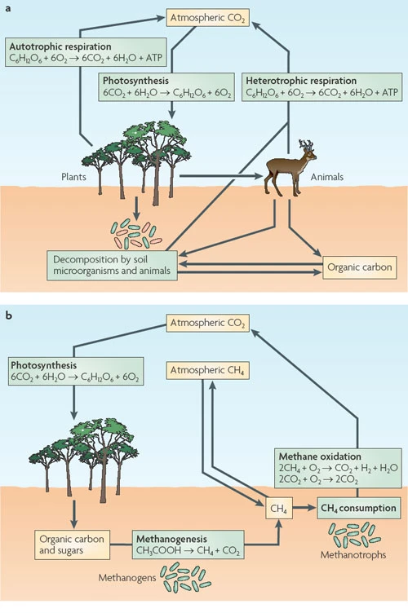
Soil microbiomes are main producers and consumers of greenhouse gas
Soil store more C than plant and atmosphere combined
Soil microbiomes control SOC storage.
~50% loss of SOC due to agriculture
Increasing temperature/ extreme events increase SOC loss
A 22-32% SOC loss under 1.5 to 5ºC in Australian natural environ (Lee et al 2021)
Adapted from NASA Earth observatory

Slide 4
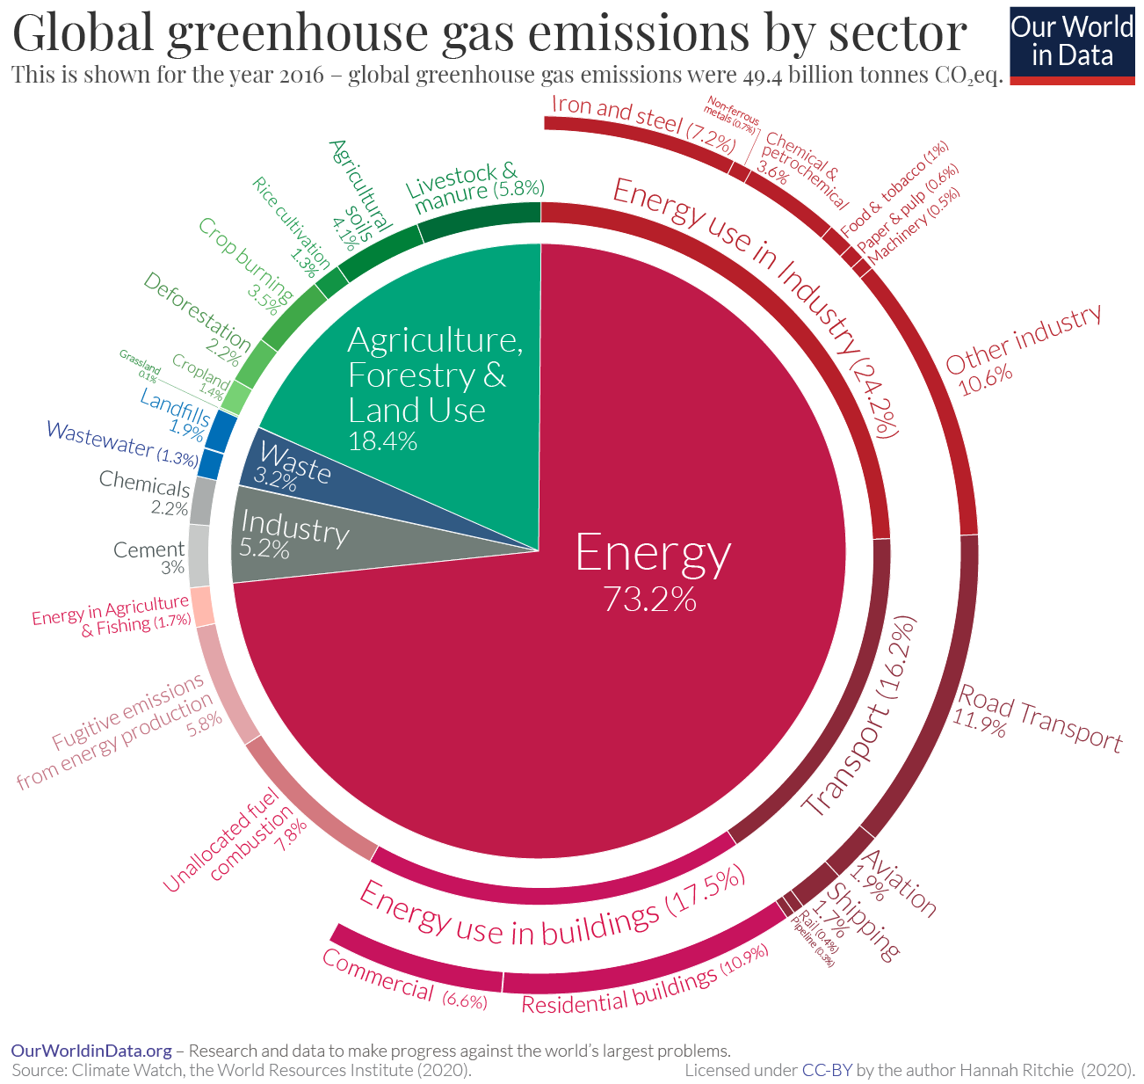
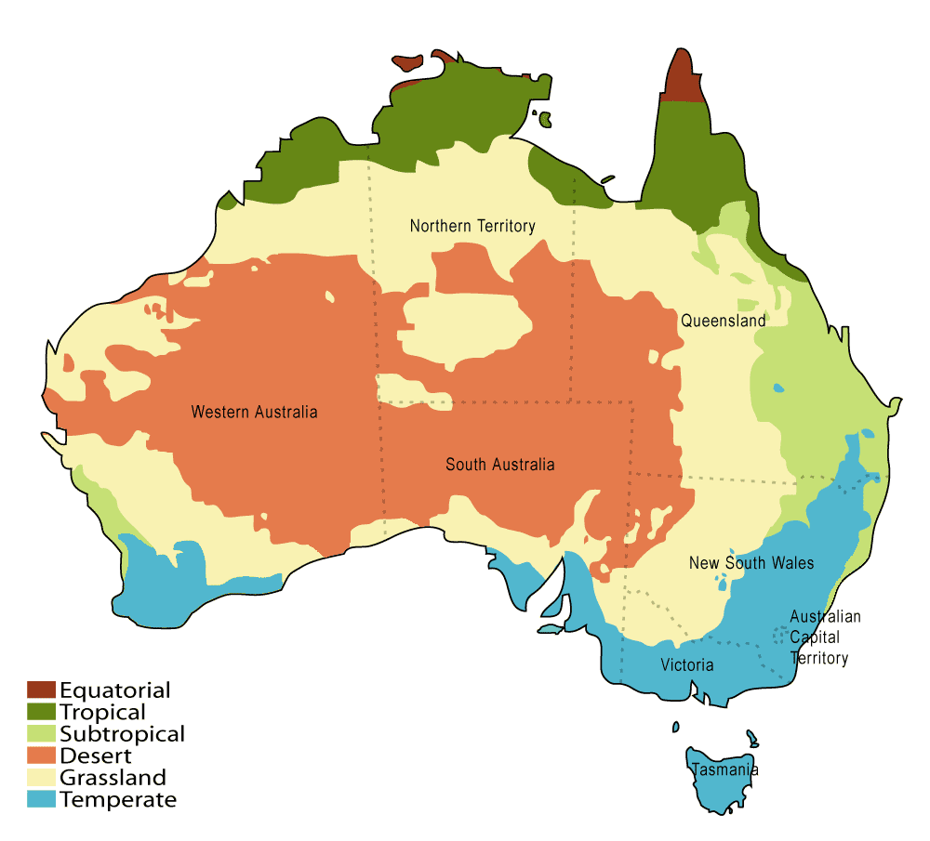
Agriculture contributions to greenhouse gas emission.
Global
Australia
13% of total emission
Fourth highest
42% methane- mainly livestock
Source: Climate Watch
Source: Climate Council

Slide 5
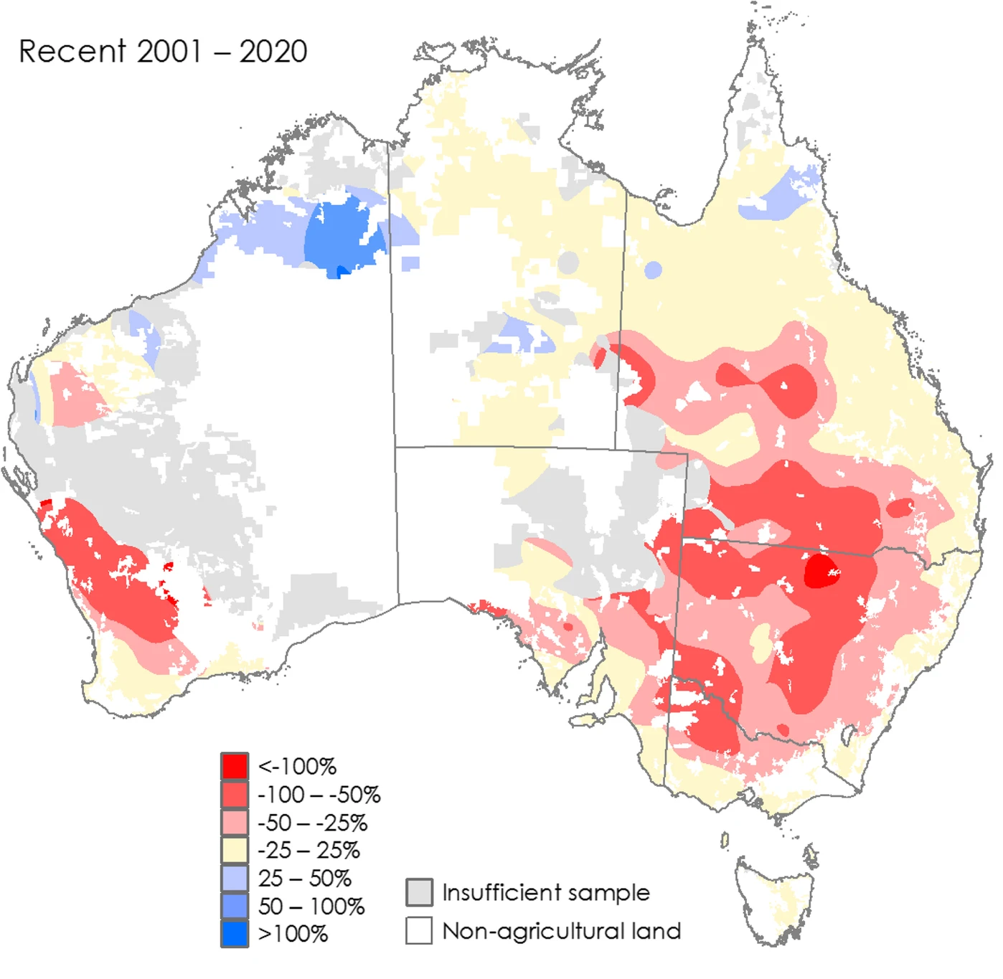
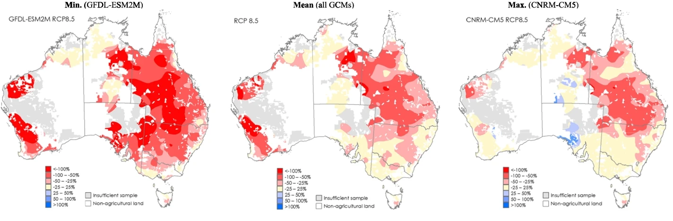
Climate change impacts of farm profitability in Australian farms
Change in rainfall patterns
Increasing temperature/ heat wave
Pest and pathogen pressures
Soil degradation/ erosion
Thermal tolerance limits of crops/ animals/ microbes
~-22.6%
Profitability decline by -22%
Future scenarios.
a. ~500 ppm- -13%
b. ~600 ppm – 25.5%
3. Adaptation strategies is needed to mitigate impacts
Mean: -25.6%
RCP 8.5 scenario: CO2 conc reach to ~600 ppm by 2050, +2ºC)
Huge et al (2022), Climate Change

Slide 6
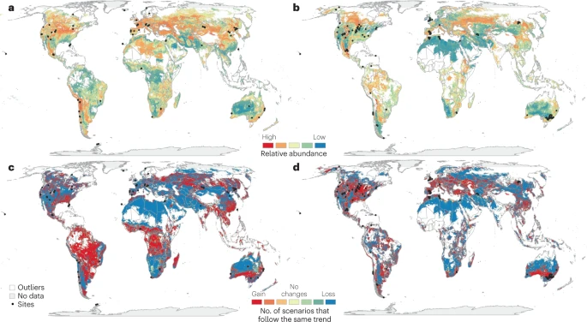
Abundance of many economically important crop pathogen will significantly increase

Slide 7
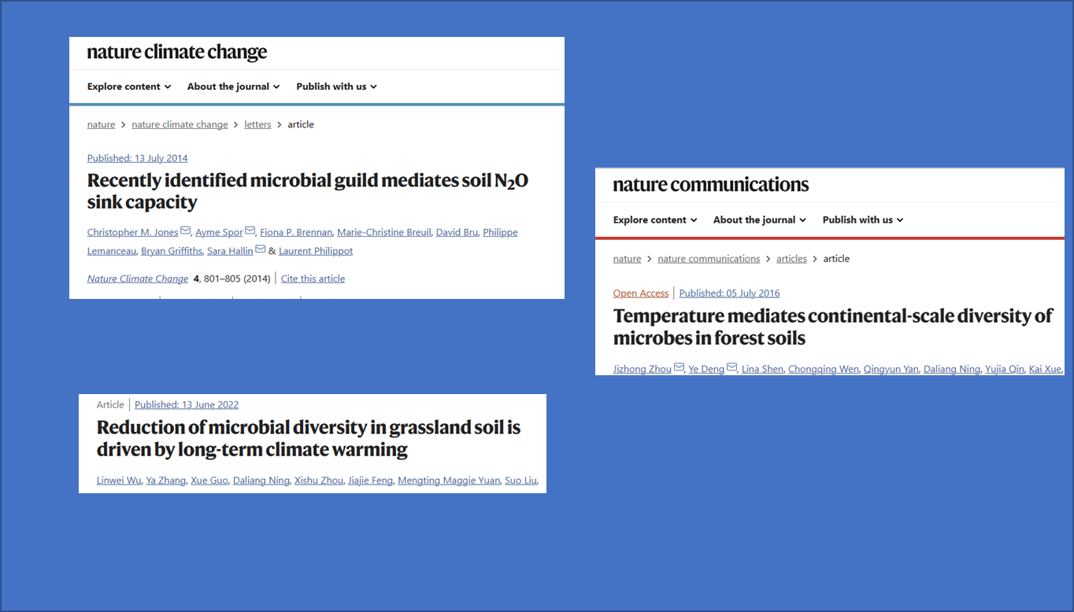
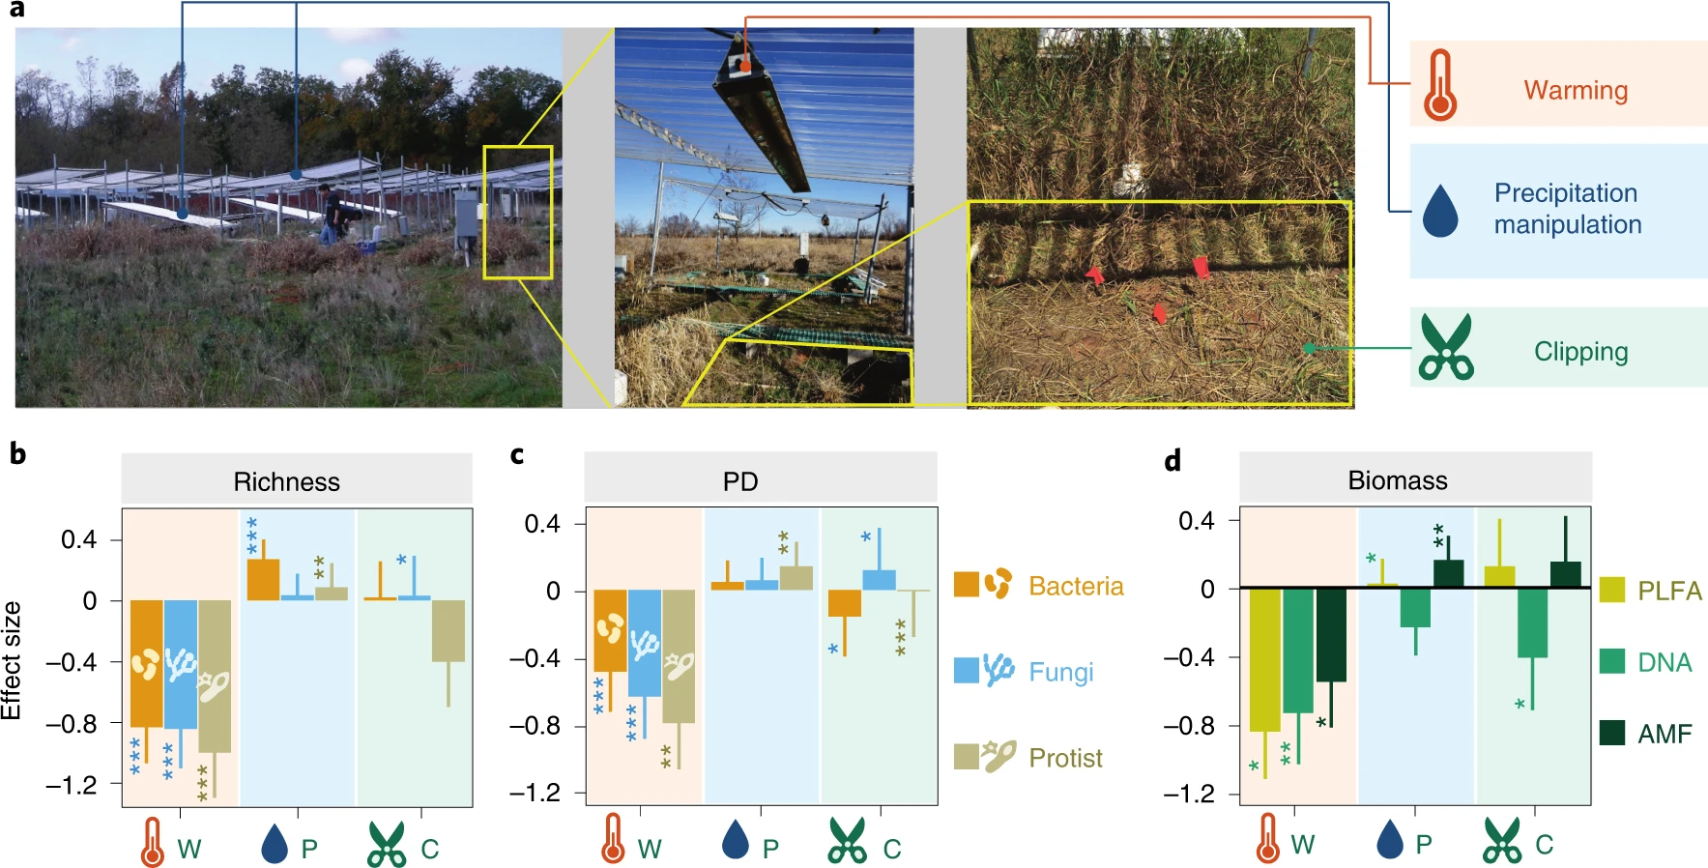
Microbes are earliest responder to environmental changes

Slide 8
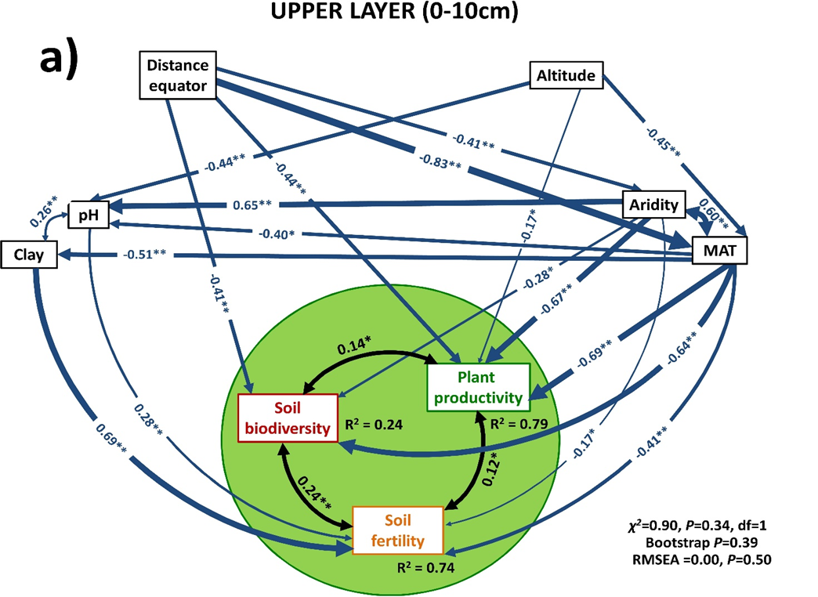
Loss of soil biodiversity reduces primary productivity, nutrient cycling, carbon storage, water storage
Global Scale
New Phytologist
Australian Scale
Delgado _Baquerizo et al., 2020
Delgado _Baquerizo et al., 2017

Slide 9
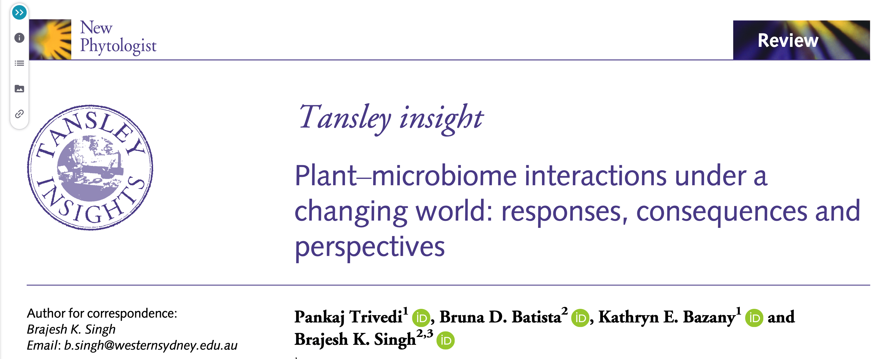
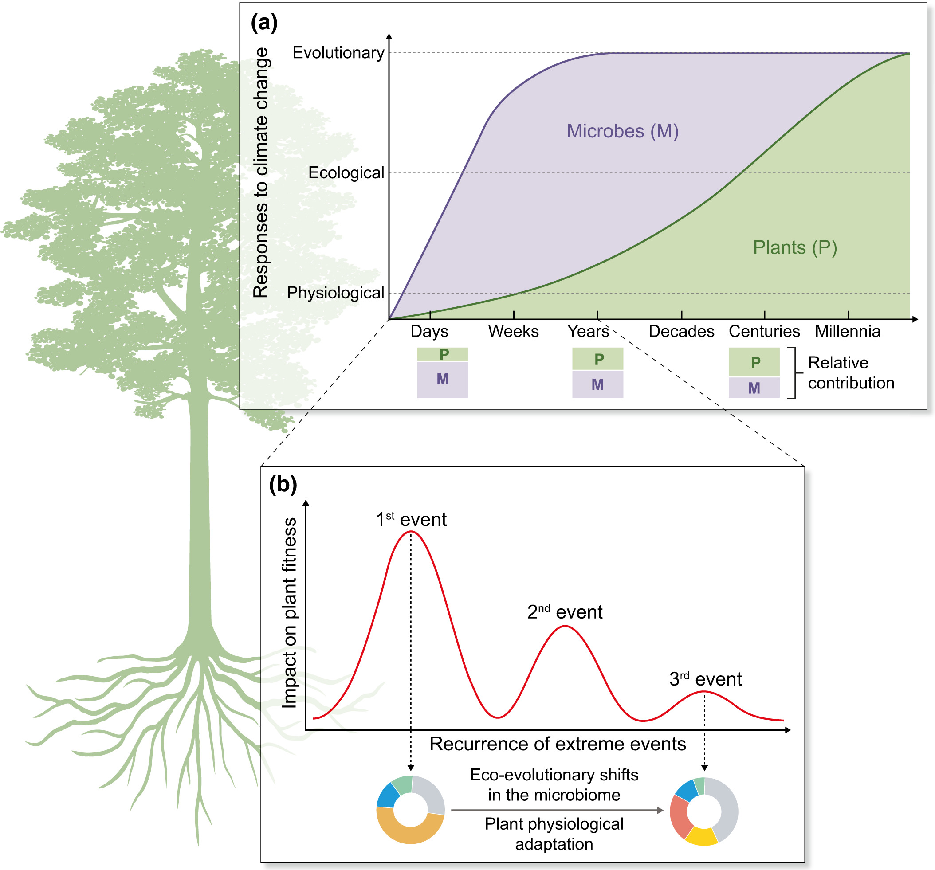
Plant adaptation to climate change
Short term adaptation driven by the plant microbiome,
Long-term adaptation driven equally by eco-evolutionary interactions between the plant microbiome and its host

Slide 10
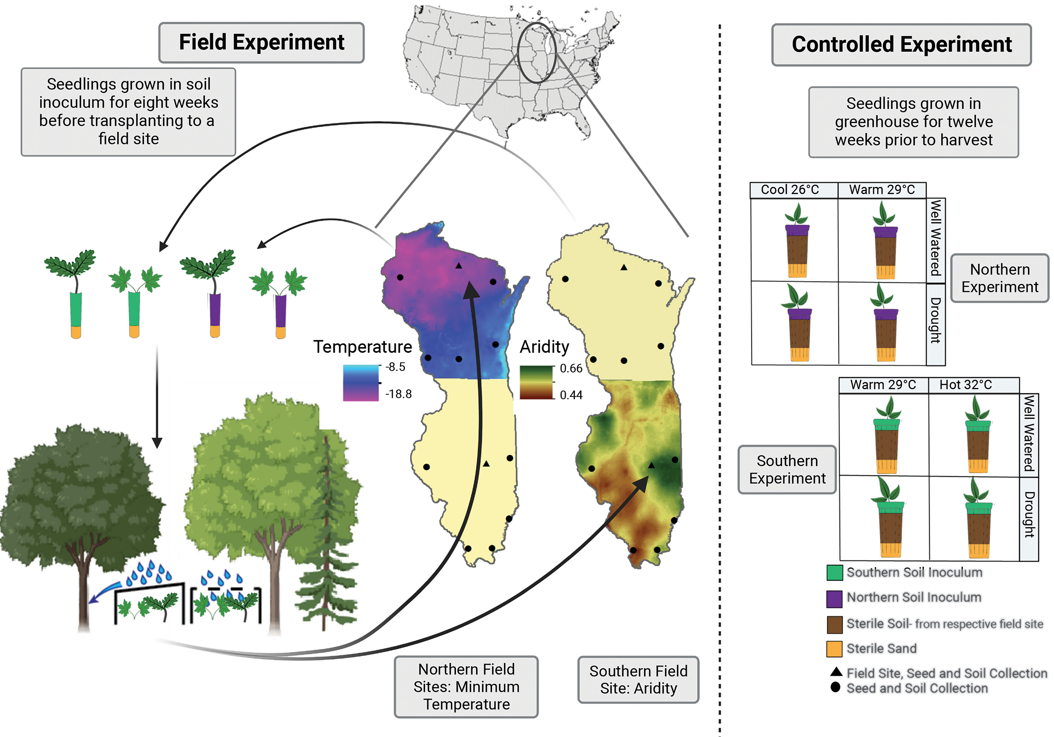
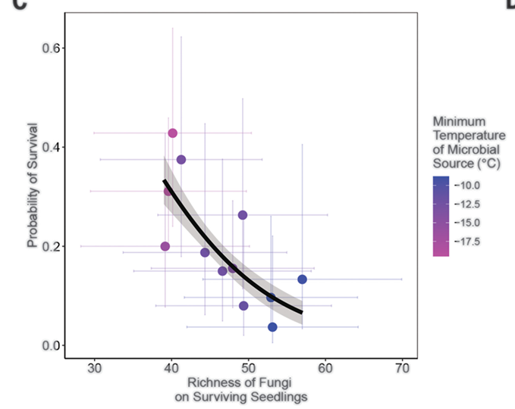
Microbial community adapted to extreme environment can help plants/ crops to cope with heat-wave, prolonged drought and other climate extremes

Slide 11
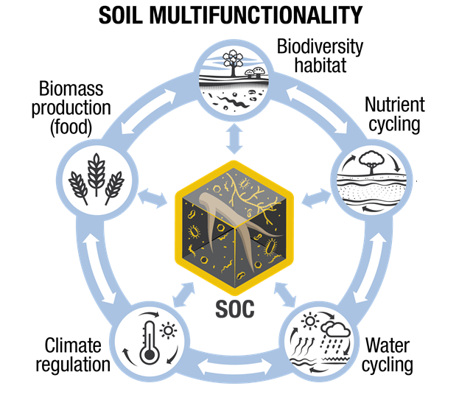
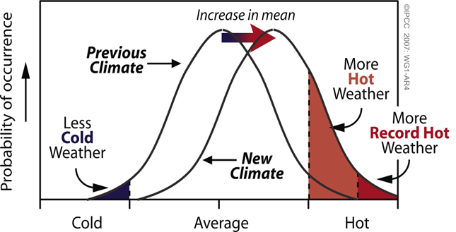
Two key potential components for future
Along with reducing emission and mitigating effects, adaptations tools are needed
Maintain soil organic carbon
Prepare agriculture for a hotter future
Soil microbes can contribute significantly to both
Thank you
Need to develop strategies so that Australia’s food production systems are sustainable in a hotter world
Slide: Prof Alex McBratney, University of Sydney
Slide: Prof Owen Atkin, Australian National University
Notes:
Soil underpin and link all of these existential challenges because soil is “multifunctional” – soil provides at least five functions that underpin the six existential challenges
These five functions are all critical.
Despite this multifunctionality, humans have focused almost exclusively on a single function – food production. The result of this narrow focus is that the other functions, such as climate regulation, have been severely degraded, with this greatly worsening the existential challenges now facing humanity. For example, anthropogenic use of soil to produce our food has contributed 15% of all greenhouse gas emissions globally.
Our challenge, therefore, is to broaden the way in which society views and values soil and to strengthen soil multifunctionality in order to contribute to human and planetary health.

