Slide 1
The Monetary Policy - Fiscal Policy nexus
Dr Jenny Gordon
Parliamentary Library pre-Budget Seminar
3 May 2023

Slide 2
Overview
Macroeconomic stability is at risk when monetary and fiscal policy conflict
Fiscal policy is using spending and taxes to influence demand and supply in the economy
Monetary policy is using interest rates, and other financial tools, to influence demand and supply
Both are constrained
Fiscal policy is constrained by history - the current settings and their beneficiaries who resist change, and by fiscal headroom (the amount that governments can expand spending relative to revenue without upsetting the markets).
Monetary policy is constrained by the country’s openness and external position (current account balance) and hence by US monetary policy
Government debt matters as it affects both fiscal headroom and the ability to operate an independent monetary policy.
Central banks must pay attention to the big macro risks - climate change, geoeconomics fragmentation and inequality - that also shape fiscal priorities and capabilities

Slide 3
Monetary and fiscal policy are not independent
From printing money to pay for budget deficits, to having to raise rates to attract foreign capital, to taking the cost to the budget into account in setting policy
Monetary dominance is when the central bank is able to set interest rates (to control inflation) independent of the fiscal situation.
Think the major push for central bank independence to counter hyperinflation, and to support open capital markets and flexible exchange rates
Fiscal dominance is when the central bank’s independence to set interest rates (to control inflation) is restricted by the level of external public debt and the cost to the budget of meeting the higher cost of budget financing.
Think Global Financial Crisis, 2013 taper tantrum, UK central bank quick reversal of QA with the Truss government pension fund crisis
Financial dominance is when the central bank has to respond to financial instability in any systemic section of the financial market by lowering interest rates beyond their desired policy setting.

Slide 4
Fiscal policy headroom is affected more by monetary policy decisions when debt is high and BoP vulnerable
Interest
rates
Exchange rate
Debt service
costs
Fiscal headroom
Government
Revenue
Government
Expenditure
Commodity prices
Economic
growth
Global growth

Slide 5
A structural budget deficit restricts fiscal headroom reducing scope to use fiscal stimulus
Entitlement programs are taking up an increasing share of revenue:
Growth in demand with an ageing population (health aged care, pensions)
Increasing expectations of quality services (childcare, aged care, health)
Gender equity in wages as women are the main source of labour in managed markets (aged care, childcare)
Increasing income and wealth inequality growing the share of the population qualifying for means tested benefits and/or increasing the level of need for those who qualify
Some argue that fiscal dominance meant interest rates were too low for too long post GFC

Slide 6
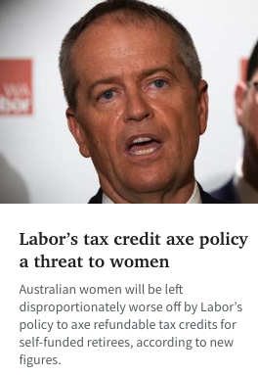
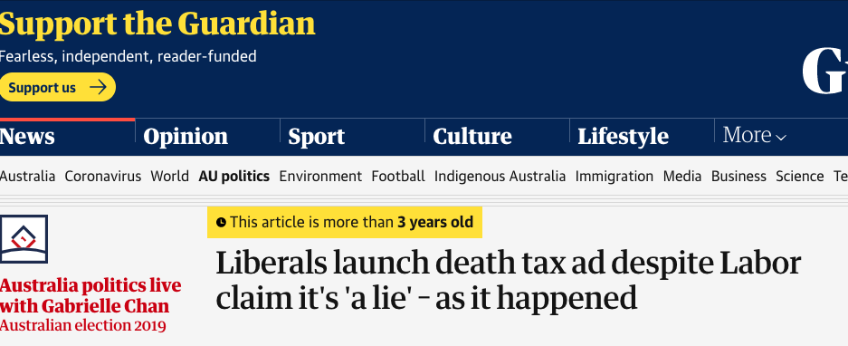
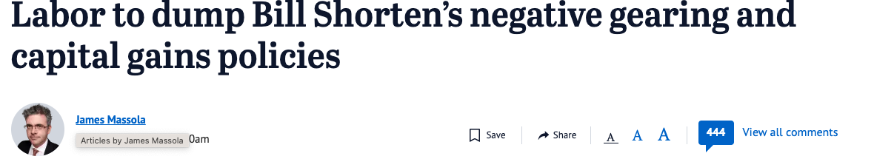
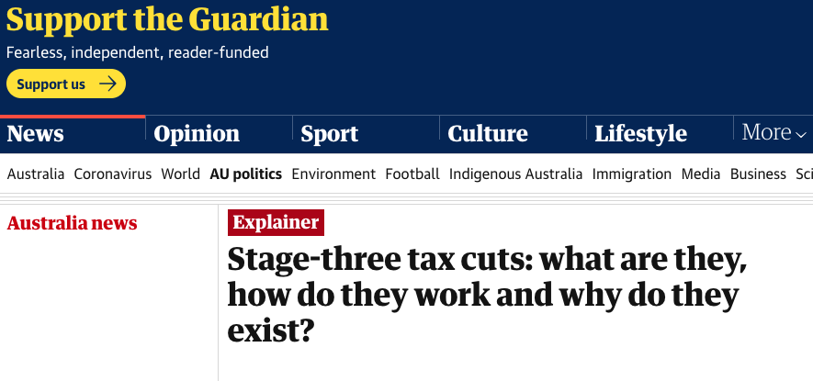
Resistance to tax reform restricts fiscal headroom on the revenue side limits taxes as a fiscal tool
Tax reform is hard
Vested interests will resist reform
Media often misrepresents/does not understand what the changes will mean - a person who loses is a good story, though rarely representative
Politics dominates good policy
Reducing spending faces the same problems

Slide 7
External factors can reduce fiscal headroom as slower global growth outlooks reduces commodity prices
Revenue impacts:
Lower commodity prices lowers mining company tax receipts
Lower GDP lowers company and personal tax receipts
Lower consumption lowers GST receipts
Expenditure impacts:
Higher unemployment and underemployment raises welfare payments (automatic stabiliser)
Weaker AUD (as a commodity currency) raises cost of debt service where denominated in USD
https://www.statista.com/chart/18787/imf-growth-projections-for-the-global-economy/ "Infographic: IMF Corrects Global Growth Forecast Down by a Sliver | Statista"><img src="https://cdn.statcdn.com/Infographic/images/normal/18787.jpeg" alt="Infographic: IMF Corrects Global Growth Forecast Down by a Sliver | Statista"

Slide 8
Monetary policy decision making can be independent - but how interest rates work to reduce inflation is anything but
Interest
rates
Exchange rate
Debt service
costs
Monetary policy
(RBA)
Inflation
Unemployment
Commodity prices: TOT
Economic
growth
Global growth

Slide 9
Monetary policy has long and uncertain lags
MP tools - no such thing as one
instrument one target
QE mainly targeted at stabilising capital
markets by limiting downside risk for investors
Easy money was seen in asset price inflation,
which boosted household wealth (unevenly)
Ultra low interest rates made borrowing cheap
But too much went into asset prices via
buy-backs and not enough into investment
in productive capacity
Fiscal stimulus, plus low mortgage costs,
boosted household savings
COVID supply disruptions, exacerbated by
Russia’s war on Ukraine
Pent up demand meets supply constraints
equals inflation
CBs biggest concern is that this triggers a
wage-price spiral
Only tool is the cash rate - which sets off
increases in mortgage rates, design to reduce
household demand, but also reduces
investment
https://substackcdn.com/image/fetch/f_auto,q_auto:good,fl_progressive:steep/https%3A%2F%2Fsubstack-post-media.s3.amazonaws.com%2Fpublic%2Fimages%2F681036b9-632e-476e-b726-815ba9db0994_1402x1010.png?utm_source=substack&utm_medium=email

Slide 10
Is the cash rate too blunt a tool to bring down inflation without collateral damage?
The Phillips curve is the empirical relationship between wage growth and unemployment (Phillips 1958) CBs use to guide rate decisions
demand shocks use rates to reduce demand to counter the effect of the demand shock on prices
supply shocks have to trade off impact of rates on inflation and on unemployment
To the extent that CBs get the rate response right, the observed Phillips curve relationship is more linear.
Has the relationship between wages growth and prices growth fundamentally changed?
Falling union membership - but in part due to the rise in services share
But labour costs are a higher share in most services
Inflation expectations have been anchored for some time but the risk is to the upside
Both fiscal policy and monetary policy choices constrained by the interrelationship - mutual dominance
https://www.statista.com/chart/29844/map-ranking-workers-rights/

Slide 11
Australia’s open economy means that monetary policy independence is limited by the Fed
Open capital markets put limits on monetary policy independence unless you are the US
Capital flows to where risk adjusted rates are highest so rate choices have effects on the country’s access to capital
Keep interest rates too low and the exchange rate depreciates adding to inflation by higher costs of imports (and profit margins for import competing goods)
The Fed interest rate tool is blunt, but it too is constrained
Most mortgages are fixed rate for 30 years and insured so dampening of household demand is muted, affecting new borrowers
But investment is very sensitive in strange ways as existing Treasury bonds become worth less - end up with financial dominance (SVB collapse)
Announcement credibility is crucial - inflationary expectations are key to reducing inflation
But the transmission mechanisms between prices and wages are weaker than in the 1970s
https://www.statista.com/chart/29055/fomc-projections-for-the-federal-funds-rate/

Slide 12
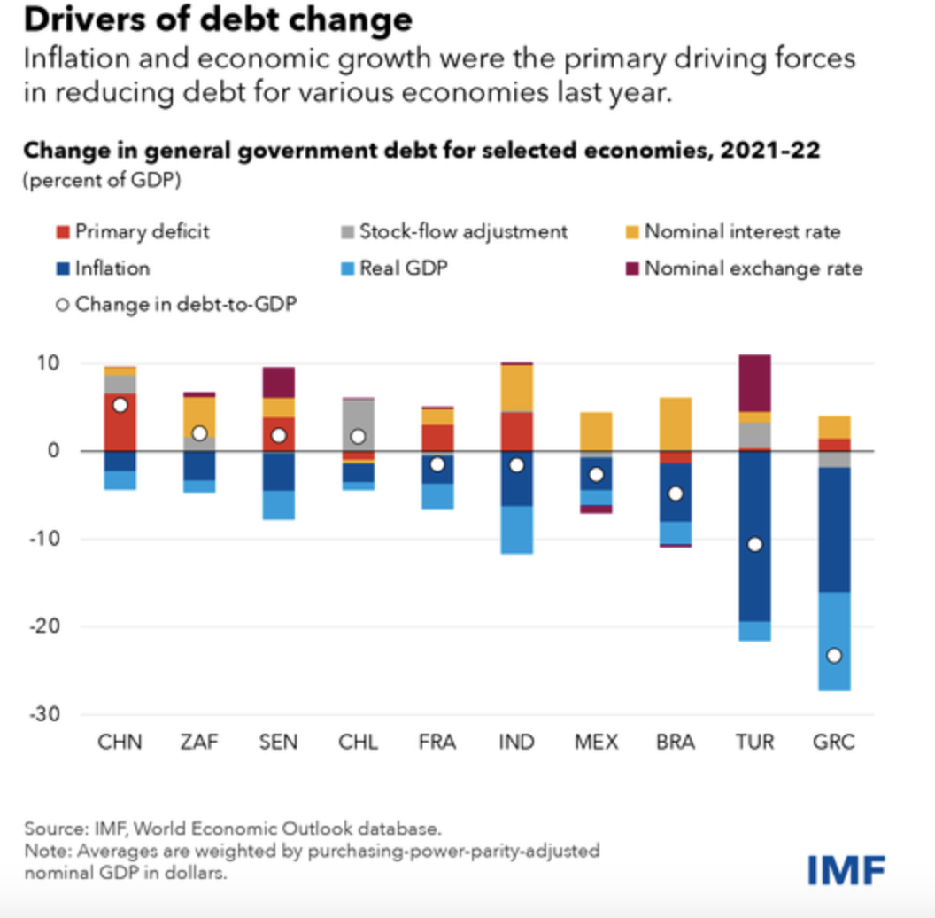
Debt is yet to constrain Australia’s monetary policy, but rising interest rates make debt more expensive to service
The budget cost of interest rate rises depends
on the term structure of debt
Interest differential on the share of debt to be refinanced
annually
Volume of new debt to new issued and term structure
of interest rates
Term structure of interest rates depends on inflation expectations
- usually slope upwards - longer term debt has a higher rate due to
greater uncertainty, but high inflation periods it slopes down if
confidence in the central bank’s ability to reduce inflation holds.
Tough on any government with debt, but much harder in developing
countries that have less well managed term structures, and face
bigger refinancing costs.
IMF Fiscal Monitor, April 2023, https://www.imf.org/en/Publications/FM/Issues/2023/04/03/fiscal-monitor-april-2023?cid=bl-com-spring2023flagships-FMOEA2023001&utm_medium=email&utm_source=govdelivery

Slide 13
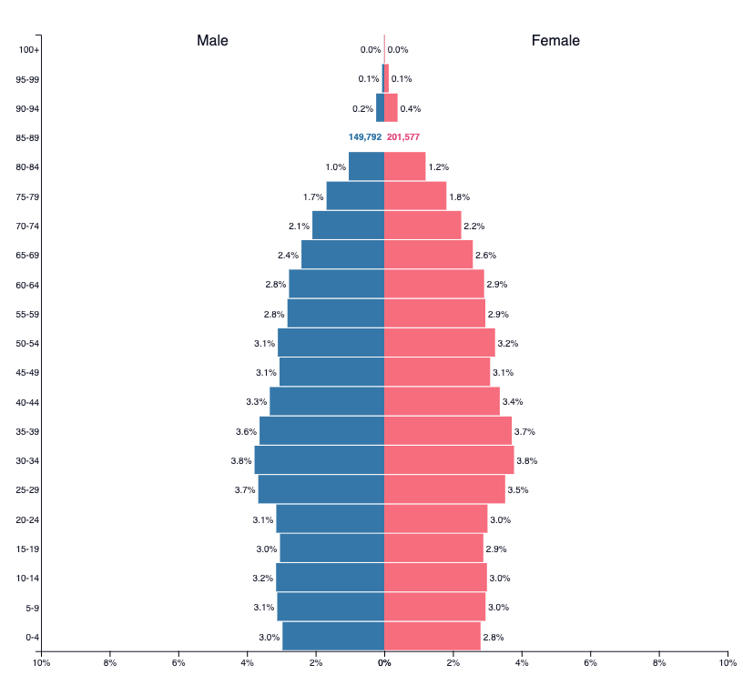
Broader dimensions that constrain monetary independence and fiscal policy headroom
Imposts on fiscal headroom:
Demography
Climate change risks
Security risks
Attitudes to taxes
https://www.news.com.au/finance/markets/world-markets/
brazil-china-ditch-us-dollar-for-trade-payments-favour-yuan/
news-story/682a517c37ba14f306e65ad0e83f6307
Australia 2023
https://www.populationpyramid.net/australia/2023/
Imposts on monetary policy independence:
Global financial architecture
  Role of the USD as a reserve currency
  SWIFT payments system
  IMF role relative to CB swaps
Fintech
Cyber security

Slide 14
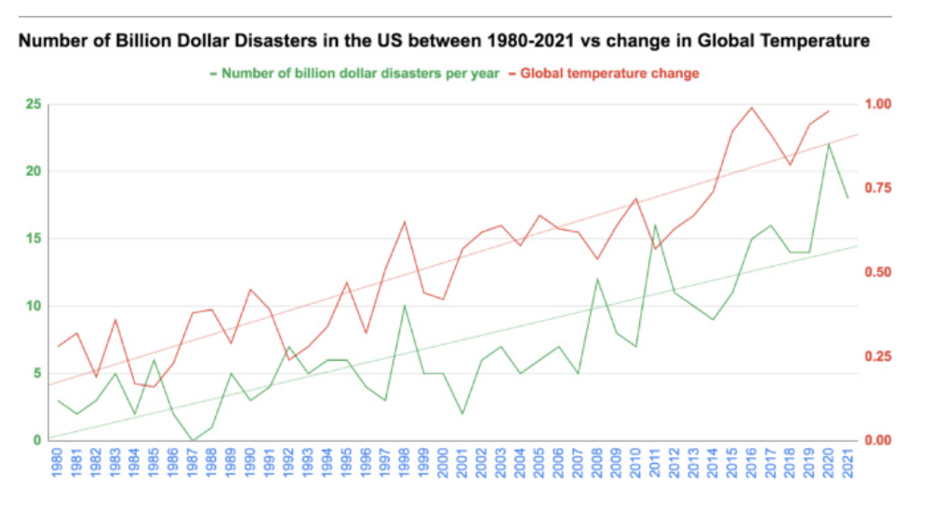
Other imposts on budgets - climate change
Climate change will put increasing pressure
on budgets directly:
cost of responding to the rising rate of natural
disasters
cost of increasing preparedness investment
cost of treating increased exposure to tropical
diseases - human and animal health
reduced productivity - agriculture yields,
production disruptions, human health -
lower tax revenues
Indirectly:
CBAM and Australian competitiveness
slower global growth and impact on commodity prices
loss and damage compensation
national security costs of geo-disruption
climate change refugees
Vijai Bhola, Attila Hertelendy, Alexander Hart, Syafwan Bin Adnan, Gregory Ciottone,
Escalating costs of billion-dollar disasters in the US: Climate change necessitates disaster risk reduction,
The Journal of Climate Change and Health, Volume 10, 2023, 100201, ISSN 2667-2782,https://doi.org/10.1016/j.joclim.2022.100201.

Slide 15
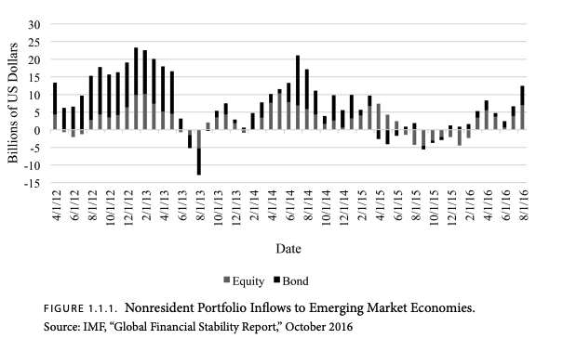
We need to care about emerging market and low income economies vulnerablity to capital market volatility
2013 Taper tantrum saw the Fed reverse QA
post the 2008 GFC massive QE
Australia’s economy is exposed to Asia’s growth
Emerging markets in our region are expected to be
the main drivers of growth over the next decade
They are still vulnerable to volatile capital flows
so financial stability matters for their growth
Commodity prices remain our major source of foreign
income, and they depend on demand
Asia’s growth is exposed to global growth and stability
Australia’s security is exposed to global growth
Refugee flows are triggered by economic insecurity
as well as physical insecurity from conflict and disasters
Geofragmentation is fuelled by nationalism, in turn
fuelled by corruption, inequality, and slowing growth.
Mishra and Rajan, Taylorcurrencies paper https://www.hoover.org/sites/default/files/research/docs/cochranepalermotaylor_currencies_ch1.pdf
https://www.imf.org/en/Publications/fandd/issues/2023/03/Central-Banks-less-is-more-raghuram-rajan?utm_medium=email&utm_source=govdelivery

Slide 16
Attitudes to taxes need to change if a balance between FP and MP is to be achieved
Taxing issues:
Efficiency in administration and incentive
distortion versus role in redistribution
Effectiveness in internalising externalities
Behaviour shaping for firms
Labour supply impacts
Savings and capacity for self-funding
health and aged care

