Slide 1


Parliamentary Library seminar: Sustainable health systems
and mental health
Professor Maree Teesson AC FASSA FAHMS RSNSW
The Matilda Centre, The University of Sydney
Chair, Australia’s Mental Health Think Tank

Slide 2
Every year in Australia:
Over
65,000
Australians
make a suicide attempt
Over
3,000
Australians die by suicide
Suicide is the
leading cause of death
for Australians
between 15 and 44 years of age
Young Australians are more likely to
take their own life
than die in motor
vehicle accidents

Slide 3
In young Australians aged 16-24 years:
26%
had symptoms of a mental disorder in the previous 12 months
in 2007
40%
had symptoms of a mental disorder in the previous 12 months
in 2021

Slide 4
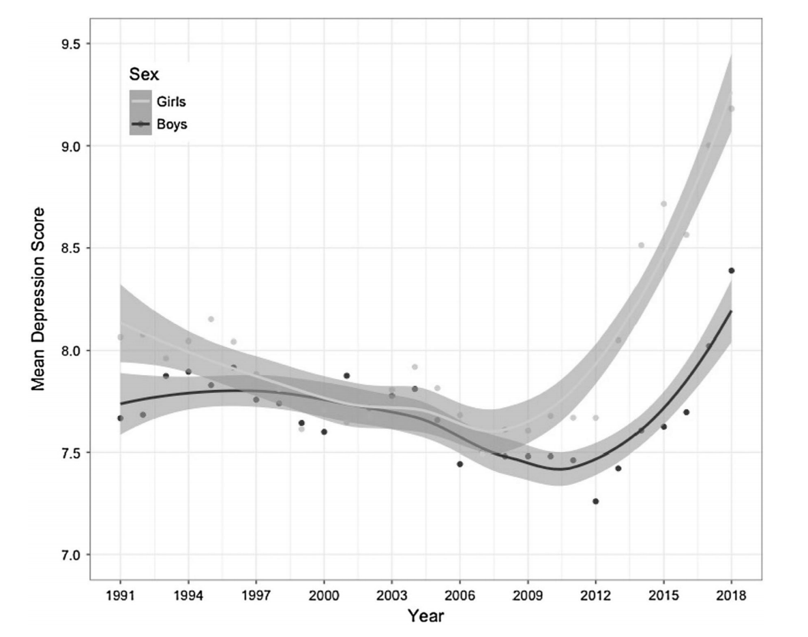
Depression among high school students in the US, 1991-2018

Slide 5

The reasons underlying these increases require urgent attention and are not fully explained

Slide 6


Slide 7



Screen Time and Depression in 3826 adolescents 2014-2018
high mean levels of social media
high mean levels of computer use
high mean levels of television use over 4 years was associated with less depression
video gaming is not associated with depression
Boers E, Afzali MH, Newton N, Conrod P. Association of Screen Time and Depression in Adolescence. JAMA Pediatr. 2019;173(9):853–859.
Notes:
THERE ARE OTHER MEGA TRENDS IN SLEEP, ECONOMIC INEQUALITY, SOCIAL COHESION ….

Slide 8

Sleep
This Photo by Unknown Author is licensed under CC BY-NC

Slide 9
Trends in sleep duration among adolescents, 1991-2019
Kaur N, Hamilton A, Chen Q, Hasin DS, Cerda M, Martins S, Keyes KM. Age, period and cohort effects of internalizing symptoms among US students and the influence of sleep duration: results from the Monitoring the Future Survey 1991-2019. Presented Sydney Prevention Conference 2020
Notes:
Suggested framing: looking more broadly, it is important that we ensure the outcomes of research and innovation reach patients – and this means better embedding research and innovation in the health system.
We know from international evidence that this is better for patients and for staff – and therefore to the sustainability of the health system. Building this in now will help future proof the system an ensure if can run as efficiently as possible, delivering the best available care, into the future.

Slide 10








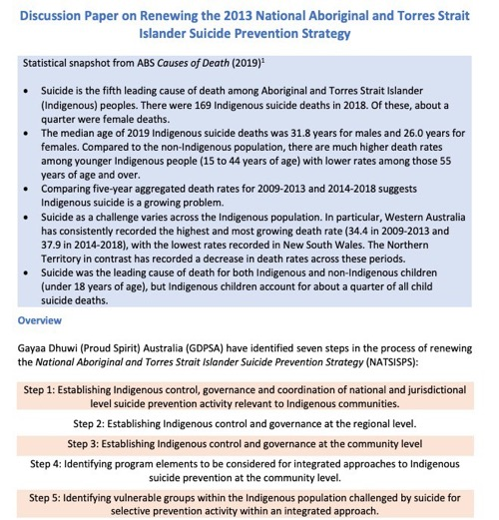



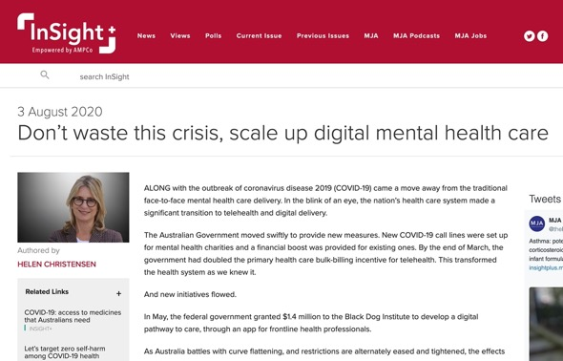


Plandemic of inaction
Notes:
No less than 55 high-profile
public inquiries relevant to mental
health have been held over the last
30 years, involving more than
55,000 public submissions and
9,000 witnesses,
Three of the significant driving issues behind the lack of implementation of these reports are:
1) A lack of independent advocacy: The reports are often produced by a government department or government-funded organisations, without sufficient buy-in from stakeholders across the mental health ecosystem. Without this buy-in, there are few organisations to advocate long term for reform recommendations to be implemented.
2) A lack of investment in implementation: There is substantial investment in the production of each of these plans, yet there is no allocated budget to invest in the implementation of the plans’ recommendations.
3) Inaccessibility: These reports are notoriously lengthy (e.g. the Productivity Commission Report consists of three volumes and over 1,600 pages). It is not feasible for most time poor policymakers and other stakeholders to utilise a document of this size.

Slide 11

Notes:
Suggested framing: looking more broadly, it is important that we ensure the outcomes of research and innovation reach patients – and this means better embedding research and innovation in the health system.
We know from international evidence that this is better for patients and for staff – and therefore to the sustainability of the health system. Building this in now will help future proof the system an ensure if can run as efficiently as possible, delivering the best available care, into the future.

Slide 12
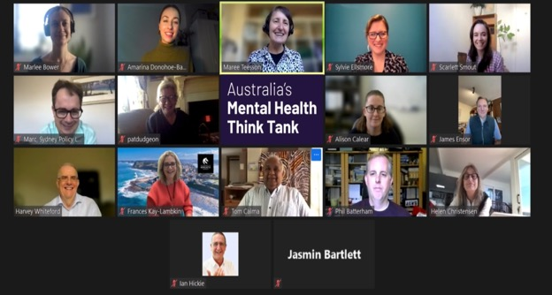
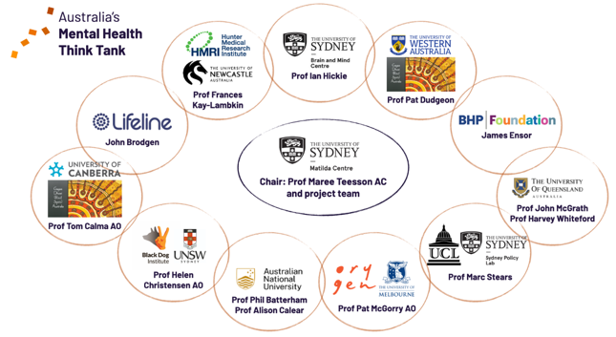

New, unified, focussed voices
Australia’s Mental Health Think Tank
www.mentalhealththinktank.org.au

Slide 13

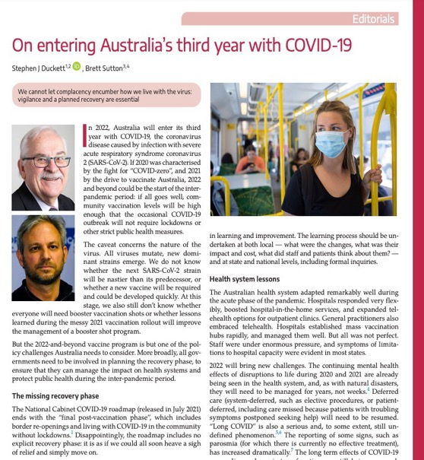

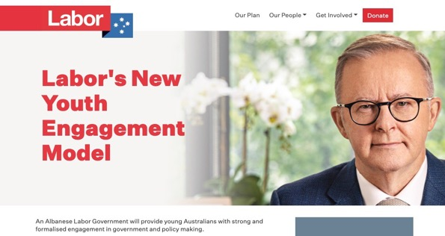

Bridge knowledge policy divide
Australia’s Mental Health Think Tank
Notes:
Suggested framing: looking more broadly, it is important that we ensure the outcomes of research and innovation reach patients – and this means better embedding research and innovation in the health system.
We know from international evidence that this is better for patients and for staff – and therefore to the sustainability of the health system. Building this in now will help future proof the system an ensure if can run as efficiently as possible, delivering the best available care, into the future.

Slide 14
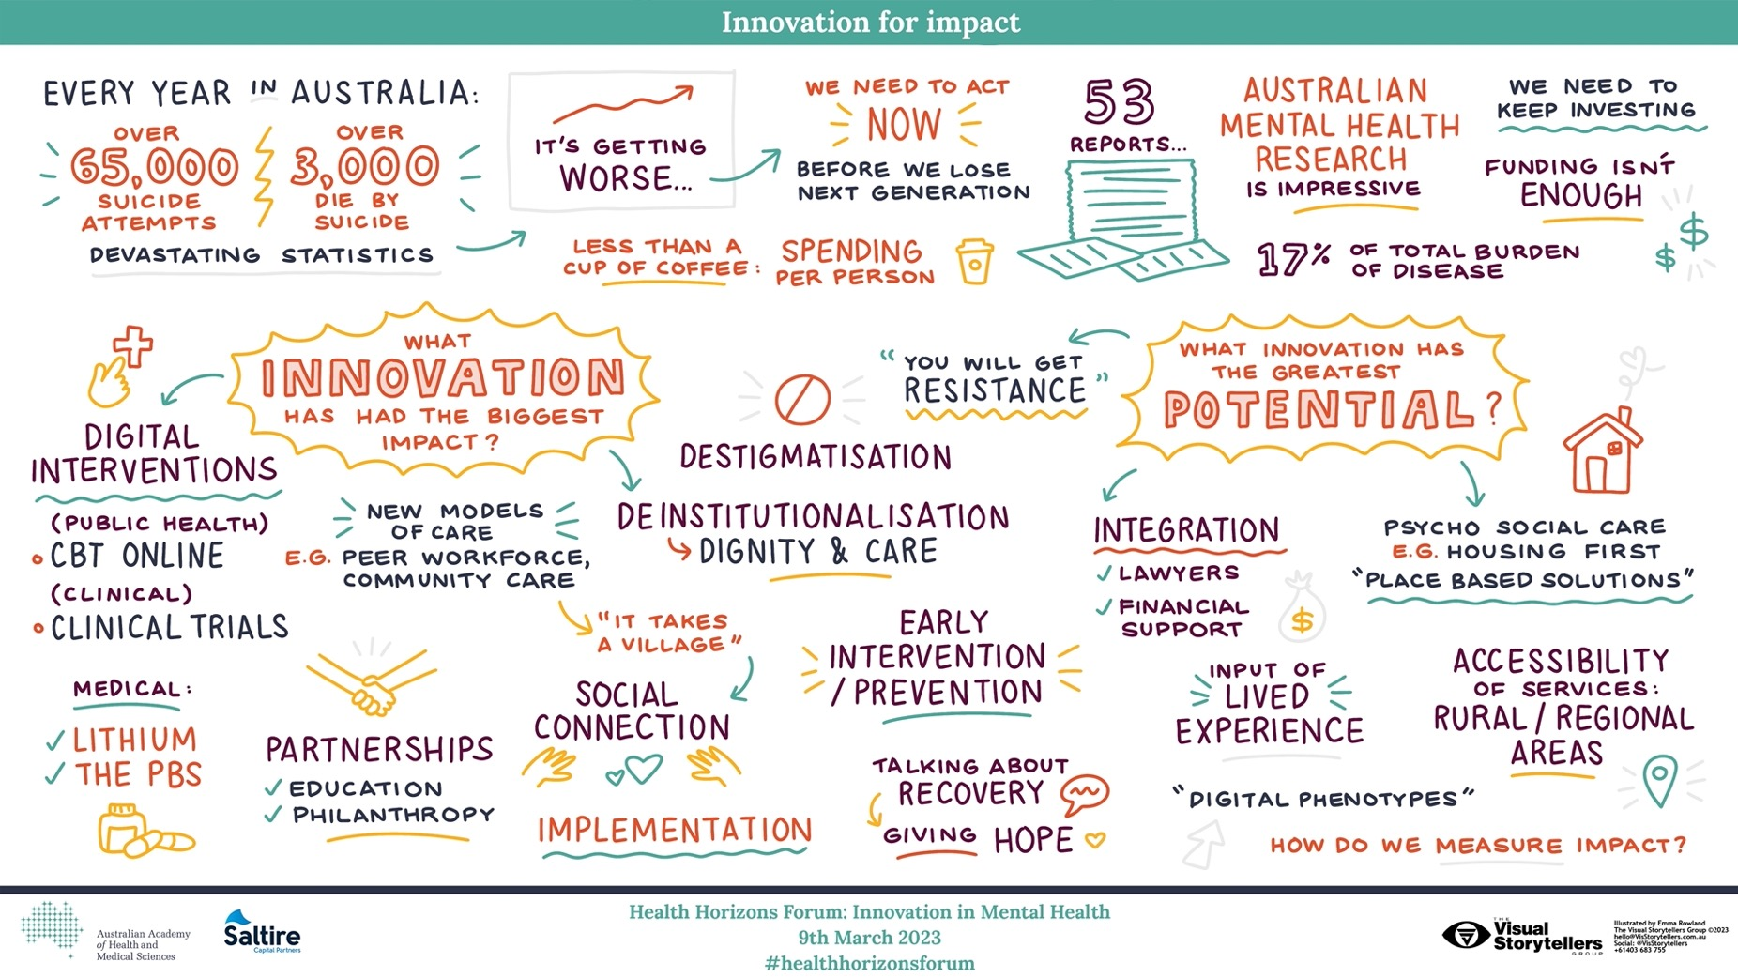

Slide 15
Embedding research and innovation in the health system
International evidence shows that research-rich health environments are better for patients and staff:
  Higher quality care
  Reduced mortality
  More efficient uptake of new innovations
  Better patient experience, improved staff satisfaction & retention
If we embed research and innovation, we will get more out of the health system and improve outcomes:
  Build a future-proof system that delivers cutting-edge care.
  Fast track Australia’s efforts to rise to health challenges.
  Maximise the efficient use of existing resources.
  aahms.org/vision
Notes:
Suggested framing: looking more broadly, it is important that we ensure the outcomes of research and innovation reach patients – and this means better embedding research and innovation in the health system.
We know from international evidence that this is better for patients and for staff – and therefore to the sustainability of the health system. Building this in now will help future proof the system an ensure if can run as efficiently as possible, delivering the best available care, into the future.

Slide 16
Mental health innovation in Australia is impressive.

Slide 17
Australian mental health research & innovation is globally impressive
Ranking of Australian research activity relative to other countries
 | Publications
 | 2017 | 2018 | 2019 | 2020 | 2021
Psychiatry & Mental Health | 4 | 4 | 5 | 6 | 6
Cancer Research | 12 | 12 | 12 | 13 | 13
Cardiology & Cardiovascular Medicine | 11 | 11 | 11 | 11 | 11
Endocrinology, Diabetes & Metabolism | 9 | 8 | 9 | 8 | 8
Immunology | 11 | 10 | 11 | 11 | 10
 | 2017 | 2018 | 2019 | 2020 | 2021
Psychiatry & Mental Health | 3 | 3 | 3 | 4 | 5
Cancer Research | 10 | 11 | 11 | 10 | 11
Cardiology & Cardiovascular Medicine | 11 | 9 | 12 | 10 | 11
Endocrinology, Diabetes & Metabolism | 6 | 7 | 7 | 6 | 7
Immunology | 9 | 8 | 9 | 10 | 8
SCImago, (n.d.). SJR — SCImago Journal & Country Rank [Portal]. 2017-2018 dataRetrieved March 2019 from http://www.scimagojr.com
SCImago, (n.d.). SJR — SCImago Journal & Country Rank [Portal]. 2020-2021 dataRetrieved March 2023 from http://www.scimagojr.com
Notes:
United States United Kingdom China Germany Canada

Slide 18
Between 2-8% of global research in mental health has an Australian research affiliation.
Notes:
Suggested framing: looking more broadly, it is important that we ensure the outcomes of research and innovation reach patients – and this means better embedding research and innovation in the health system.
We know from international evidence that this is better for patients and for staff – and therefore to the sustainability of the health system. Building this in now will help future proof the system an ensure if can run as efficiently as possible, delivering the best available care, into the future.

Slide 19
References
AIHW 2020, 'National drug strategy household survey 2019', Australian Institute of Health and Welfare Canberra, Australia.
AIHW 2023, Suicide & self-harm monitoring, Canberra, Australia.
Australian Bureau of Statistics 2008, 'National Study of Mental Health and Wellbeing 2007', ABS.
Australian Bureau of Statistics 2022, 'National Study of Mental Health and Wellbeing 2020-2021', ABS.
Australian Government Productivity Commission 2019, Productivity Commission Mental Health Draft Report Overview, Canberra, Australia.
Australian Government Productivity Commission 2020, Mental Health: Productivity Commission Inquiry Report, Canberra, Australia.
Boers E, Afzali MH, Newton N, Conrod P. Association of Screen Time and Depression in Adolescence. JAMA Pediatr. 2019;173(9):853–859.
Bower, M, Buckle, C, Rugel, E, Donohoe-Bales, A, Mcgrath, L, Gournay, K, Barrett, E, Phibbs, P & Teesson, M 2021a, '‘Trapped’,‘anxious’ and ‘traumatised’: COVID-19 intensified the impact of housing inequality on Australians’ mental health', International journal of housing policy, pp. 1-32.
Bower, M, Donohoe-Bales, A, Smout, S, Ngyuen, AQH, Boyle, J, Barrett, E & Teesson, M 2022a, 'In their own words: An Australian community sample’s priority concerns regarding mental health in the context of COVID-19', PloS one, vol. 17, no. 5, pp. e0268824.
Bower, M, Smout, S, Donohoe-Bales, A, Teesson, L, Lauria, E, Boyle, J, Batterham, P, Calear, A, Riches, J & Grager, A 2022b, 'A hidden pandemic? An umbrella review of global evidence on mental health in the time of COVID-19’. Fronteirs in Psychiatry, 14 - 2023 | https://doi.org/10.3389/fpsyt.2023.1107560
Bower, M, Smout, S, Ellsmore, S, Donohoe-Bales, A, Sivaprakash, P, Lim, C, Gray, M, Francis, A, Grager, A & Riches, J 2021b, 'COVID-19 and Australia’s mental health: An overview of academic literature, policy documents, lived experience accounts, media and community reports’ www.mentalhealththinktank.org.au

Slide 20
References
Francis, CJ, Johnson, A & Wilson, RL 2022, 'The personal cost of repetitive mental health inquiries that fail to result in change', Collegian, vol. 29, no. 5, pp. 728-737.
Keyes, KM, Gary, D, O’malley, PM, Hamilton, A & Schulenberg, J 2019, 'Recent increases in depressive symptoms among US adolescents: trends from 1991 to 2018', Social Psychiatry and Psychiatric Epidemiology, vol. 54, no. 8, pp. 987-996.
Mindgardens Neuroscience Network 2019, 'Review of the burden of disease for neurological, mental health and substance use disorders in Australia: White Paper 2019', Sydney, Australia.
Morris, ZS, Wooding, S & Grant, J 2011, 'The answer is 17 years, what is the question: understanding time lags in translational research', Journal of the Royal Society of Medicine, vol. 104, no. 12, pp. 510-520.
OECD 2021, Measuring what matters for child well-being and policies, OECD Publishing.
Santomauro, DF, Herrera, AMM, Shadid, J, Zheng, P, Ashbaugh, C, Pigott, DM, Abbafati, C, Adolph, C, Amlag, JO & Aravkin, AY 2021, 'Global prevalence and burden of depressive and anxiety disorders in 204 countries and territories in 2020 due to the COVID-19 pandemic', The Lancet, vol. 398, no. 10312, pp. 1700-1712.
Solmi, M, Radua, J, Olivola, M, Croce, E, Soardo, L, Salazar De Pablo, G, Il Shin, J, Kirkbride, JB, Jones, P, Kim, JH, Kim, JY, Carvalho, AF, Seeman, MV, Correll, CU & Fusar-Poli, P 2022, 'Age at onset of mental disorders worldwide: large-scale meta-analysis of 192 epidemiological studies', Molecular Psychiatry, vol. 27, no. 1, pp. 281-295.
Whiteford, H 2022, 'The Productivity Commission inquiry into mental health', Australian & New Zealand Journal of Psychiatry, vol. 56, no. 4, pp. 328-331.
To find out more:
www.mentalhealththinktank.org.au
www.sydney.edu.au/matilda-centre/

Slide 21

  THANK YOU
  Presented by Professor Maree Teesson AC FASSA FAHMS
  The Matilda Centre for Research in Mental Health and Substance Abuse
  Maree.Teesson@sydney.edu.au

