Slide 1
Economic & Geopolitical Outlook for APAC
Dr Simon Baptist
Chief Economist Economist Intelligence Unit
September 2022

Slide 2
What we’ll go through today:
Macro outlook (Global and Asia)
China deep dive
Business trends and risks

Slide 3
Growth outlook

Slide 4
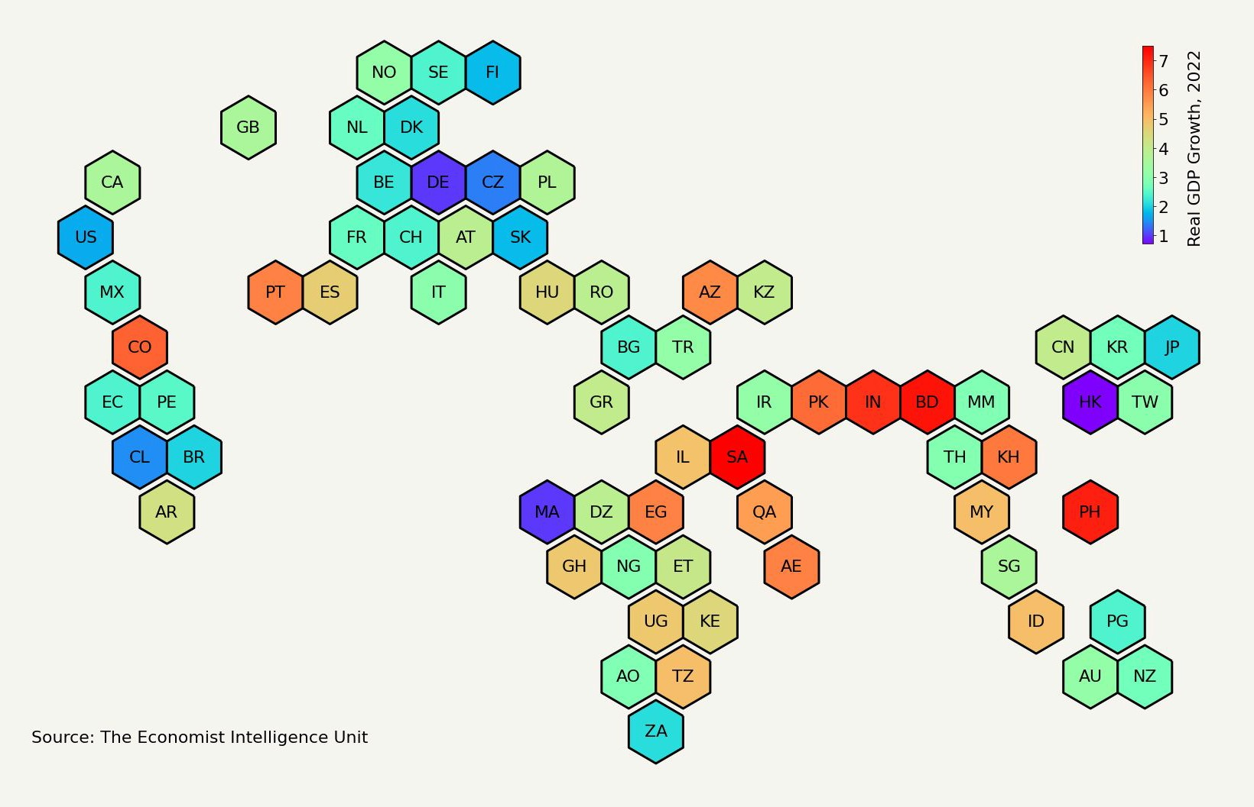
Global growth of 2.8% in 2022 - down from 3.9% before war started
Recessions in
Russia (-7.5%),
US growth downgrade to 1.7%, due to high inﬂation
Ukraine (-37%); also Germany, Italy, Turkey
China economy battered ~4%
RU
UA
Global inﬂation: from 5.6% pre-war
to 8% now
Euro zone growth down from 4% to 1.9%, At a standstill for rest of 2022.
VN
LK
Commodity and supply chain waves across Asia
LatAm will suffer from higher global inﬂation, but higher commodities prices beneﬁcial to some countries
MEA commodity exporters will beneﬁt from higher prices
Source: EIU July 2022 forecasts

Slide 5
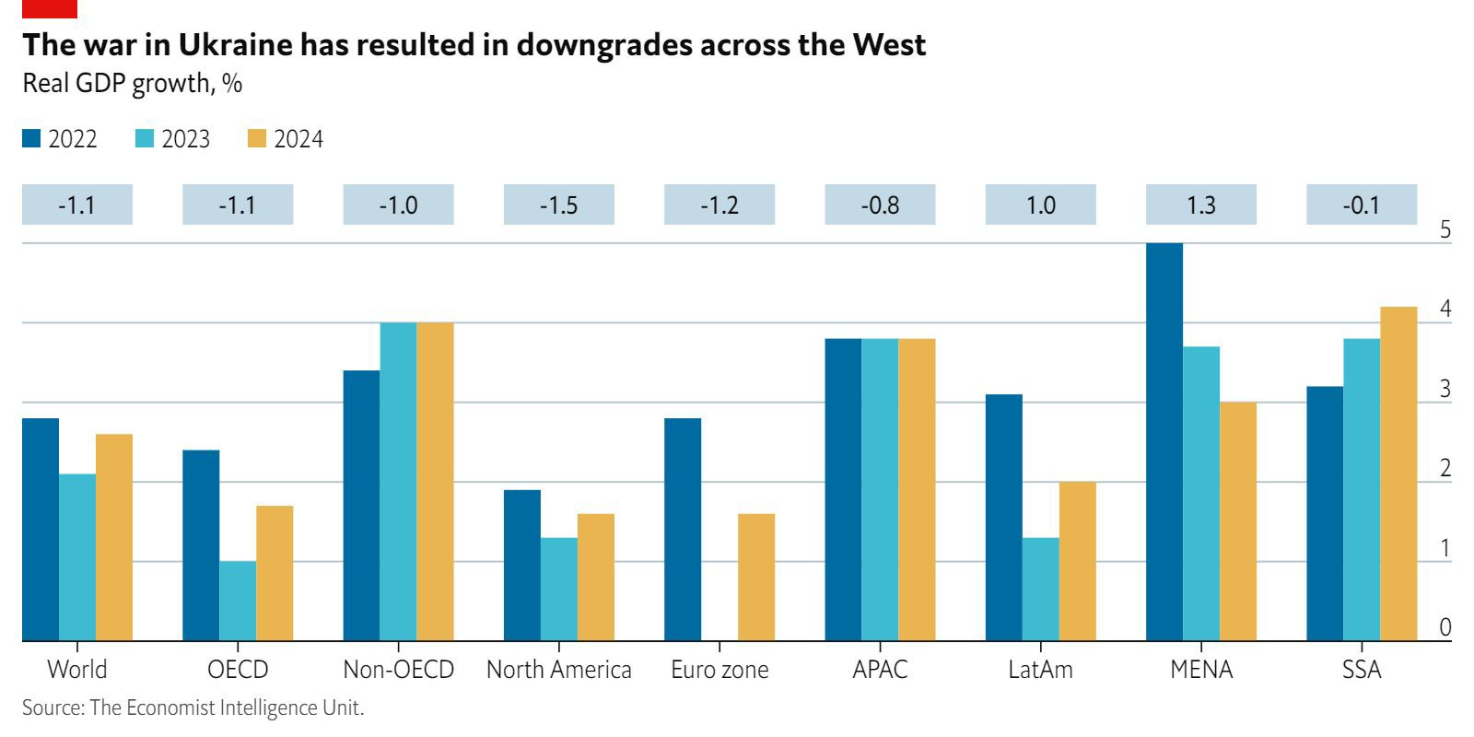
Growth falls to 2.1% next year: APAC most consistent over the cycle
2022 GDP forecast change since Ukraine invasion
2023
full-year -ve growth in: AT, DE, IT,
LK, NL, RU, TL, UK
APAC no major fullyear -ve growth expected (JP at risk)
0% growth in 2023!

Slide 6
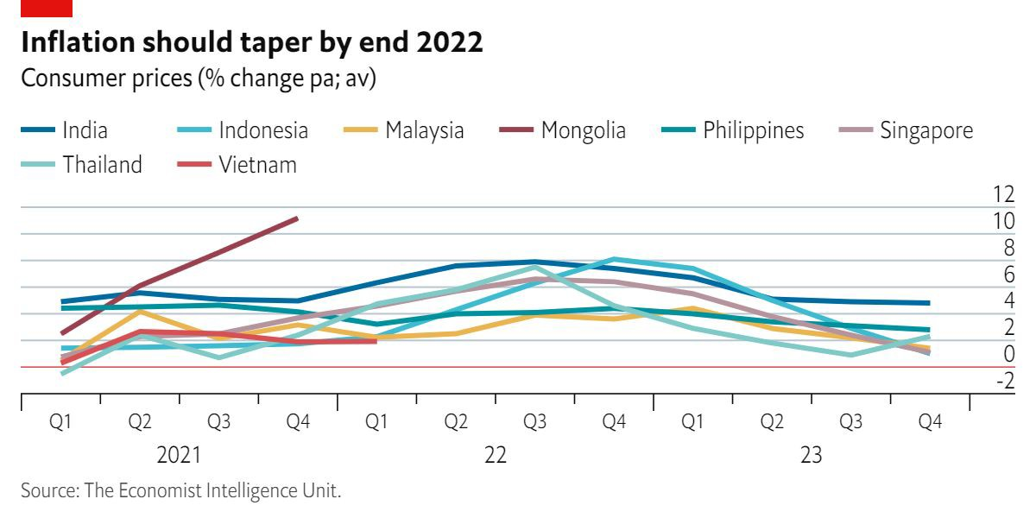
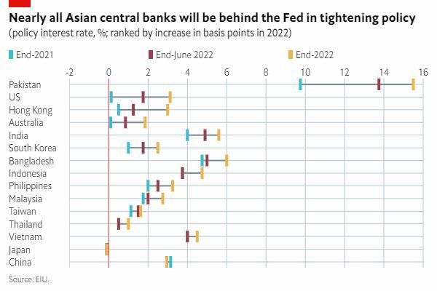
Inﬂection point for Central Banks
Central banks that tightened early are better positioned to weather Fed rises
Post-2009 interest rates were essentially at zero in most major developed markets; the zero-bound meant that interest rates were not enough to stimulate the economy
QE used to further reduce borrowing costs and increase liquidity as central banks bought government and corporate bonds
That will now unwind, with some uncertainty of how it will lay out but mainly it means…
Less liquidity → Harder to get funding
-> Higher refinance risk
Higher interest rates → More risk aversion
→ Higher hurdle rate for ROI
Not raising policy rates!

Slide 7
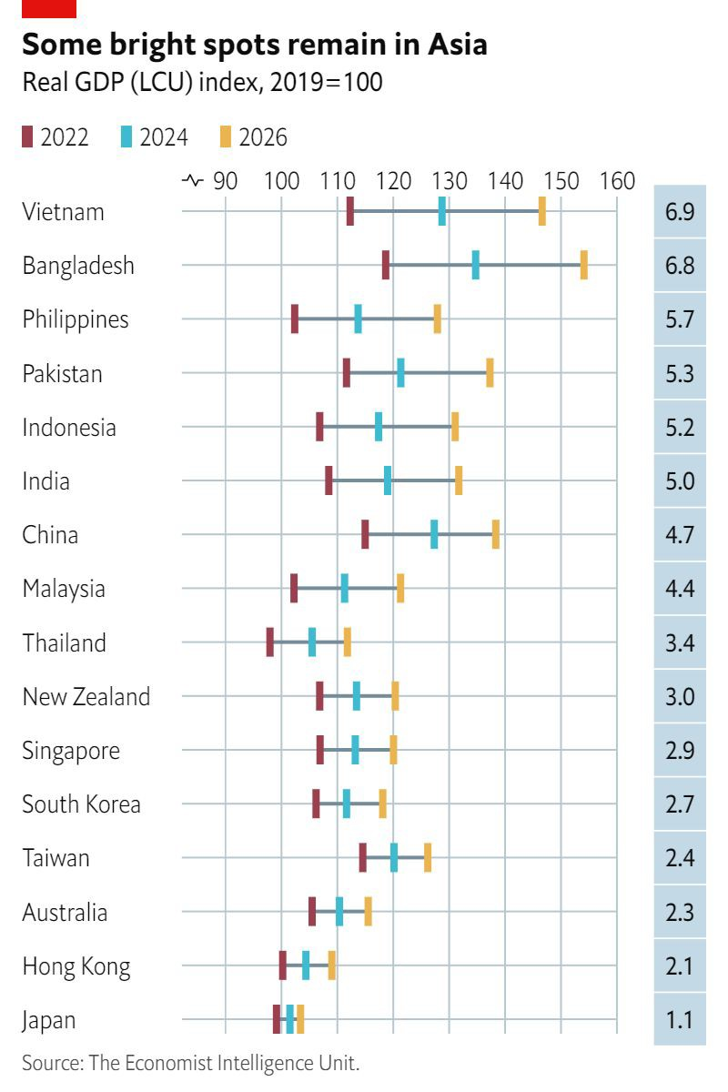
Asia GDP growth at 3.8% p.a. in 2022-24, but there are disparities
The tailwinds of supply chain expansion, relentless China growth and low interest rates that have propelled Asia in recent decades are all
CAGR, 2022-26
weakening
Slower growth momentum in China will weigh on regional GDP
Asian central banks starting to raise rates, but not as much as US
Capital outflow to DMs, higher yields and security
US companies remain largest contributor of ODI, despite China’s economic heft in the region
Greater trade integration, but also geopolitical splits
Governance, policy and strategy will be stronger differentiating factors for both companies and governments with these tougher background conditions

Slide 8
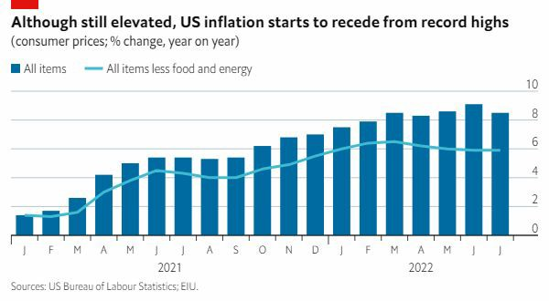
Is the US economy headed for a recession?
GDP growth in the US will slow sharply over the course of 2022 and 2023, but NO recession
Stubbornly high inflation, rising interest rates and stalling growth all around the world
Consumer demand should be resilient enough to avoid an outright recession as defined by NBER
Tight labour market and strong household savings
Things could turn ugly if another shock as big as the invasion of Ukraine…
There is another inflationary spike (Double-digit increases in CPI for 2 conseq. months)
Fed overcorrection
(Over shooting peak range of 3.25-3.50%)
US asset price collapse
(US stock market indices fall by >40% from July)

Slide 9
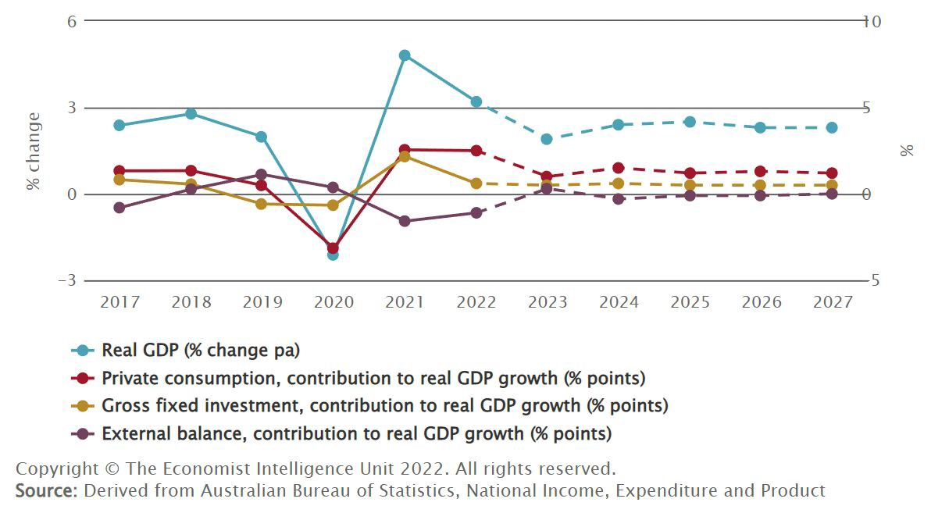
Australia being carried by consumers and lockdown savings
Above global-av 2022 growth of 3.2%
Domestic demand at 4.3% in 2022, but will more than halve in 2023:
Inflation eats into private consumption in 2023, and federal budget edges back to primary surplus
Back to ~2.5% growth from 2024 on
Partial but not total relief from high commodity prices
Weak China and slow RBA pulling A$ down by more than high export prices pushing it up slowing a China a longer-term headwind
Oil a big import item
Strategic issues:
Economic re-orientation away from China
Green transition both domestically and the export mix Managing relations with ASEAN/Pacific amidst geopolitical shift Russia sanctions: chance for a mining investment mini-boom?

Slide 10
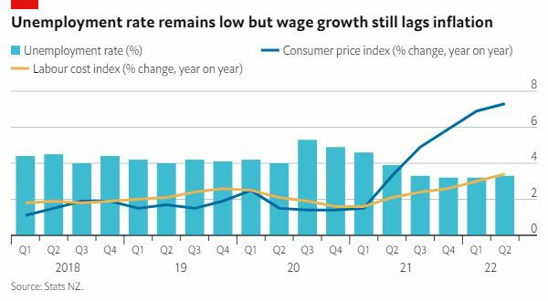
NZ economy is overheating but we expect a soft landing
Growth will decelerate to 2.5% this year and keep slowing into 2023
Inflation is at a 30-year high and the RBNZ is even further behind the curve than the RBA; interest rates will peak at 4.00% in mid-2023
Education and tourism sectors will permanently shrink due to loss of Chinese demand
Like in Australia, consumer savings are high and this reduces downside risk
While the fiscal deficit is coming down from its covid high, deficits look set to be ongoing, in contrast to pre-covid
Government priorities:
surpluses; high tax receipts mean less fiscal pressure than in Australia
Inequality and cost of living
Housing affordability and investment subject to centrist voters Trade diversification from China and finalising more FTAs
Climate change action while maintaining agricultural competitiveness

Slide 11
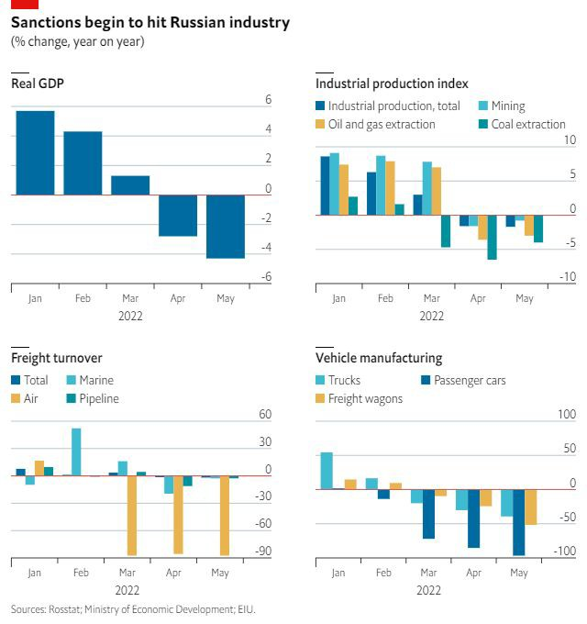
Tough times ahead in Russia
Sanctions are working:
Sanctions are having a big impact on the Russian economy.
Rouble has recouped losses: capital controls.
Trade surplus is huge: import collapse
(Scarce) data point to drop in consumption and investment.
Russia is heading into huge recession and default
EU measures to curb Russian energy imports will bite.
Export controls (energy, semiconductors) will bite in the long run.
Will make already bleak outlook bleaker.
What next for Putin’s regime?
War and a poor economy are risks to the regime.
However, most Russians support Putin.
Many Russians feel that bridges w West are burnt.
No signs of an exodus or massive social unrest in Russia.
Domestic media scene is also tightly controlled.
Likeliest scenario is that Putin’s days are not numbered.

Slide 12
China deep dive

Slide 13
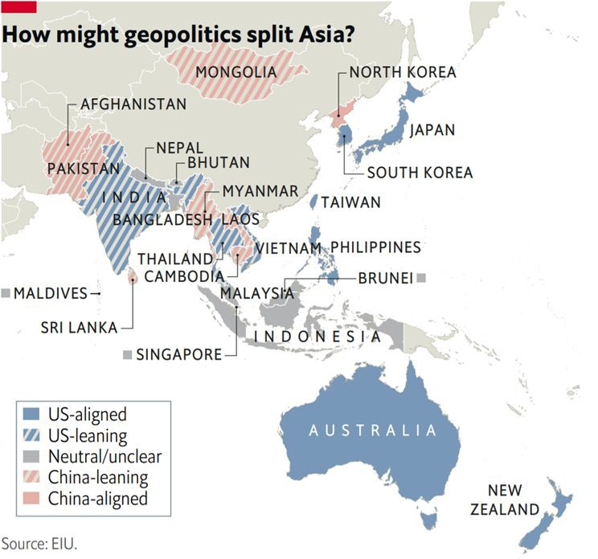
Could the US-China rivalry derail the Asian century?
13
Asia is starting to look similar to late 19th-century EU
Territorial disputes among neighbouring economies
Intensified competition between a rising power (China) and the incumbent (US)
Lack of a recognised arbitration framework
US-China tensions and decoupling will accelerate
Watch out for:
Formation of competing cold war-type blocs, unwinding of trade and supply chains
Systemic bipolarity between US and China that leads to bifurcation and “choosing sides”
Rise of nationalism / populist policies

Slide 14
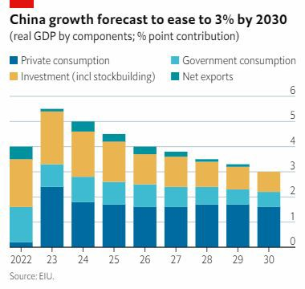
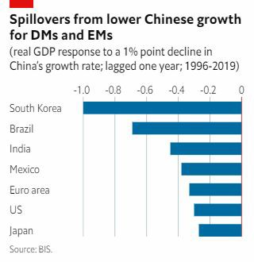
What impact from China’s structural slowdown?
14

Slide 15
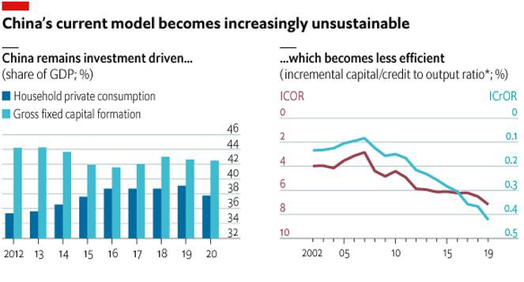
What impact from China’s structural slowdown?
15

Slide 16
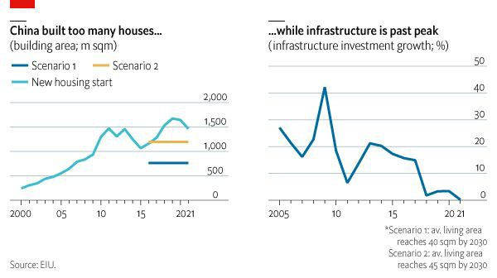
What impact from China’s structural slowdown?
16

Slide 17
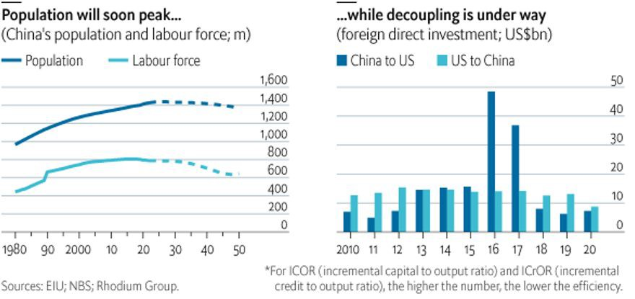
What impact from China’s structural slowdown?
17

Slide 18
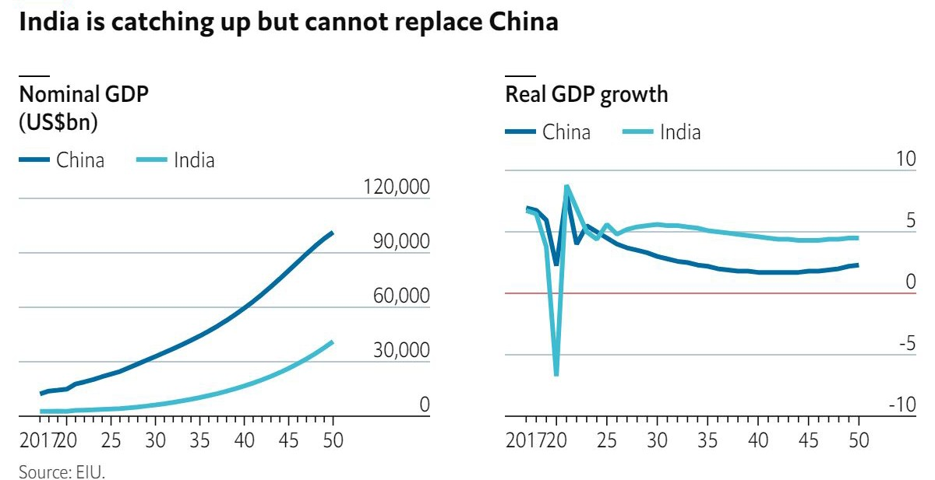
India offers new opportunities but not a substitute for China
18

Slide 19
Business trends and risks

Slide 20
A new era for business and the global economy
Partly caused by covid-19 and the war in Ukraine, but also pre-existing trends
01 02
03
Localised supply chains
Commodities are back
Green transition diverges
Shorten supply chains
Build resilience
Opportunity: build new supplier networks
Increased food insecurity
Higher prices
Opportunity: Food tech
DMs: low-carbon shift, seismic in EU
EMs: still relying on fossil fuels
04
Weaponisation of business
05
Tech gets (geo)political
06
Lower for longer is over
Russia and China look for alternative payment systems
Firms can’t escape controversy
Tech as a competitive advantage
Internet becomes more national and less regional
Interest rates come off the zero lower bound
Capital will be more costly

Slide 21
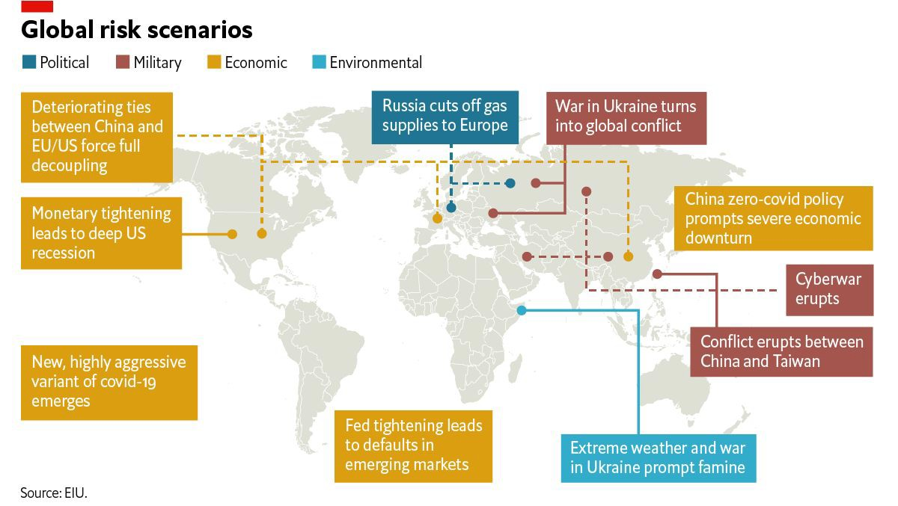
What are the top ten risks for the global economy?
Other business risks:
Spikes in input prices,
volatility
Great resignation and talent shortages
“Friend-shoring” trend, diversifying supply sources
Greater need and importance of localisation

Slide 22
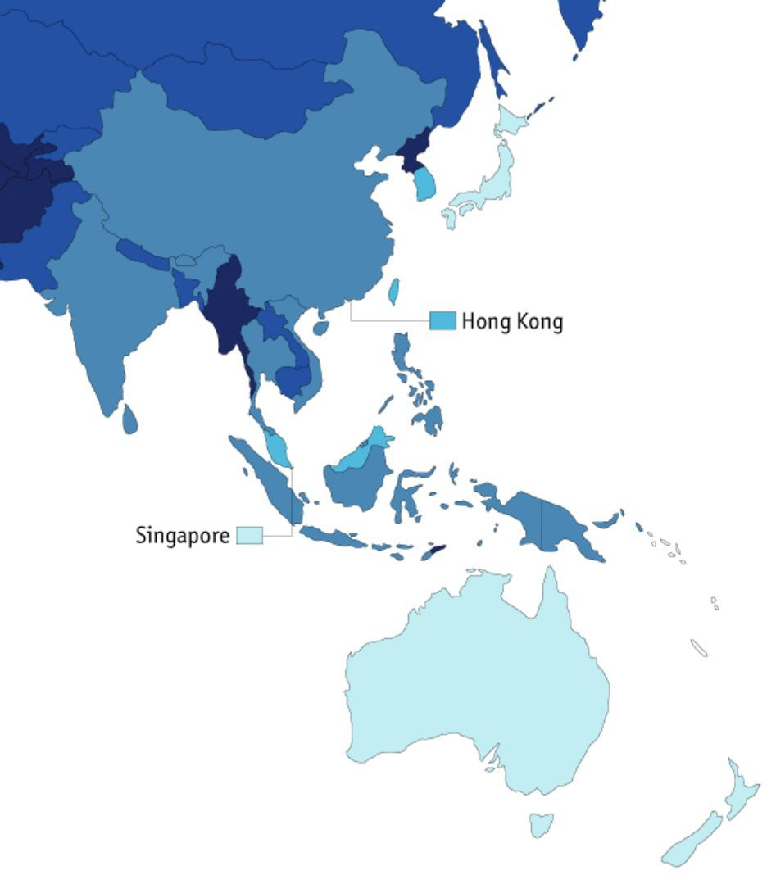
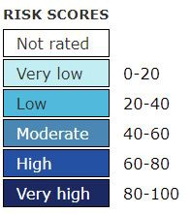
Operational risk map - legal and regulatory
Common regulatory risks in Asia
Failing state-owned enterprises (SOEs) reform and privatization
South Korea:
20
Privatisation of non-performing SOEs to reduce bloat
Reduce the size of the state sector, but politics get in the way
Myanmar: 85
Thailand: 43
Taiwan: 20
Foreign companies may be forced to sell local ownership stakes
Especially for “protected” industries like healthcare
Protectionism is on the rise, and so are populist policies Greater trade integration changes the regulatory environment
Lots of new regional trade pacts (CPTPP , RCEP)
Existing regulation need to be updated or changed
Not all governments have strict compliance
Rolling back of some incentives
Malaysia: 38
Vietnam: 55
Indonesia: 58
Philippines: 58
5
Australia: 8

Slide 23
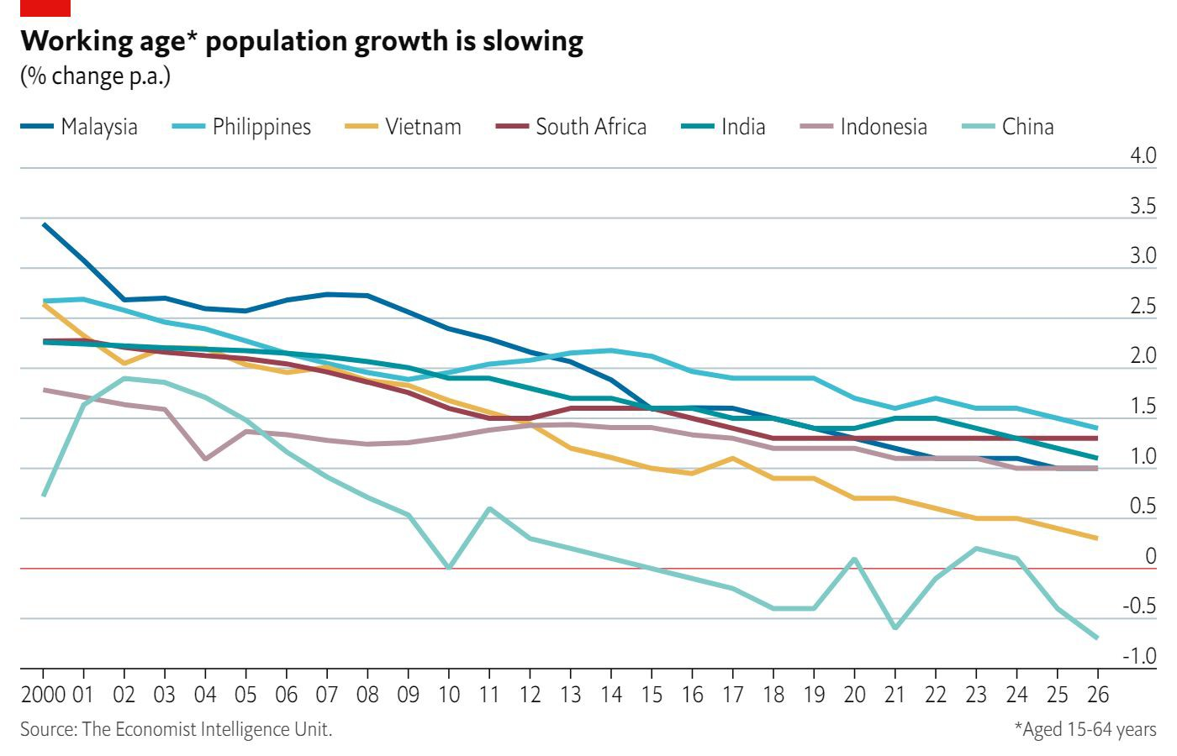
Addressing shrinking workforces and tight labour markets
Populations are shrinking, aging
Birth rates in many developed and developing markets have been declining for decades
No “quick fix” to the effect of birth rates on workforce
Reevaluating how work gets done
Workforce planning and role changes
More use of apps and digital processes by firms and customers
Increased tech and sustainability focuses require new skills
Upskilling and reskilling employees Bringing new people into workforce

Slide 24
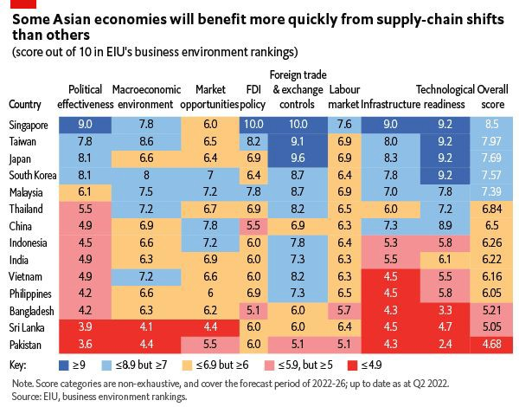
FDI outlook for Asia ex-China is still solid
No mass exodus from China
Vast consumer market still attractive, strong growth in household spending
Importance in global production networks and unrivalled logistical infrastructure
Some investment pull out, but most taking “wait-and-see” approach
Bigger firms already entrenched and unable to pivot out easily
But firms in certain sectors are or likely will retrench: management consulting, audit, finance, semiconductors

Slide 25
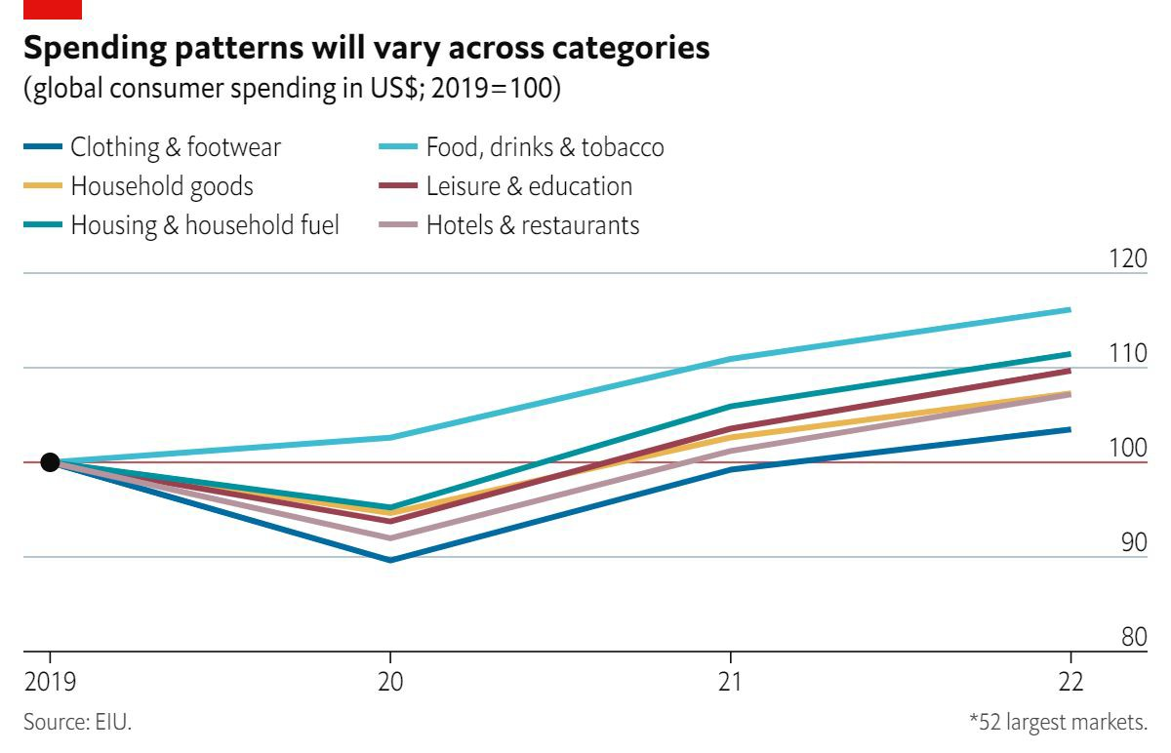
How are consumers holding up?
Spending on services over goods; OOH advertising opportunities
Offline recovers at the expense of online
Increased household savings to cushion price hikes (but only to an extent)
Inflation is hurting consumer confidence
High prices of essentials to lower discretionary spending
Interest rate hikes to weigh on big-ticket purchases
Income inequality will worsen

Slide 26
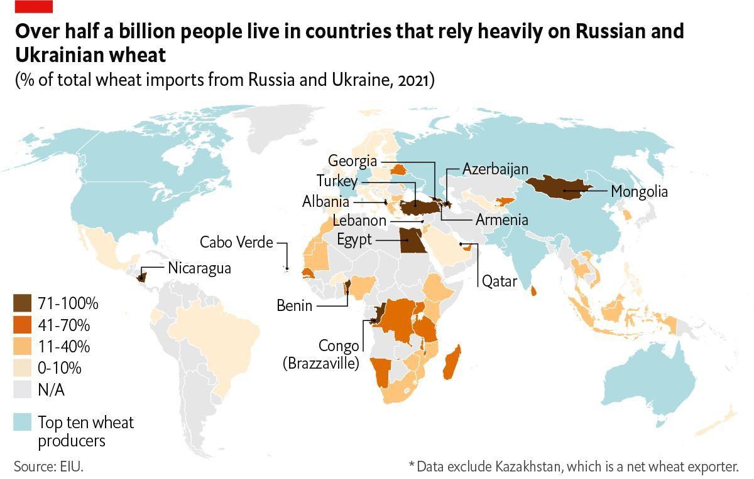
Food insecurity will catalyse government action
Russia and Ukraine account for 30% of global wheat trade, over 50% of sunflower oil
High fertilizer prices will lower crop yields
Climate change will compound problems
Disproportionate impact on developing economies (civil unrest, migration etc)
Opportunity to build sustainable food systems

Slide 27
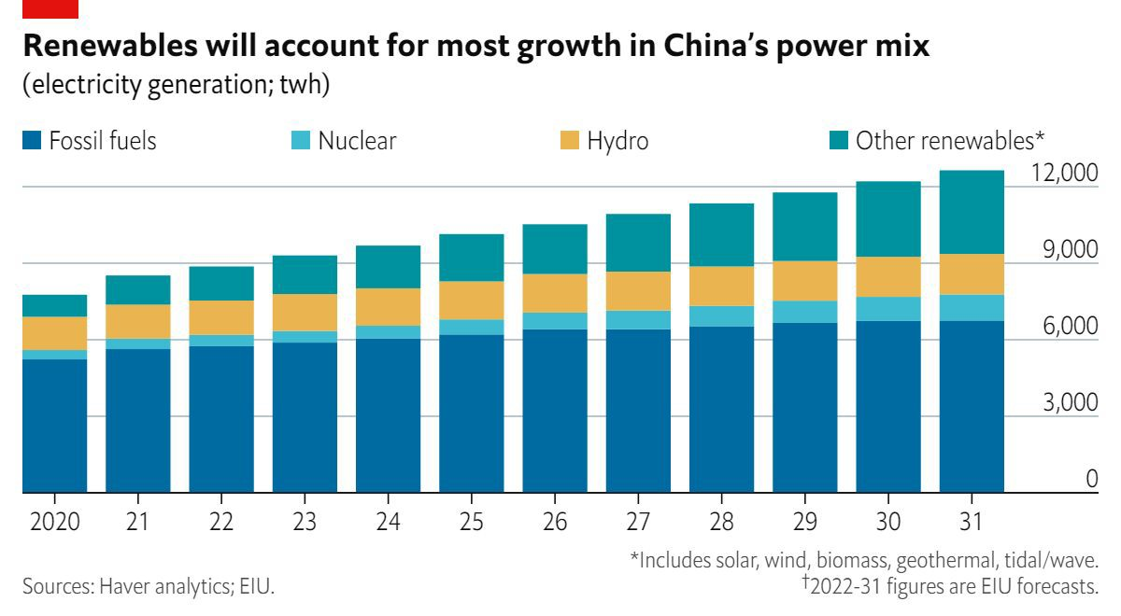
Europe in energy crisis, but transition continues elsewhere
Russia weaponizing gas exports
Hungary, the Czech Republic and Slovakia to take the biggest economic hit; Germany, Austria and Italy will face gas shortages.
Rationing in the German industrial sector will have region-wide spillover effects.
Elsewhere, the main impact will come through high energy prices, falling confidence and weak external trade.
Many Asian LNG contracts are long-term, IN/CN taking advantage of cheap Russian supplies

Slide 28
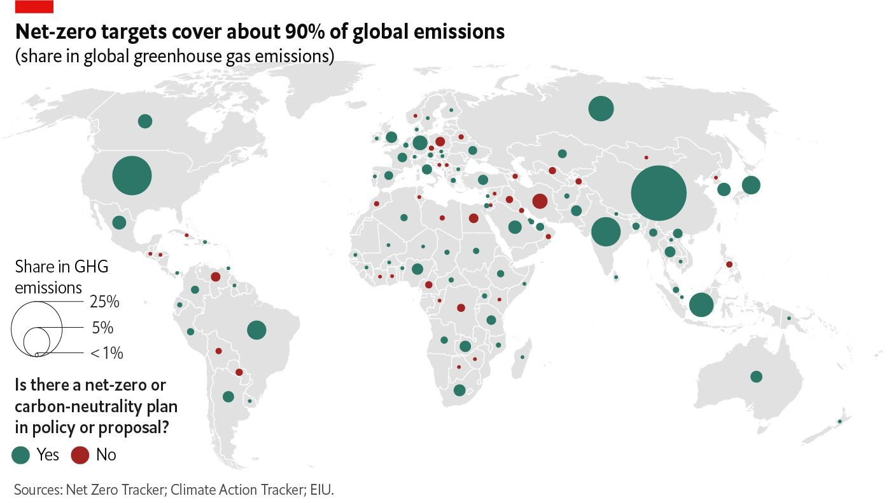
Climate change priorities shifting in short and medium-term
Energy security will be priority amid geopolitical frictions
High energy costs, supply uncertainties will lead to delays now, but higher commitment longer term
High metal prices to hinder transition Interest rate hikes can discourage investment in new tech; financing
Emissions trajectory between advanced and developing economies will widen
EMs don’t want to cut emissions, but facing reality of vulnerability

Slide 29
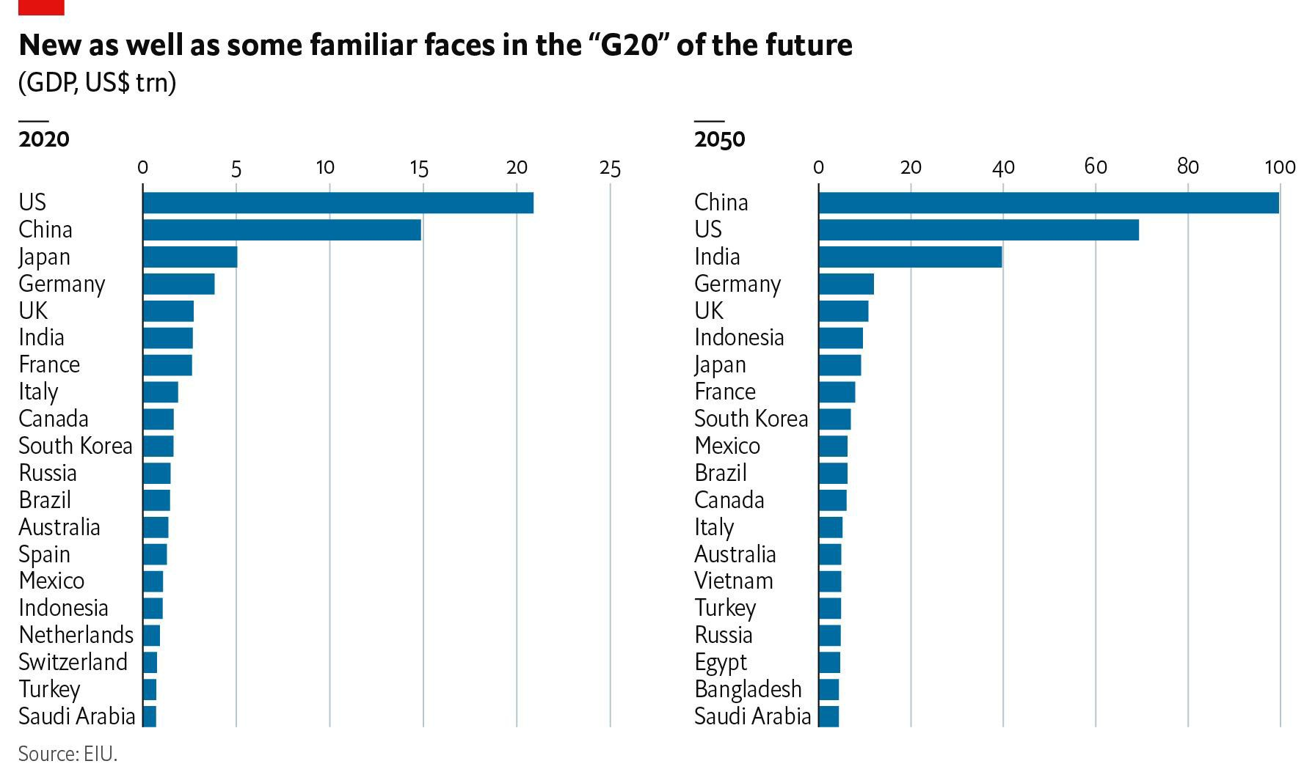
Who will be the economic powers of tomorrow?
Asia’s growth drivers
Urbanisation
Strengthening trade network and integration
Growth in the services sector, wage growth
Tech: catch up and innovation
Roadblocks
Supply chain reshoring
Geopolitical risks Bad policymaking
China will overtake US somewhere in 2030-35
Asian economies might be growing, but not all will be rich

Slide 30
Questions? Want our free daily or weekly newsletters and regular whitepapers? Need data for a project?
Dr Simon Baptist
Chief Economist Economist Intelligence Unit
Matthew Glassman
Your dedicated account manager Economist Intelligence Unit
simonbaptist@eiu.com
matthewglassman@eiu.com

