Slide 1
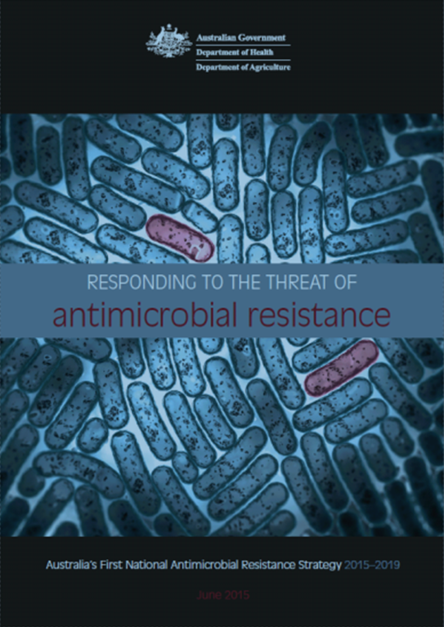
Antimicrobial resistance (AMR)
Parliamentary briefing
Sept 21, 2022
Prof Cheryl Jones MBBS (Hons) PhD FRACP GAICD FAHMS
Head of School and Dean
Sydney Medical School
Faculty of Medicine and Health
Cheryl.jones@sydney.edu.au

Slide 2
Overview
What is antimicrobial resistance (AMR)
What are the drivers to AMR?
Why is AMR important?
What is the current state of AMR- Globally/Australia
Strategies to tackle AMR (and challenges)
Concluding remarks

Slide 3
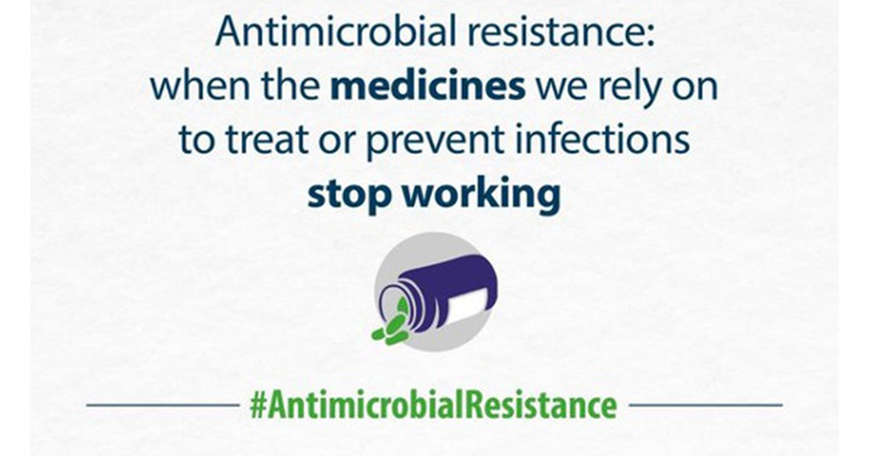

What is Antimicrobial resistance (AMR)?

Slide 4
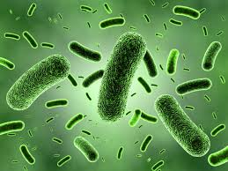
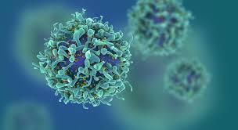
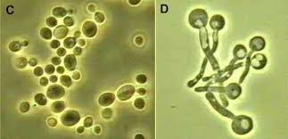
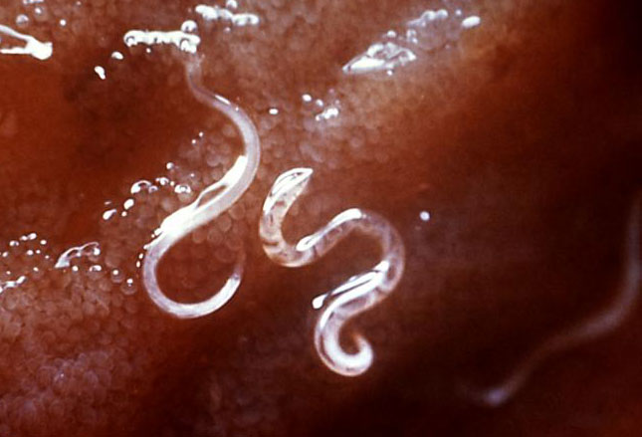
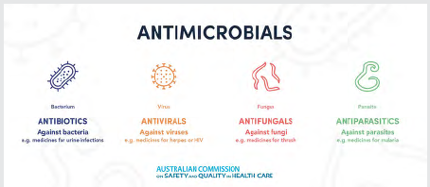

Microorganisms
Bacteria
Viruses
Fungi
Parasites
Word | Definition
Antibiotic | Drug that kills or inhibits growth of bacteria
Antimicrobial | Drugs that kill or inhibit growth of microorganisms (bacteria, fungi, parasites or viruses)
Antimicrobial Resistance | When a micro-organism has altered genetically so that a drugs doesn't kill it or stop it growing
Superbug | A micro-organism (usually a bacteria) that is resistant to most drugs (antibiotics)

Slide 5
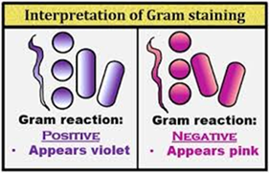
Examples of some
Microorganisms of concern
Bacteria
Viruses
Fungi
Parasites
Gram positives:
MRSA (‘Resistant golden Staph.”)
VRE Vancomycin Resistant Enterococci
Strep. pneumoniae
Enterobacteriacae (Gram negative rods)
E. Coli
Klebsiella pneumoniae
Enterobacter cloacae
Shigella spp
Ps. aeruginosa
Mycobacteria
M. tuberculosis (TB)
HIV
Influenza
Candida auris
Falciparum malariae
Beta-lactams (e.g. penicillins) are the antibotics are the preferred treatment.
Resistance often occurs through “β-lactamases”
Extended-spectrum β-lactamases (ESBLs)
Plasmid-borne AmpC enzymes (pAmpCs) and
Carbapenemases (CPE)

Slide 6
Surveillance for infections and disease
GP visit
ICU
Hospital
Symptomatic
Infected
Exposed
General population
Death
Clear definitions
Clear denominator(s)
Causal association

Slide 7
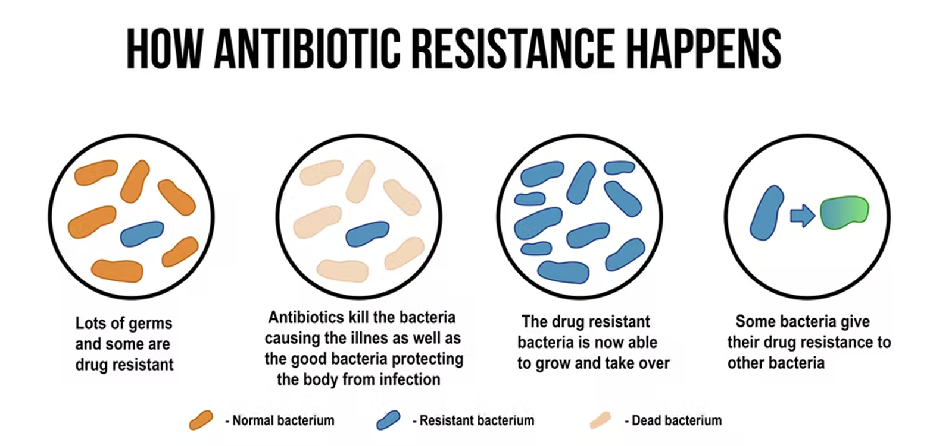
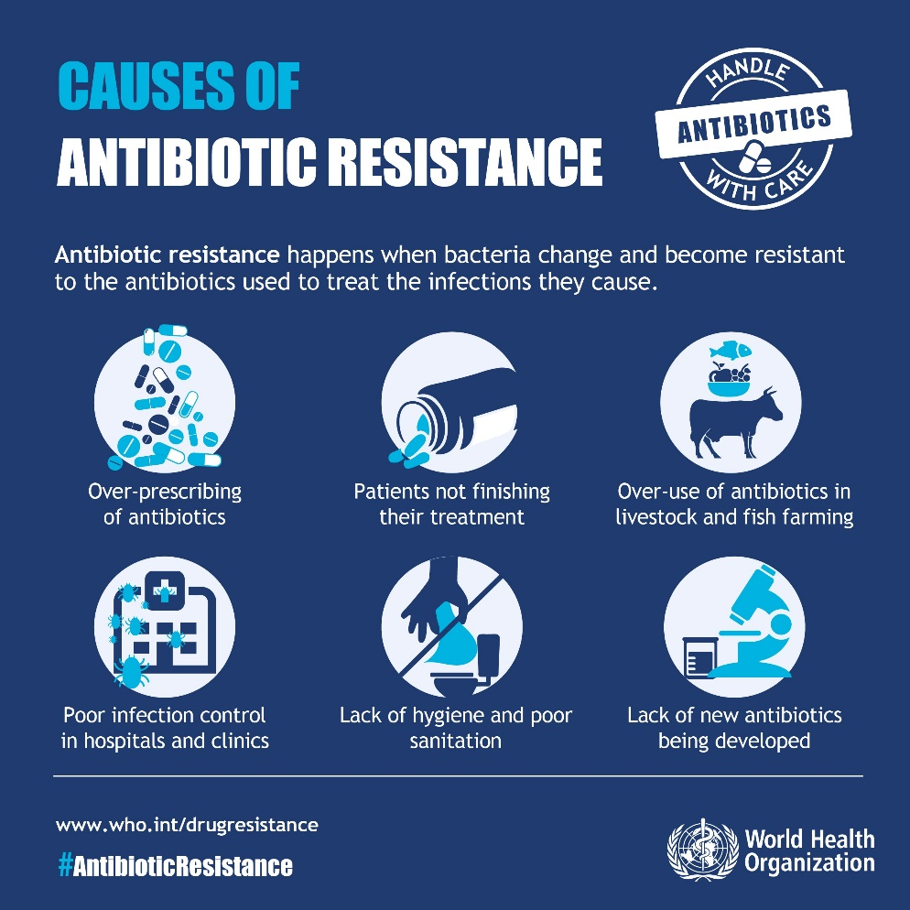
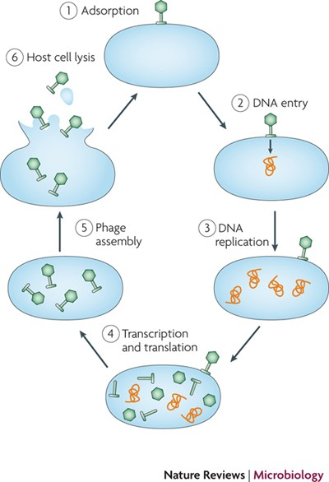
Mechanism of Antimicrobial Resistance (AMR) and its drivers

Slide 8






Sources of AMR
AMR occurs not only in hospitals, but also in aged care facilities and in the community
Transmission between them is poorly defined
Community
general practice
Residential aged care
Hospitals
Imported
Environment:
Crops water
Animals
Slide courtesy of Prof K Thursky

Slide 9
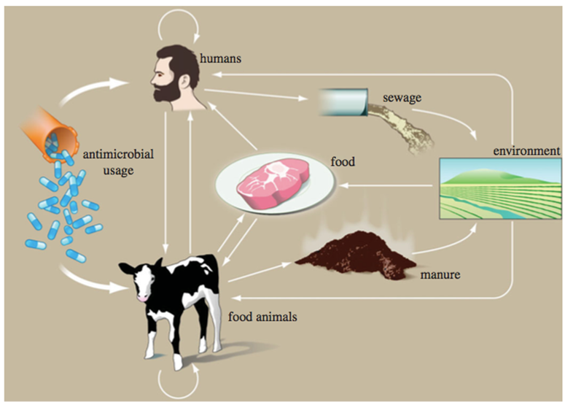
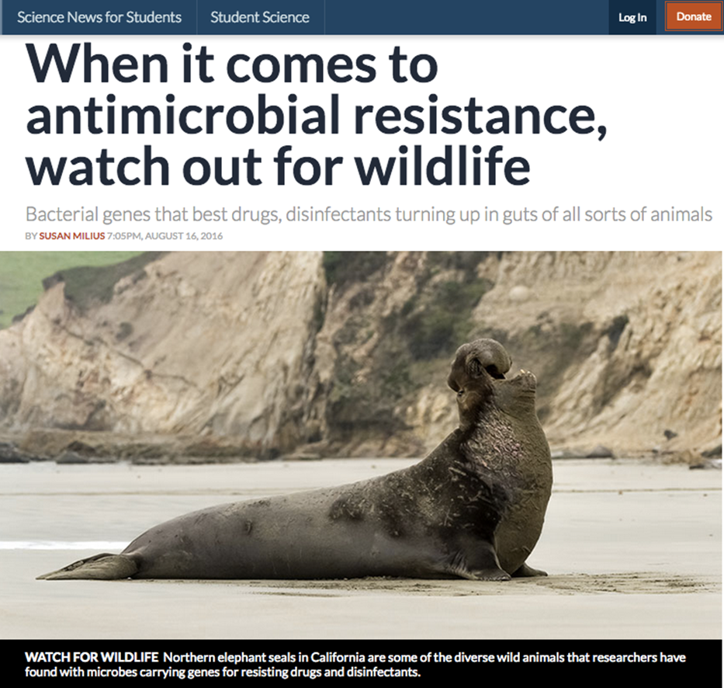
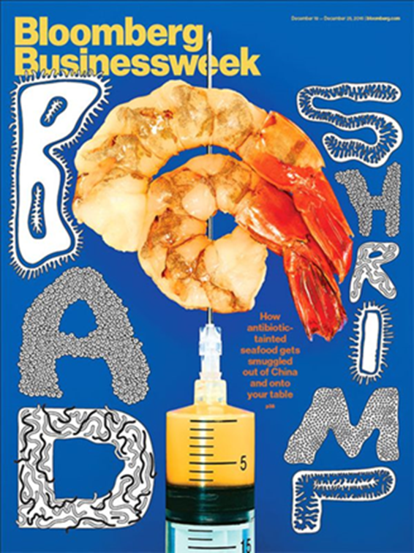
AMR is an Ecosystem Problem
Staph. aureus CC398 core genome discrete-trait mapping by host. Branches are coloured according to inferred ancestral host (human or livestock)
Woolhouse et al Phil Trans R Soc B 2015
Notes:
Interconnected ecosystem approach – tree provides evidence of animal-human transfer, more common than vice versa but at present we have very little animal data from which to derive these associations

Slide 10
Sources of AMR
International travel
Notes:
Human population mobility further promotes resistance – visiting friends and family, eating street food, medical tourism additional sources for resistant strains to be imported to Australia

Slide 11
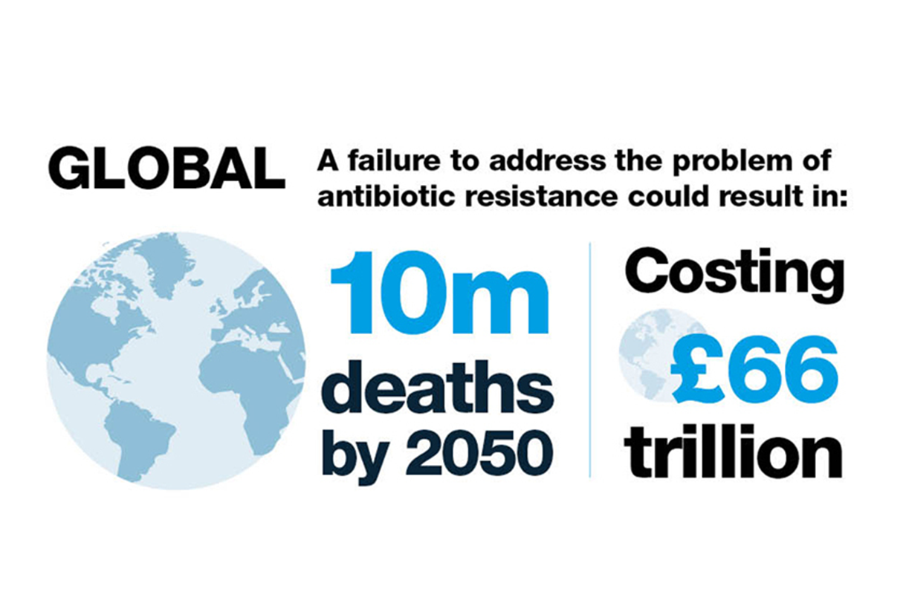
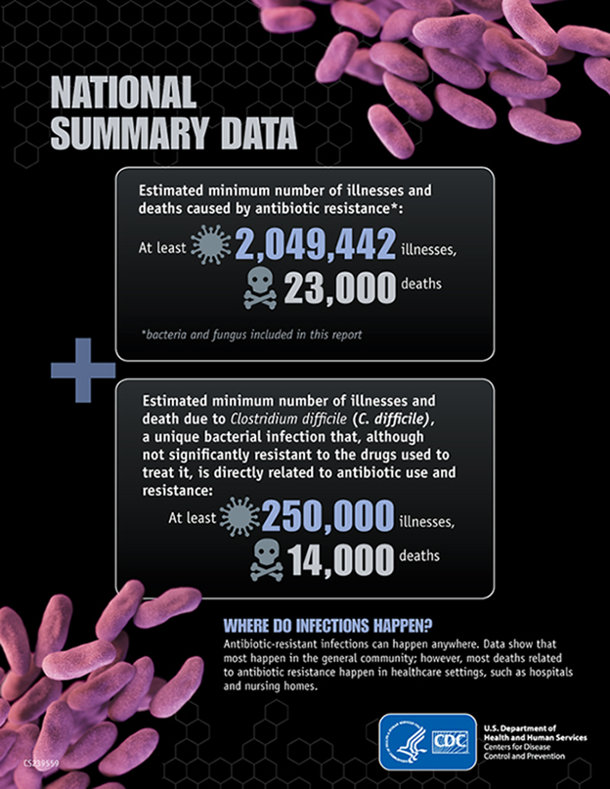
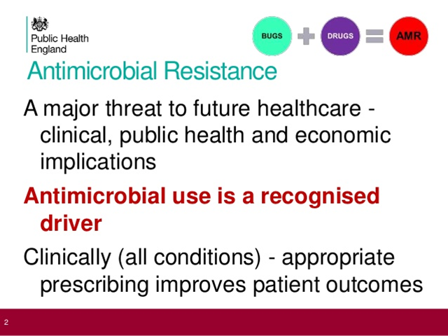
What is AMR important?- Cost and patient outcomes

Slide 12
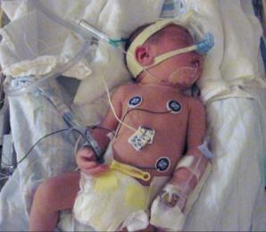
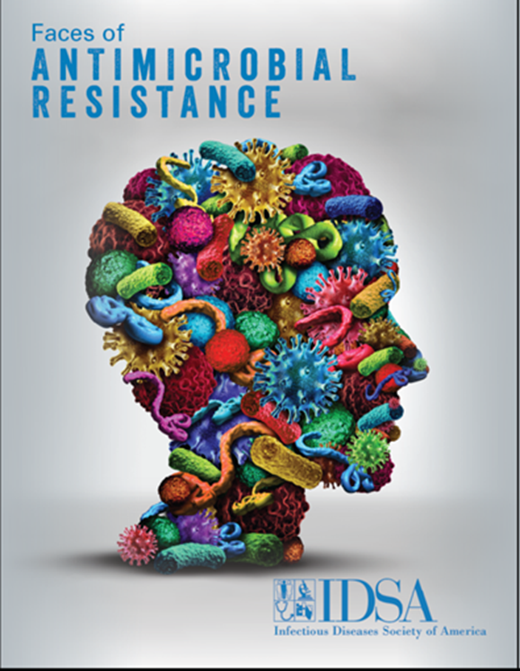
Current healthcare depends on antibiotics
Safe surgery
Safe obstetric care
Intensive care
Transplantation
Chemotherapy for malignancy
Immunosuppression
Neonatal care
Notes:
12
Advances in modern medicines such as transplantation, neonatal care, cancer treatments, safe surgery and obstetric care and ICU interventions all rely on effective antibiotics to control infection. Without antibiotics these therapies will be endangered and our most vulnerable patients put at risk.

Slide 13
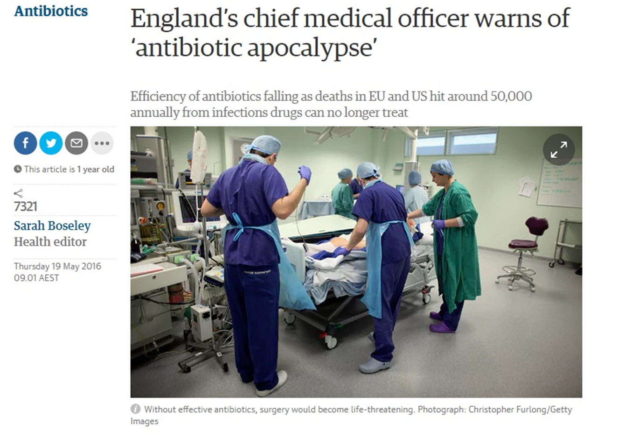
Resistant organisms
Not well treated by empiric regimens*
Effective drugs may be more toxic
Treatment may be prolonged, with more complications and higher costs
Mortality may be higher overall
*Depending on organism/condition

Slide 14
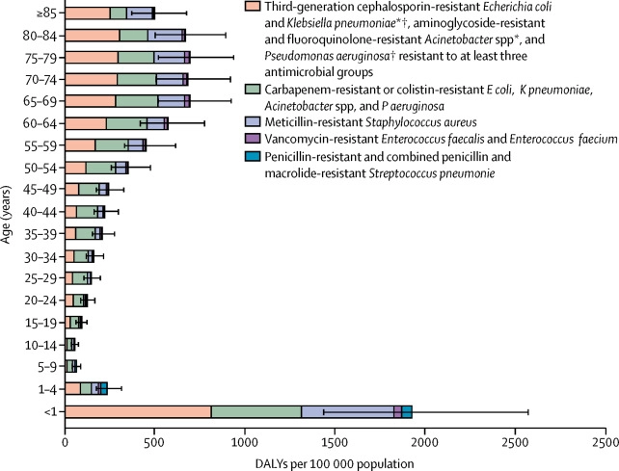

Burden of infections with antibiotic-resistant bacteria in DALYs, EU by age group 2015
Figure 3
DALYs=
Disability
Adjusted
Life
Years
The Lancet Infectious Diseases 2019 1956-66DOI: (10.1016/S1473-3099(18)30605-4)
Notes:
Burden of infections with antibiotic-resistant bacteria in DALYs, EU and European Economic Area, 2015
Error bars are 95% uncertainty intervals. Greece did not report data on S pneumoniae isolates to the European Antimicrobial Resistance Surveillance Network in 2015. DALY rates are age-standardised to limit the effect of demographic differences across countries; numbers of cases and deaths are not age-standardised. DALYs=disability-adjusted life-years. *Excludes those resistant to carbapenem or colistin. †In 2015, most of the third-generation cephalosporin-resistant E coli (88·6%) and K pneumoniae (85·3%) isolates reported to the European Antimicrobial Resistance Surveillance Network produced an extended-spectrum β-lactamase.⁹

Slide 15
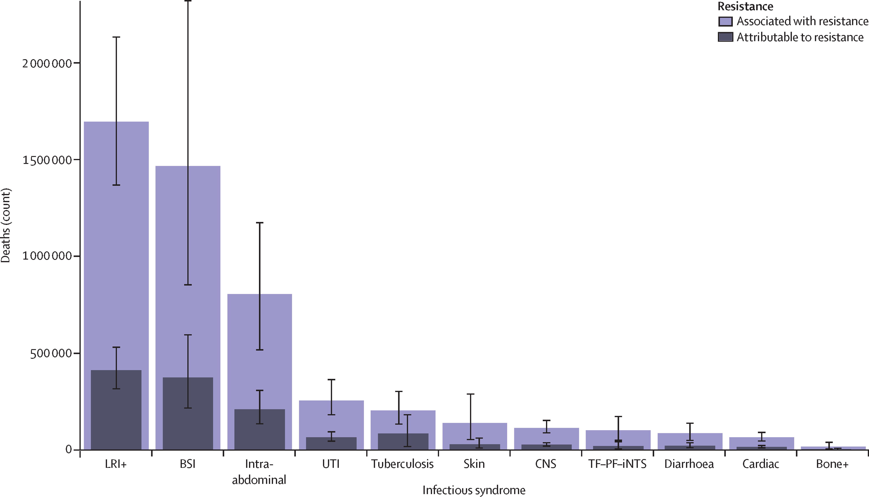
Global deaths (counts) attributable to and associated with bacterial antimicrobial resistance by infectious syndrome, 2019
Figure 3
LRI= lower respiratory tract infection
BSI= blood stream infection
UTI= urinary tract infection
CNS= meningitis
The Lancet 2022 399629-655DOI: (10.1016/S0140-6736(21)02724-0)
Copyright © 2022 The Author(s). Published by Elsevier Ltd. This is an Open Access article under the CC BY 4.0 license Terms and Conditions
Notes:
Global deaths (counts) attributable to and associated with bacterial antimicrobial resistance by infectious syndrome, 2019
Estimates were aggregated across drugs, accounting for the co-occurrence of resistance to multiple drugs. Error bars show 95% uncertainty intervals. Does not include gonorrhoea and chlamydia because we did not estimate the fatal burden of this infectious syndrome. Bone+=infections of bones, joints, and related organs. BSI=bloodstream infections. Cardiac=endocarditis and other cardiac infections. CNS=meningitis and other bacterial CNS infections. Intra-abdominal=peritoneal and intra-abdominal infections. LRI+=lower respiratory infections and all related infections in the thorax. Skin=bacterial infections of the skin and subcutaneous systems. TF–PF–iNTS= typhoid fever, paratyphoid fever, and invasive non-typhoidal Salmonella spp. UTI=urinary tract infections and pyelonephritis.

Slide 16
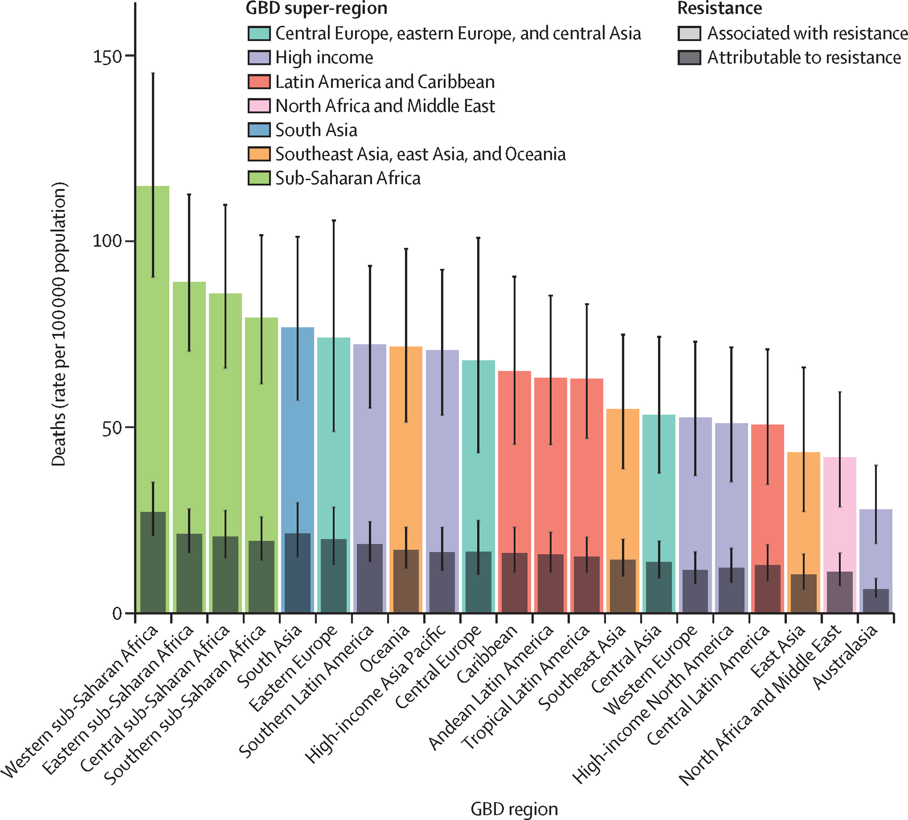
All-age rate of deaths attributable to and associated with bacterial antimicrobial resistance by Global Burden of Disease region, 2019
Figure 2
The Lancet 2022 399629-655DOI: (10.1016/S0140-6736(21)02724-0)
Copyright © 2022 The Author(s). Published by Elsevier Ltd. This is an Open Access article under the CC BY 4.0 license
Notes:
All-age rate of deaths attributable to and associated with bacterial antimicrobial resistance by GBD region, 2019
Estimates were aggregated across drugs, accounting for the co-occurrence of resistance to multiple drugs. Error bars show 95% uncertainty intervals. GBD=Global Burden of Diseases, Injuries, and Risk Factors Study.

Slide 17

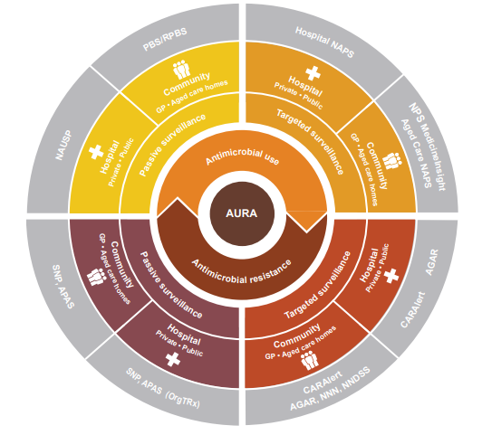
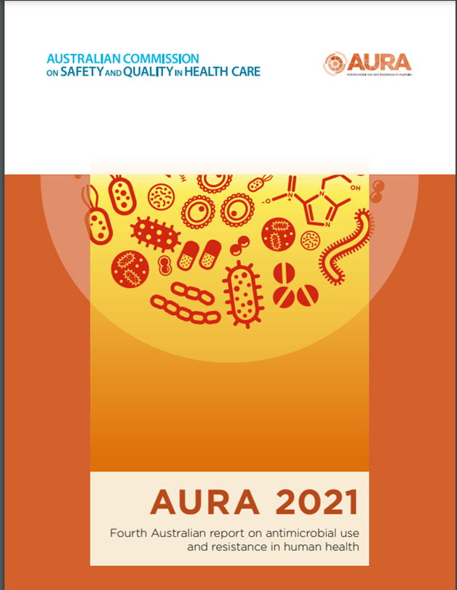
Antimicrobial ‘use’ and
‘appropriateness’
Antimicrobial Resistance-
Priority organisms

Slide 18
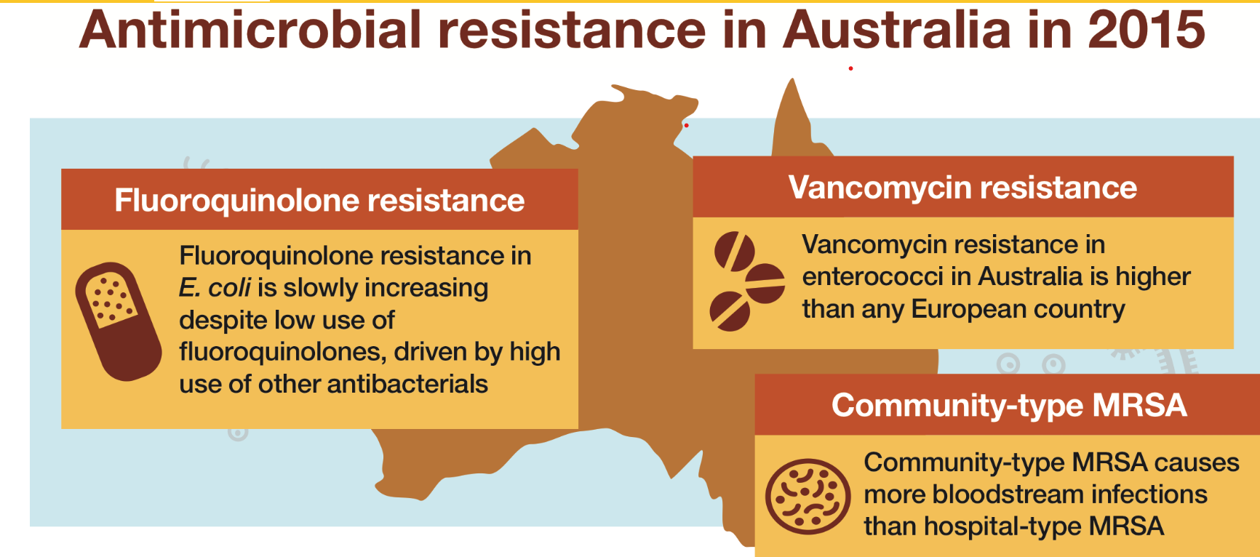

Slide 19
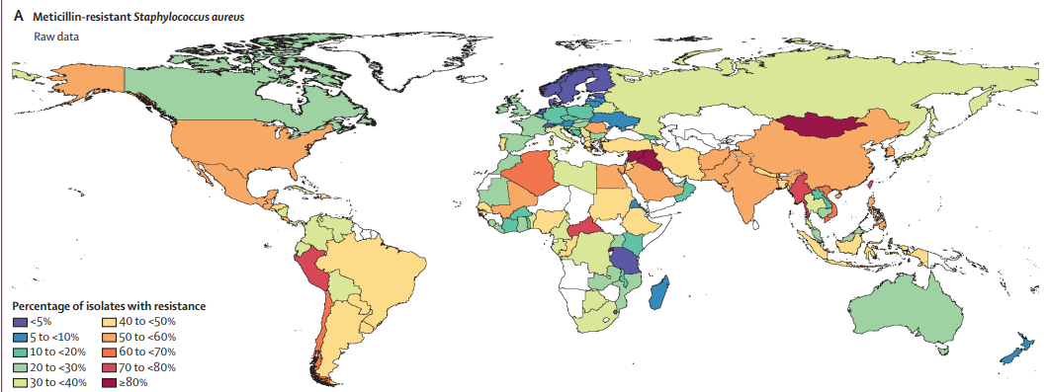
Antimicrobial resistance in Australia
MRSA Staphylococcus aureus (Golden Staph)
In Australia, between 10.7% and 30.8% of isolates are methicillin-resistant S. aureus (MRSA), depending on the setting.
Australia ranks in the top half of countries for MRSA rates
Community strains of MRSA rather than hospital acquired infections now cause a significant proportion of infections in both the community and hospitals.
Overall mortality with S. aureus bacteraemia in Australia was 16% in 2015 and higher overall in MRSA
The Lancet 2022 399629-655DOI: (10.1016/S0140-6736(21)02724-0)
Notes:
In Europe, the EU/EEA population-weighted
mean percentage has significantly decreased
from 23.2% in 2009 to 15.5% in 2019. A decrease
in methicillin-resistant SAB has been reported
in several parts of the world,19,20 and is believed
to be due to the implementation of antimicrobial stewardship and a package of improved
infection control procedures including hand
hygiene, MRSA screening and decolonisation,
patient isolation and infection prevention care
bundles.21–25The percentage of methicillinresistant SAB in Australia, however, has notdecreased significantly over the eight years of
ASSOP, ranging from 18.3% in 2013 to 17.6%
in 2020 (p = 0.06).
A total of 2,734 SAB episodes were reported, of which 79.7% were community-onset. Of S. aureus isolates, 17.6% were methicillin resistant. The 30-day all-cause mortality associated with methicillin-resistant SAB was 14.2%,
which was not significantly different from the 13.3% mortality associated with methicillin-susceptible SAB (p = 0.6). With the exception of the β-lactams and erythromycin, antimicrobial resistance
in methicillin-susceptible S. aureus was rare.
Australian Staphylococcus aureus Surveillance Outcome Programme (ASSOP) Blood Stream Infection annual reports prepared by the Australian Group on Antimicrobial Resistance

Slide 20
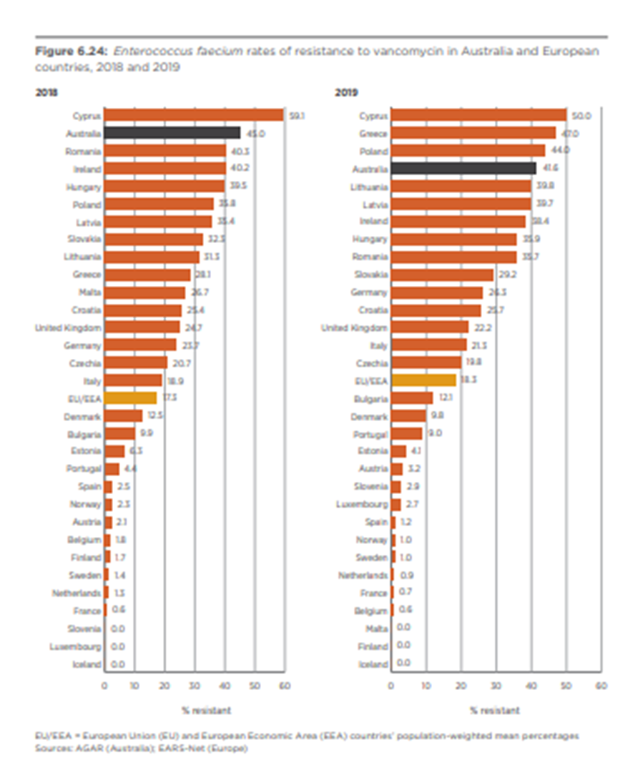
Antimicrobial resistance in Australia
Vancomycin Resistant Enterococci (VRE)
Enterococci are mainly opportunistic pathogens that are naturally resistant to common antibiotics
Ampicillin resistance has emerged worldwide during the past 20 years, including in Australia, increasing the use of vancomycin for treatment
Australia now has very high rates of vancomycin-resistant E. faecium (VRE), higher than most European countries in 2018 and 2019

Slide 21
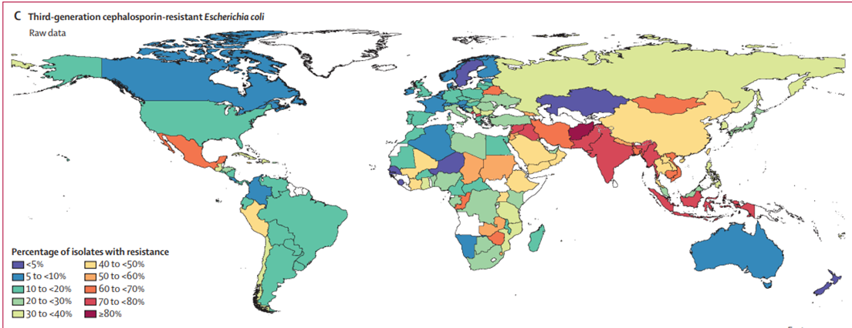
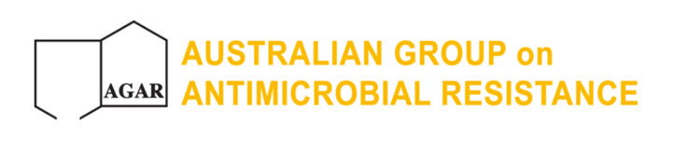
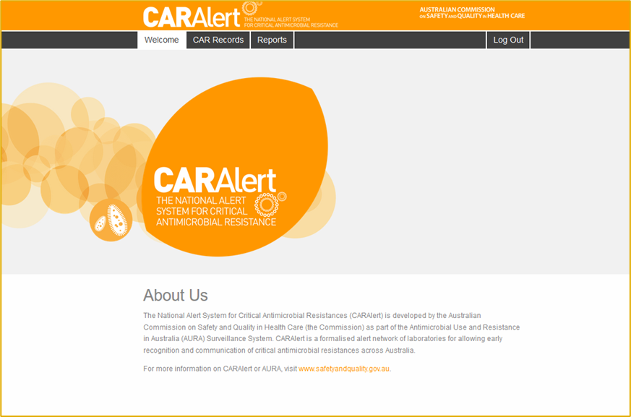
Antimicrobial resistance in Australia
Enterobacteriaceae
The Gram negative bacteria (E. coli, Klebsiella pneumoniae, Enterobacter cloacae) can be normal flora in our gastrointestinal tract, but may cause urinary tract infections, and blood stream, and intravascular device infections in hospitals
2021 83% bloodstream specimens, were CPE (CAR Alert)
Therapy difficult. Higher mortality
Notes:
The most common and clinically significant resistance mechanisms for Enterobacteriaceae are β-lactamases.
There are many types and some are intrinsic, but many are acquired on mobile genetic elements, able to persist and spread to other organisms.
Increasing over time in all settings
In 2015 ESBL phenotype in 6–12% of E. coli and 5–7% of K. pneumoniae.
Also increased risk of resistance to other drugs (gentamicin, ciprofloxacin)

Slide 22
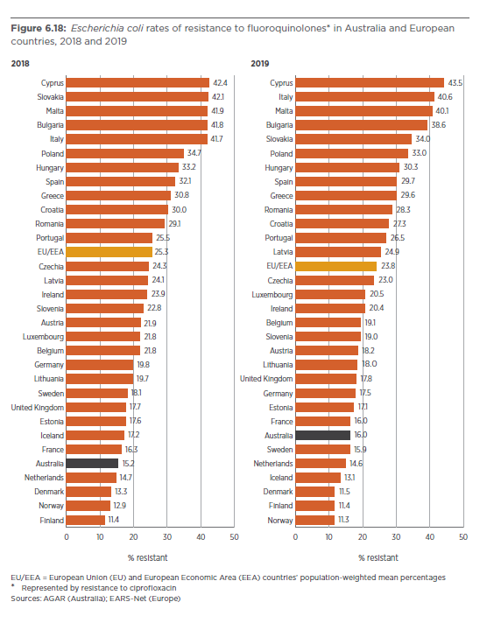
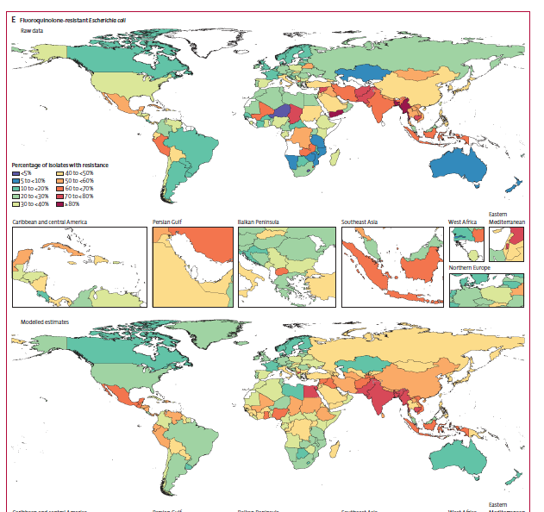
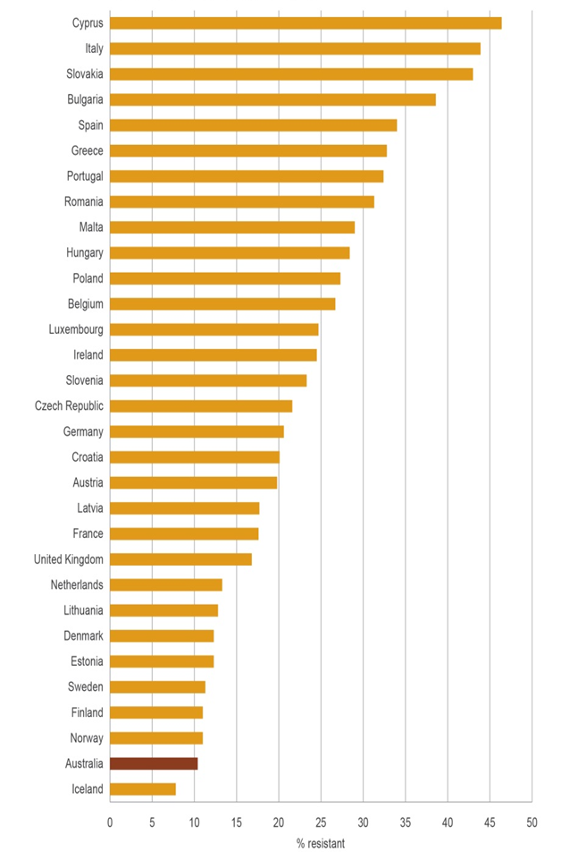
AMR in Australia
Fluoroquinolone resistant E. coli increased in Australia from 2014 to 2020/2021
Ciprofloxacin non-susceptibility was found in 11% isolates in 2014 and 16.6% of E. coli isolates, 2018/19
2014 2018 2019
The Lancet 2022 399629-655DOI: (10.1016/S0140-6736(21)02724-0)
Source: AURA 2016 and 2021 reports

Slide 23

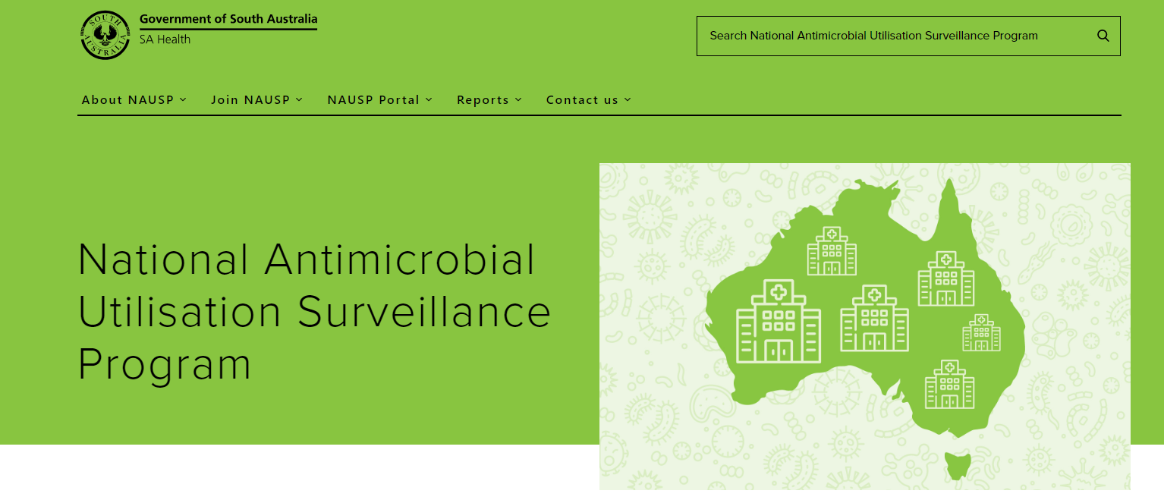
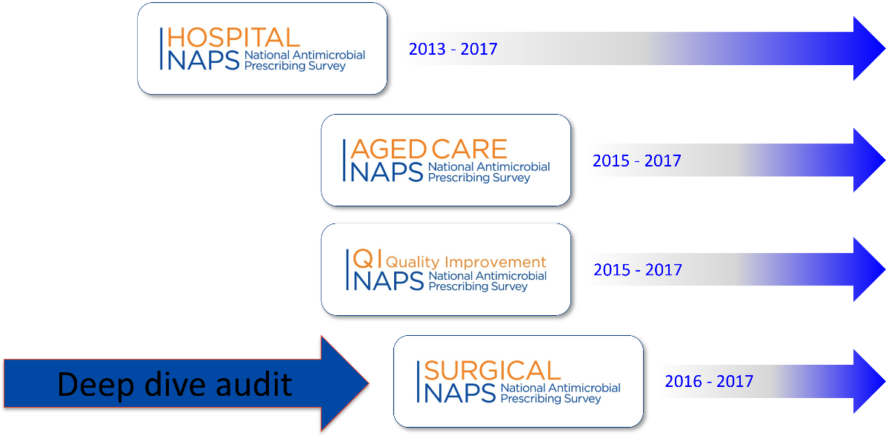



Antimicrobial use and appropriateness in Australia
National Antimicrobial Utilisation Surveillance Program (NAUSP)
conducted by SA Health
National Antimicrobial Prescribing Survey (NAPS)
conducted by the National Centre for Antimicrobial Stewardship (NCAS)
Also:

Slide 24
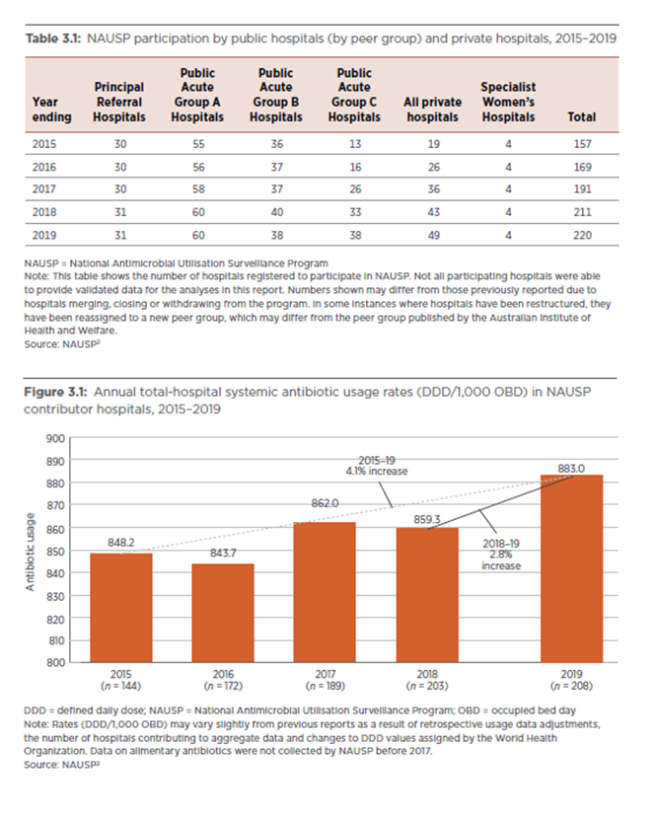
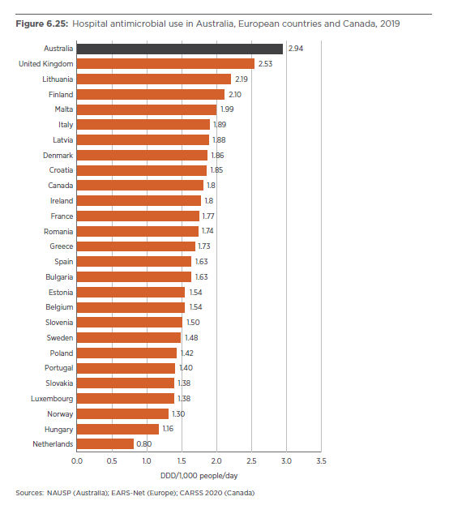
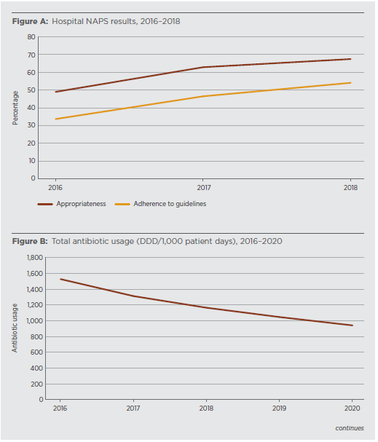
Volume of Use in hospitals NAUSP and NAPS
Source: AURA 2021 report

Slide 25
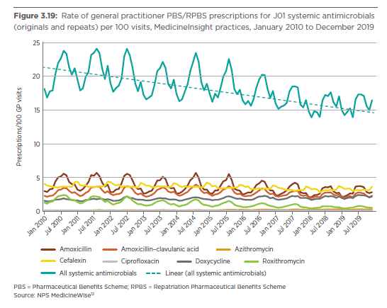
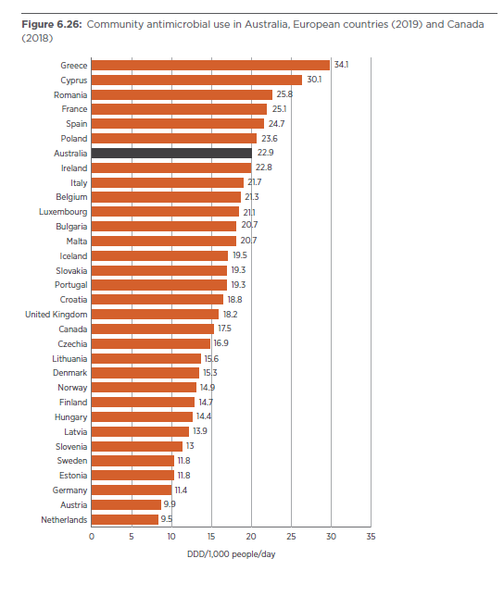
Volume of use community
Source: AURA 2021 report

Slide 26
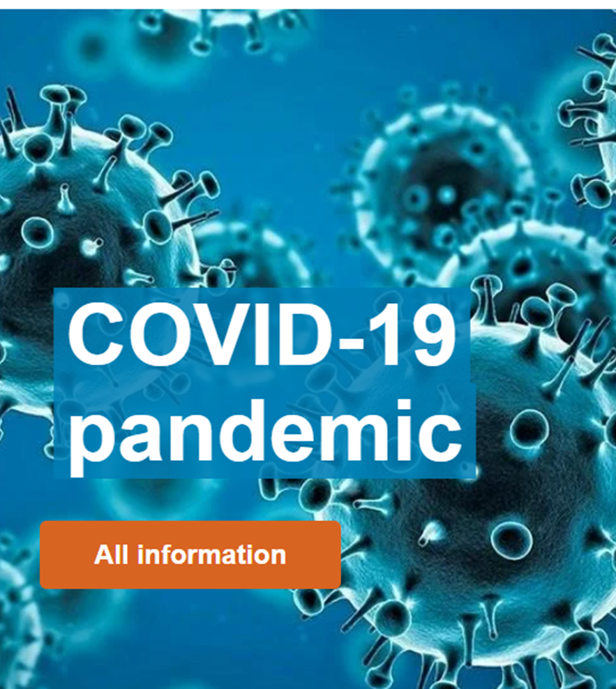
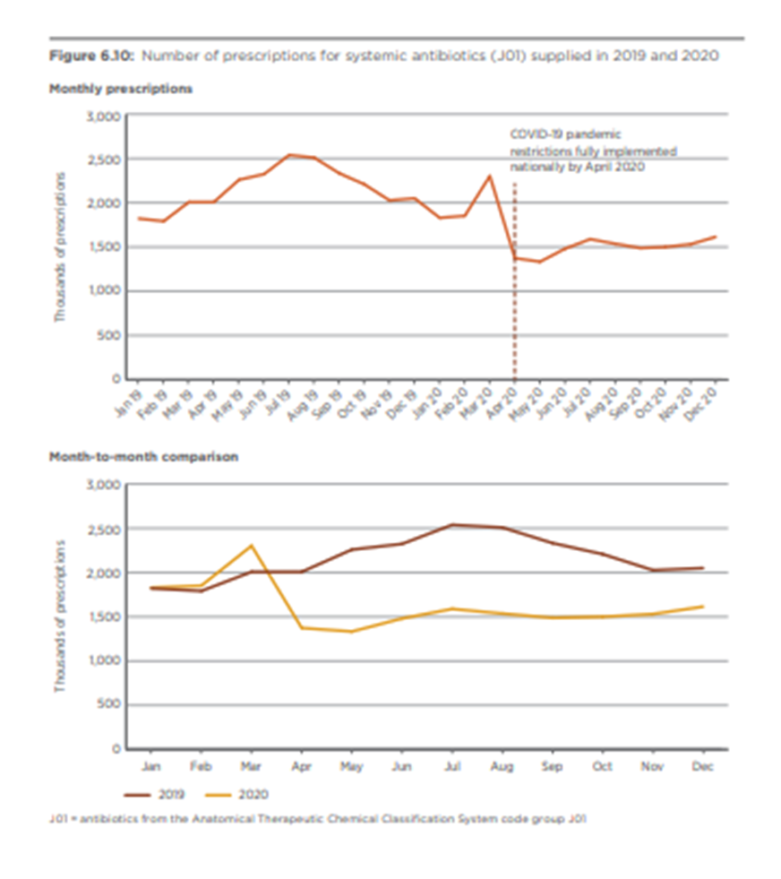
Source: AURA 2021 report
Notes:
The impact of COVID-19 on antimicrobial resistance remains unclear and may be influenced by a number of contributing factors. A combination of COVID-19 related travel restrictions on incoming travellers throughout much of 2020 and 2021, and an increasing awareness of and utilization of antimicrobial stewardship as part of the National Safety and Quality Health Service Standards 313 implementation and accreditation Australia-wide, may have reduced some resistance particularly for ESBLs.
Pharmaceutical Benefits Scheme data indicate that the COVID-19 pandemic had a profound impact on antimicrobial use in 2020, with a 40% drop in antimicrobials dispensed between March and April in 2020, with use remaining at this lower level for the rest of the year.14
It is also possible that a reduction in elective surgery and, related to this, post-surgical blood stream infections may have occurred during 2020 and 2021.
Future AGAR surveys will help determine if the observed reduction in resistance rates is sustained.

Slide 27
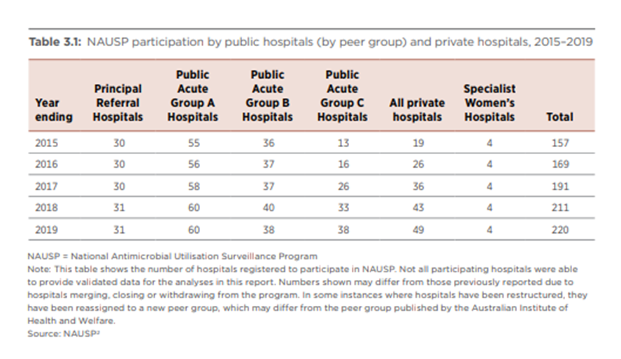
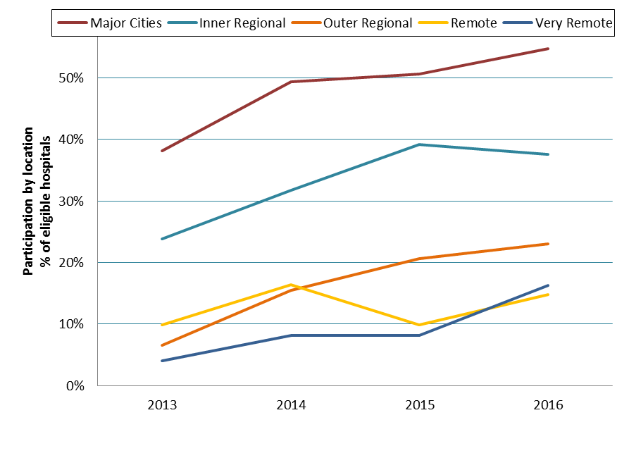
Metropolitan vs Rural /Regional hospitals
Private hospitals Private laboratories
44% of hospitals are in private sector
Implications for data collection and sharing, regulation, reporting
Private laboratory ownership
implications for testing
A. AURA 2016 report B. AURA 2021 report)

Slide 28
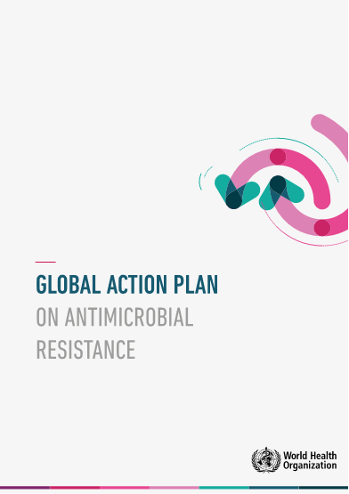
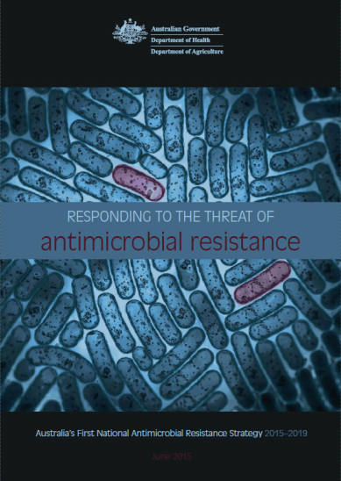
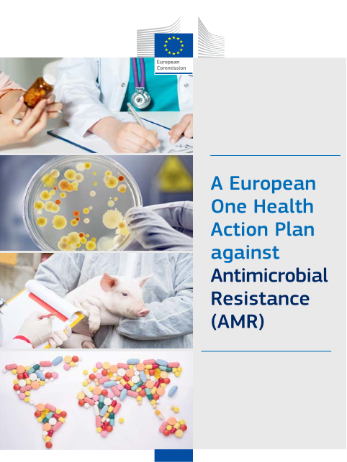
Response to AMR Strategies
Objectives
1. Increase awareness and understanding of antimicrobial resistance, its implications, and actions to combat it through effective communication, education and training.
2. Implement effective antimicrobial stewardship practices across human health and animal care settings to ensure the appropriate and judicious prescribing, dispensing and administering of antimicrobials.
3. Develop nationally coordinated One Health surveillance of antimicrobial resistance and antimicrobial usage.
4. Improve infection prevention and control measures across human health and animal care settings to help prevent infections and the spread of antimicrobial resistance.
5. Agree a national research agenda and promote investment in the discovery and development of new products and approaches to prevent, detect and contain antimicrobial resistance.
6. Strengthen international partnerships and collaboration on regional and global efforts to respond to antimicrobial resistance.
7. Establish and support clear governance arrangements at the local, jurisdictional, national and international levels to ensure leadership, engagement and accountability for actions to combat antimicrobial resistance.

Slide 29
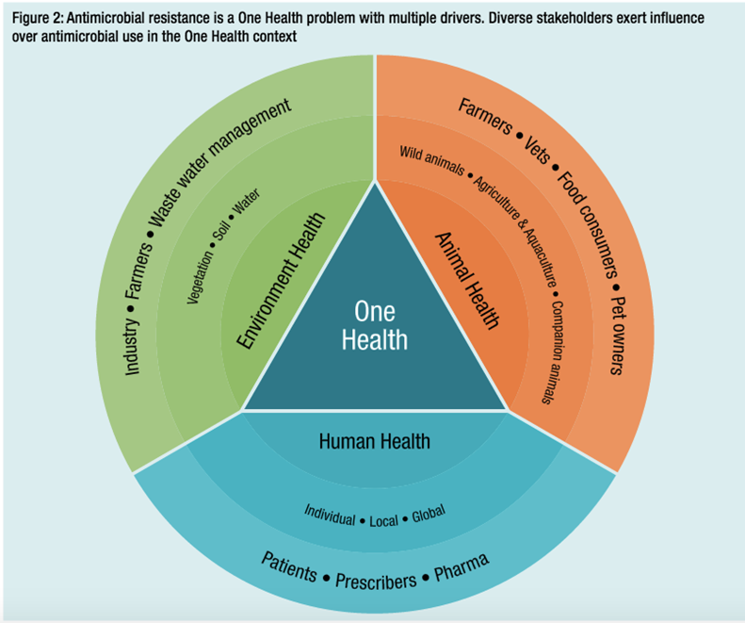
Intervention Strategies to tackle AMR
Prevent Infection and Spread (Control) of AMR; globally coordinated surveillance (One health)
Prevent infections through Vaccines
Improve use /avoid misuse of antimicrobials- Antimicrobial Stewardship; Improve use in Animals and farming
Research and Innovation,New Drugs, New Vaccines, New Diagnostic tests

Slide 30





Better data linkages to help improve antimicrobial prescribing and use
Antimicrobial Use in Hospitals
NAPS, SNAPS, NAUSP
Imported AMR
Antimicrobial Use in the Community
PBS, NPS Medicines Insight
HAI Surveillance
Hand Hygiene
Patient outcomes from hospital admissions databases
AMR Surveillance
AGAR
OrgTrx
Bureau of Statistics
Medicare data
Complex relationships
How to measure impact?
Antimicrobial use and
AMR Surveillance in animals
Antimicrobial/AMR residues in crops, water
Slide -Prof Karin Thursky

Slide 31



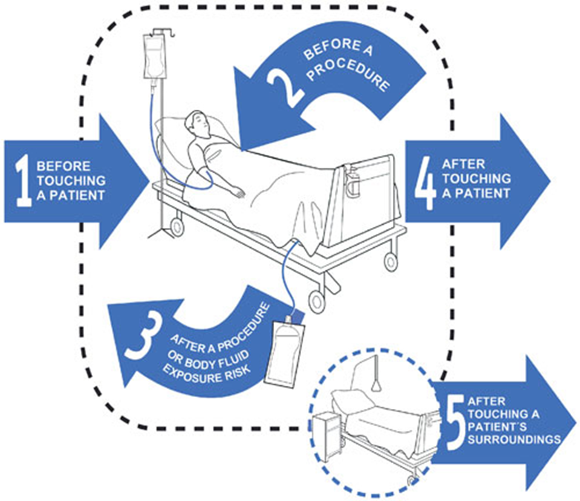



Infection prevention and control of AMR
hospital-based programs focused on preventing health-care acquired infections,
  5 points moments for hand hygiene
  Built environment
community-based programs focused on water, sanitation, and hygiene, particularly LMICs
Notes:
Built environment
Health care Staffing
Bed occupancy should not exceed capacity
These
only one of the six leading pathogens
(S pneumoniae), although new vaccine programmes are
underway for S aureus, E coli, and others.45 Vaccination
programmes are an important strategy for preventing
S pneumoniae,46 and vaccine development is crucial for
pathogens that currently have no vaccine. Other vaccines,
such as the influenza or rotavirus vaccines, also play a
role in preventing febrile illness, which can lead to a

Slide 32



Antimicrobial stewardship (AMS)
AMS = A collection of interventions aiming to optimise antimicrobial therapy to improve patient outcomes, while limiting impact on ecology (emergence of resistance), effects of drug toxicity, and cost
Stewardship = Guiding judicious use of a precious resource
Evidence from systematic reviews that
AMS improves prescribing behaviours, reduce unnecessary antibiotic use, improve concordance with guideline, reduce durations of use
reduced antibiotic use does not increase mortality
these improvements reduce length of stay - cost saving
Schuts, Lancet Inf Dis 2016 Mar 2
Davey Cochrane Library 2017
Slide courtesy of Prof K Thursky
Notes:
Adherence to prescribing guidelines
Reduced mortality RRR 35% p<0.001
Restriction of access to broad spectrum antibiotics
Reduces antibiotic consumption, and (sometimes) reduces resistance
Culture driven de-escalation
Reduces mortality RRR 56%p<0.001
Staph aureus bacteraemia ID expert review
Reduces mortality RRR 66%p<0.001
IV to oral switch strategies
Shorter length of stay, no difference in mortality
Use of therapeutic drug monitoring
Reduces nephrotoxicity

Slide 33




Slide 34
Concluding remarks
AMR is one of the biggest threats to public health worldwide
  Globally approximately almost 5 million deaths each year associated with bacterial AMR in 2019
  increasing risk to patient safety because it reduces the number of antimicrobials available to treat infections.
  increased death and disability associated with infections from multidrug-resistant organisms.
  AMR may limit future capacity to perform medical procedures such as organ transplantation, cancer chemotherapy, diabetes management and major surgery, because of a lack of effective antimicrobials
Australia is not immune:
  Patients from endemic countries admitted to hospitals here
  Colonisation of travellers returning from high prevalence areas
  Multi-facility outbreaks of “CPE”
  Highest rates worldwide of hospitalised patients receiving an antibiotic
  25-50% of use is inappropriate
AMR requires global public health action
  Stewardship, enhanced hygiene, mass media, rapid diagnostic tests, new drugs and vaccines
Cross-jurisdictional capacity required to coordinate and manage national AMR control
AMR is everyone’s problem

Slide 35

Acknowledgements
Prof Karin Thursky, NCAS
Prof Kirsty Buising, NCAS
Dr Brendan McMullan UNSW, SCHN Randwick
Prof Jodie Vernon, Doherty Institute, Uni of Melbourne
Prof Jon Iredell, Westmead Institute for Medical Research
Phage Australia, Uni of Sydney
A Prof Tom Gottleib, Uni of Sydney, Sydney Local Health District
AGAR
Australian Safety and Quality Health Commission
Contributors to AURA 2021 report
  https://www.safetyandquality.gov.au/our-work/antimicrobial-resistance/antimicrobial-use-and-resistance-australia-surveillance-system/aura-2021

