Slide 1
Extracting innovation from digital gridlock: How copyright law is stifling innovation, what it’s costing and how to fix it
Nicholas Gruen, Sept 2012

Slide 2
Outline
Limitations and exceptions to copyright
Content industries and exceptions industries
Legal obsolescence: Copyright in the digital age
Specific ‘fair dealing’ exceptions v flexible exceptions
The benefits of flexible exceptions and safe harbours
  Risks to intermediaries
  Productivity impacts

Slide 3
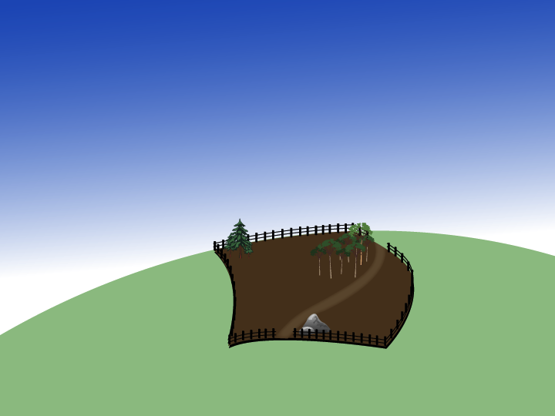
Airspace rights
Resumption (for compensation)
Re-zoning (without compensation)
Boundary defines what you own
Requirements to address weeds, native
vegetation, building regulations etc
Easement
Mineral rights

Slide 4
Attorney General’s Department, May 2005
Giving owners an absolute right to control all uses by other persons would be economically inefficient and, importantly, frustrate the policy objectives copyright is intended to achieve.

Slide 5
Exceptions delineate IP
Exceptions do not permit, or assist piracy
They define IP rights and how they fit in the information eco system
They answer questions like
  How much can I quote without permission?
  Can I change my (legitimate) CD into mp3 format? Can I record a free-to-air show and watch it later?
  When does an internet intermediary need permission to handle digital material.

Slide 6
The limitations and exceptions industries
$182 Bil, 14% GDP
2,363,000 employed
Source: ABS/Lateral Economics
$93 Bil, 6.6% GDP
908,000 employed
Source: ABS/PwC

Slide 7
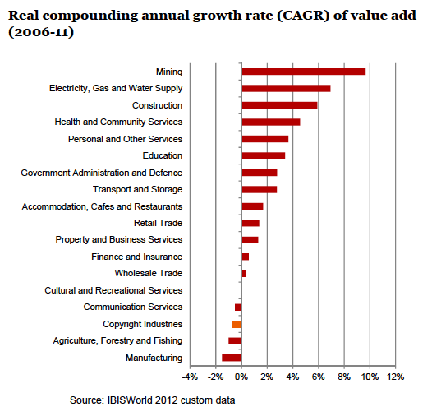

Slide 8
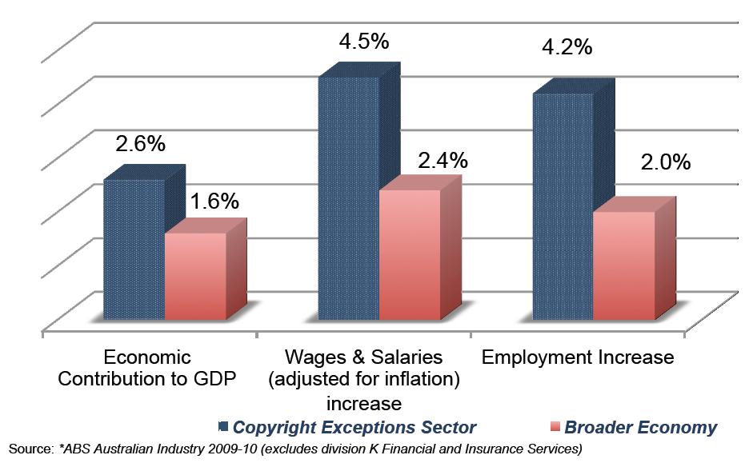
Exceptions and limitations industries 2007-10

Slide 9
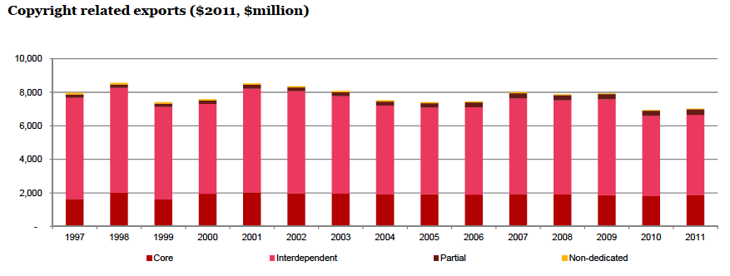
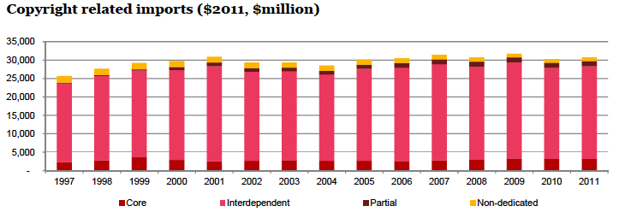
Trade performance: Content Industries
Imports $30.8 Bil
Exports $7 Bil

Slide 10
Trade performance: Exceptions Industries
Imports $15.6 Bil
Exports $26.6 Bil

Slide 11
The copy – right in the analogue world
Domain of
analogue
copyright
Creator
Publisher
Printer
Distributor
Customer
Customer
Distributor
Customer
Customer
Customer
Customer
Distributor
Copies
made
No copies
made
No copies made

Slide 12
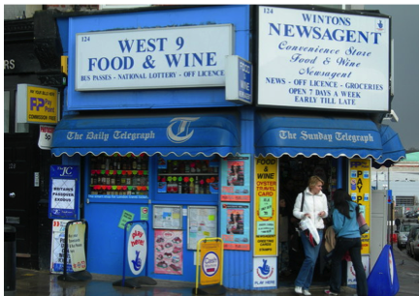
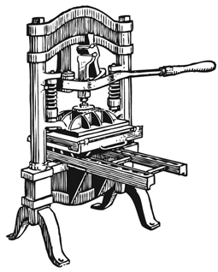
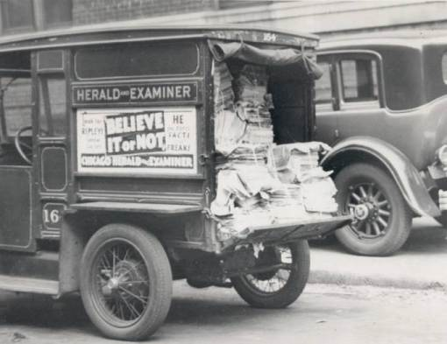
The analogue copy – right
CHUCKMAN'S PHOTOS ON WORDPRESS

Slide 13
The copy – right in the digital world
Domain of
digital
copyright
Creator
Publisher
Printer
Search Engine
Customer
Customer
ISP
Customer
Customer
Customer
Customer
Telco
Infrastructure provider
Copies
made
Copies made

Slide 14
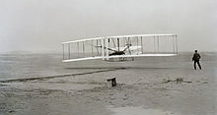
Legal obsolescence

Slide 15
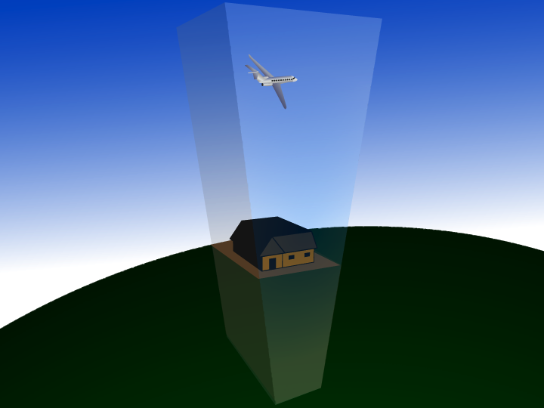
Cuius est solum, eius est usque ad caelum et ad inferos:
For whomever owns the soil, it is theirs up to Heaven and down to Hell.

Slide 16
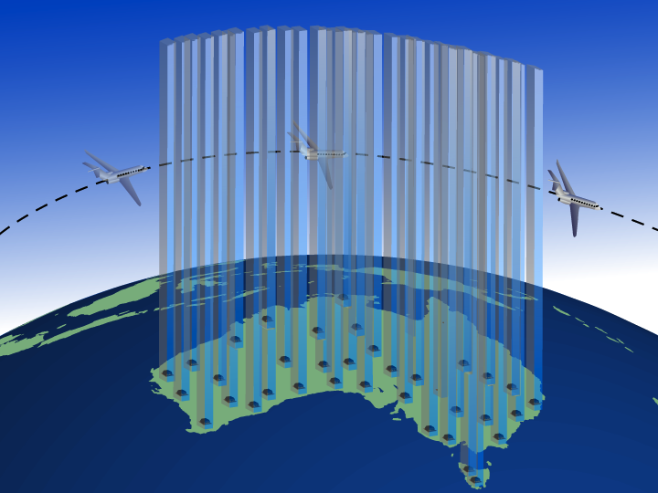
Cuius est solum, eius est usque ad caelum et ad inferos:
For whomever owns the soil, it is theirs up to Heaven and down to Hell.

Slide 17
Copyright red tape
Simply looking at Australian intermediaries and content publishers, if all 1,000 intermediaries sought individual licenses from all 3.8 million potential content publishers, there would be 3.8 billion transactions.
Transaction costs > $900 bil p.a in Australia alone.
If all the internet intermediaries required explicit licences from all potential rights holders globally
Transaction costs = $ Trillions.
i.e. > Australia’s GDP

Slide 18
Fair dealing v flexible exceptions

Slide 19
Specifically defined exceptions
Time shifting was infringement till 2006 (s111)
Audio – without DRM – can be format shifted (s109A)
  But not if it’s downloaded (however legitimately)
Video tape can be format shifted (S 110AA)
  But not other forms of video like files
Print (but only a book, magazine or periodical) can be reformatted as digital, but not a digital original (s43C)
A library can copy a work if it’s been lost or stolen (S51(A)(c))

Slide 20
S49 Reproducing and communicating works by libraries and archives for users
(1) A person may furnish to the officer in charge of a library or archives:
(a) a request in writing to be supplied with a reproduction of an article, or a part of an article, contained in a periodical publication or of the whole or a part of a published work other than an article contained in a periodical publication, being a periodical publication or a published work held in the collection of a library or archives; and
(b) a declaration signed by him or her stating:
(i) that he or she requires the reproduction for the purpose of research or study and will not use it for any other purpose; and
(ii) that he or she has not previously been supplied with a reproduction of the same article or other work, or the same part of the article or other work, as the case may be, by an authorized officer of the library or archives.
(2) Subject to this section, where a request and declaration referred to in subsection (1) are furnished to the officer in charge of a library or archives, an authorized officer of the library or archives may, unless the declaration contains a statement that to his or her knowledge is untrue in a material particular, make, or cause to be made, the reproduction to which the request relates and supply the reproduction to the person who made the request.
Note: The reproduction could be made from another reproduction of the article or published work in the collection of the library or archives that was made without infringing copyright because of subsection 51A(1), to replace the article or published work because it was damaged, had deteriorated or had been lost or stolen.
(2A) A person may make to an authorized officer of a library or archives:
(a) a request to be supplied with a reproduction of an article, or part of an article, contained in a periodical publication, or of the whole or a part of a published work other than an article contained in a periodical publication, being a periodical publication or a published work held in the collection of a library or archives; and
(b) a declaration to the effect that:
(i) the person requires the reproduction for the purpose of research or study and will not use it for any other purpose;
(ii) the person has not previously been supplied with a reproduction of the same article or other work, or the same part of the article or other work, as the case may be, by an authorized officer of the library or archives; and
(iii) by reason of the remoteness of the person’s location, the person cannot conveniently furnish to the officer in charge of the library or archives a request and declaration referred to in subsection (1) in relation to the reproduction soon enough to enable the reproduction to be supplied to the person before the time by which the person requires it.
(2B) A request or declaration referred to in subsection (2A) is not required to be made in writing.
(2C) Subject to this section, where:
(a) a request and declaration referred to in subsection (2A) are made by a person to an authorized officer of a library or archives; and
(b) the authorized officer makes a declaration setting out particulars of the request and declaration made by the person and stating that:
(i) the declaration made by the person, so far as it relates to the matters specified in subparagraphs (2A)(b)(i) and (ii), does not contain a statement that, to the knowledge of the authorized officer, is untrue in a material particular; and
(ii) the authorized officer is satisfied that the declaration made by the person is true so far as it relates to the matter specified in subparagraph (2A)(b)(iii);
an authorized officer of the library or archives may make, or cause to be made, the reproduction to which the request relates and supply the reproduction to the person.
Note: The reproduction could be made from another reproduction of the article or published work in the collection of the library or archives that was made without infringing copyright because of subsection 51A(1), to replace the article or published work because it was damaged, had deteriorated or had been lost or stolen.
(3) Where a charge is made for making and supplying a reproduction to which a request under subsection (1) or (2A) relates, subsection (2) or (2C), as the case may be, does not apply in relation to the request if the amount of the charge exceeds the cost of making and supplying the reproduction.
(4) Subsection (2) or (2C) does not apply in relation to a request for a reproduction of, or parts of, 2 or more articles contained in the same periodical publication unless the articles are requested for the same research or course of study.
(5) Subsection (2) or (2C) does not apply to a request for a reproduction of the whole of a work (other than an article contained in a periodical publication), or to a reproduction of a part of such a work that contains more than a reasonable portion of the work unless:
(a) the work forms part of the library or archives collection; and
(b) before the reproduction is made, an authorized officer has, after reasonable investigation, made a declaration stating that he or she is satisfied that a reproduction (not being a second‑hand reproduction) of the work cannot be obtained within a reasonable time at an ordinary commercial price.

Slide 21
Continued
(5AA) For the purposes of subsection (5), if the characteristics of the work are such that subsection 10(2) or (2A) is relevant to the question whether the reproduction contains only a reasonable portion of the work, then that question is to be determined solely by reference to subsection 10(2) or (2A) and not by reference to the ordinary meaning of reasonable portion.
(5AB) For the purposes of paragraph (5)(b), in determining whether a reproduction (not being a second‑hand reproduction) of the work cannot be obtained within a reasonable time at an ordinary commercial price, the authorized officer must take into account:
(a) the time by which the person requesting the reproduction requires it; and
(b) the time within which a reproduction (not being a second‑hand reproduction) of the work at an ordinary commercial price could be delivered to the person; and
(c) whether an electronic reproduction of the work can be obtained within a reasonable time at an ordinary commercial price.
(5A) If an article contained in a periodical publication, or a published work (other than an article contained in a periodical publication) is acquired, in electronic form, as part of a library or archives collection, the officer in charge of the library or archives may make it available online within the premises of the library or archives in such a manner that users cannot, by using any equipment supplied by the library or archives:
(a) make an electronic reproduction of the article or work; or
(b) communicate the article or work.
(6) The copyright in an article contained in a periodical publication is not infringed by the making, in relation to a request under subsection (1) or (2A), of a reproduction of the article, or of a part of the article, in accordance with subsection (2) or (2C), as the case may be, unless the reproduction is supplied to a person other than the person who made the request.
(7) The copyright in a published work other than an article contained in a periodical publication is not infringed by the making, in relation to a request under subsection (1) or (2A), of a reproduction of the work, or of a part of the work, in accordance with subsection (2) or (2C), as the case may be, unless the reproduction is supplied to a person other than the person who made the request.
(7A) Subsections (6) and (7) do not apply to the making under subsection (2) or (2C) of an electronic reproduction of:
(a) an article, or a part of an article, contained in a periodical publication; or
(b) the whole or part of a published work, other than such an article;
in relation to a request under this section for communication to the person who made the request unless:
(c) before or when the reproduction is communicated to the person, the person is notified in accordance with the regulations:
(i) that the reproduction has been made under this section and that the article or work might be subject to copyright protection under this Act; and
(ii) about such other matters (if any) as are prescribed; and
(d) as soon as practicable after the reproduction is communicated to the person, the reproduction made under subsection (2) or (2C) and held by the library or archives is destroyed.
(7B) It is not an infringement of copyright in an article contained in a periodical publication, or of copyright in a published work, to communicate it in accordance with subsection (2), (2C) or (5A).
(8) The regulations may exclude the application of subsection (6) or (7) in such cases as are specified in the regulations.
(9) In this section:
archives means an archives all or part of whose collection is accessible to members of the public.
library means a library all or part of whose collection is accessible to members of the public directly or through interlibrary loans.
supply includes supply by way of a communication.
Note: Under section 203F, it is an offence to make a false or misleading declaration for the purposes of this section. Sections 203A, 203D and 203G create offences relating to the keeping of declarations made for the purposes of this section.
(s49(7A)(d)) requires libraries to destroy any copy (including digital copy) they have scanned of an item, once it’s been supplied on interlibrary loan. So the scan must be done again for each request

Slide 22
48A Copying by Parliamentary libraries for members of Parliament
The copyright in a work is not infringed by anything done, for the sole purpose of assisting a person who is a member of a Parliament in the performance of [their] duties . . . by an authorized officer of a [Parliamentary] library.

Slide 23
50 Reproducing and communicating works by libraries or archives for other libraries or archives
(1) The officer in charge of a library may request, or cause another person to request, the officer in charge of another library to supply the officer in charge of the first‑mentioned library with a reproduction of an article, or a part of an article, contained in a periodical publication, or of the whole or a part of a published work other than an article contained in a periodical publication, being a periodical publication or a published work held in the collection of a library:
(a) for the purpose of including the reproduction in the collection of the first‑mentioned library;
(aa) in a case where the principal purpose of the first‑mentioned library is to provide library services for members of a Parliament—for the purpose of assisting a person who is a member of that Parliament in the performance of the person’s duties as such a member; or
(b) for the purpose of supplying the reproduction to a person who has made a request for the reproduction under section 49.
(2) Subject to this section, where a request is made by or on behalf of the officer in charge of a library to the officer in charge of another library under subsection (1), an authorized officer of the last‑mentioned library may make, or cause to be made, the reproduction to which the request relates and supply the reproduction to the officer in charge of the first‑mentioned library.
Note: The reproduction could be made from another reproduction of the article or published work in the collection of the other library that was made without infringing copyright because of subsection 51A(1), to replace the article or published work because it was damaged, had deteriorated or had been lost or stolen.
(3) Where, under subsection (2), an authorized officer of a library makes, or causes to be made, a reproduction of the whole or part of a work (including an article contained in a periodical publication) and supplies it to the officer in charge of another library in accordance with a request made under subsection (1):
(a) the reproduction shall, for all purposes of this Act, be deemed to have been made on behalf of an authorized officer of the other library for the purpose for which the reproduction was requested; and
(b) an action shall not be brought against the body administering that first‑mentioned library, or against any officer or employee of that library, for infringement of copyright by reason of the making or supplying of that reproduction.
(4) Subject to this section, if a reproduction of the whole or a part of an article contained in a periodical publication, or of any other published work, is, by virtue of subsection (3), taken to have been made on behalf of an authorised officer of a library, the copyright in the article or other work is not infringed:
(a) by the making of the reproduction; or
(b) if the work is supplied under subsection (2) by way of a communication—by the making of the communication.
(5) The regulations may exclude the application of subsection (4) in such cases as are specified in the regulations.
(6) Where a charge is made for making and supplying a reproduction to which a request under subsection (1) relates, subsection (3) does not apply in relation to the request if the amount of the charge exceeds the cost of making and supplying the reproduction.
(7) Where:
(a) a reproduction (in this subsection referred to as the relevant reproduction) of, or of a part of, an article, or of the whole or a part of another work, is supplied under subsection (2) to the officer in charge of a library; and
(b) a reproduction of the same article or other work, or of the same part of the article or other work, as the case may be, has previously been supplied under subsection (2) for the purpose of inclusion in the collection of the library;
subsection (4) does not apply to or in relation to the relevant reproduction unless, as soon as practicable after the request under subsection (1) relating to the relevant reproduction is made, an authorized officer of the library makes a declaration:
(c) setting out particulars of the request (including the purpose for which the relevant reproduction was requested); and
(d) stating that the reproduction referred to in paragraph (b) has been lost, destroyed or damaged, as the case requires.
(7A) If:
(a) a reproduction is made of the whole of a work (other than an article contained in a periodical publication) or of a part of such a work, being a part that contains more than a reasonable portion of the work; and
(b) the work from which the reproduction is made is in hardcopy form; and
(c) the reproduction is supplied under subsection (2) to the officer in charge of a library;
subsection (4) does not apply in relation to the reproduction unless:
(d) in a case where the principal purpose of the library is to provide library services for members of a Parliament—the reproduction is so supplied for the purpose of assisting a person who is a member of that Parliament in the performance of the person’s duties as such a member; or
(e) as soon as practicable after the request under subsection (1) relating to the reproduction is made, an authorized officer of the library makes a declaration:
(i) setting out particulars of the request (including the purpose for which the reproduction was requested); and
(ii) stating that, after reasonable investigation, the authorized officer is satisfied that a copy (not being a second‑hand copy) of the work cannot be obtained within a reasonable time at an ordinary commercial price.
(7B) If:
(a) a reproduction is made of the whole of a work (including an article contained in a periodical publication) or of a part of such a work, whether or not the part contains more than a reasonable portion of the work; and
(b) the work from which the reproduction is made is in electronic form; and
(c) the reproduction is supplied under subsection (2) to the officer in charge of a library;
subsection (4) does not apply in relation to the reproduction unless:
(d) in a case where the principal purpose of the library is to provide library services for members of a Parliament—the reproduction is so supplied for the purpose of assisting a person who is a member of that Parliament in the performance of the person’s duties as such a member; or
(e) as soon as practicable after the request under subsection (1) relating to the reproduction is made, an authorized officer of the library makes a declaration:
(i) setting out particulars of the request (including the purpose for which the reproduction was requested); and
(ii) if the reproduction is of the whole, or of more than a reasonable portion, of a work other than an article—stating that, after reasonable investigation, the authorised officer is satisfied that the work cannot be obtained in electronic form within a reasonable time at an ordinary commercial price; and
(iii) if the reproduction is of a reasonable portion, or less than a reasonable portion, of a work other than an article—stating that, after reasonable investigation, the authorised officer is satisfied that the portion cannot be obtained in electronic form, either separately or together with a reasonable amount of other material, within a reasonable time at an ordinary commercial price; and
(iv) if the reproduction is of the whole or of a part of an article—stating that, after reasonable investigation, the authorised officer is satisfied that the article cannot be obtained on its own in electronic form within a reasonable time at an ordinary commercial price.
(7BA) For the purposes of subsections (7A) and (7B), if the characteristics of the work are such that subsection 10(2) or (2A) is relevant to the question whether the reproduction contains only a reasonable portion of the work, then that question is to be determined solely by reference to subsection 10(2) or (2A) and not by reference to the ordinary meaning of reasonable portion.
(7BB) For the purposes of subparagraphs (7A)(e)(ii) and (7B)(e)(ii), (iii) and (iv), in determining whether a copy of the work, the work, the portion of the work or the article (as appropriate) cannot be obtained within a reasonable time at an ordinary commercial price, the authorized officer must take into account:
(a) the time by which the person requesting the reproduction under section 49 requires the reproduction; and
(b) the time within which a reproduction (not being a second‑hand reproduction) of the work at an ordinary commercial price could be delivered to the person; and
(c) whether the copy, work, portion or article can be obtained in electronic form within a reasonable time at an ordinary commercial price.
(7C) If:
(a) a reproduction is made in electronic form by or on behalf of an authorised officer of a library of the whole of a work (including an article contained in a periodical publication) or of a part of such a work; and
(b) the reproduction is supplied under subsection (2) to the officer in charge of another library;
subsection (3) does not apply in relation to the reproduction unless, as soon as practicable after the reproduction is supplied to the other library the reproduction made for the purpose of the supply and held by the first‑mentioned library is destroyed.
(8) Subsection (4) does not apply to a reproduction or communication of all or part of 2 or more articles that are contained in the same periodical publication and that have been requested for the same purpose unless:
(a) the purpose is the one described in paragraph (1)(aa) (assisting a member of a Parliament perform his or her duties); or
(b) the purpose is the one described in paragraph (1)(b) (supplying a reproduction to a person requesting it under section 49 for research or study) and the reproduction of the articles was requested under section 49 for the same research or course of study.
(10) In this section:
library means:
(a) a library all or part of whose collection is accessible to members of the public directly or through interlibrary loans; or
(b) a library whose principal purpose is to provide library services for members of a Parliament; or
(c) an archives all or part of whose collection is accessible to members of the public.
supply includes supply by way of a communication.
Note: Under section 203F, it is an offence to make a false or misleading declaration for the purposes of this section. Sections 203A, 203D and 203G create offences relating to the keeping of declarations made for the purposes of this section.

Slide 24
Flexible exceptions
Self-assessment against general tests
As with our taxes
Common law test of ‘fair use’ considers:
  Purpose and character of use, including whether commercial or non-profit educational purposes;
  Nature of the copyrighted work;
  The extent of portion used in relation to whole work; and
  The effect of the use upon the market for the copyright.

Slide 25
Economic significance

Slide 26
How do investors value IP security?
Booz studies in the US and Europe
Found investors highly averse to legal uncertainty
  Particularly regarding inadvertent copyright infringement
Making it easier to hold websites liable for others’ uploads of unlicensed content reduced pool of investors by 81% in US and 68% in Europe
Would require huge increase in returns to attract investment
Equivalent to $2 bil in Australian market

Slide 27
The cost to Productivity: Early stage investment
IP uncertainty has major impact on early stage investment
Early stage investment is a major contributor to innovation
Not factored into our modelling

Slide 28
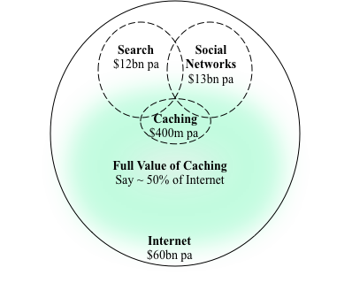
The value of internet infrastructure

Slide 29
Akamai Technologies 2011 Annual Report
We may need to defend against patent or copyright infringement claims, which would cause us to incur substantial costs. . . .
Any litigation or claims, whether or not valid . . . could result in substantial costs and . . . require us to:
Cease selling or using products that incorporate the challenged intellectual property;
Pay substantial damages and incur significant litigation expenses;
Obtain a license from the holder of the infringed intellectual property right, which license may not be available on reasonable terms or at all; or
Redesign products or services.
If we are forced to take any of these actions, our business may be seriously harmed.

Slide 30
The Internet as enabling technology:
The cost to productivity
Reducing transactions costs central to productivity growth on the internet
Lack of safe harbour and flexible exceptions raises transactions costs
Depresses innovation and investment amongst internet intermediaries
  Investment more likely to proceed if imports substitute poorly
  If high latency is tolerated imports will substitute
High latency is obstacle to reducing transactions costs

Slide 31
The Internet as enabling technology:
The cost to productivity
Had fractionally higher productivity produced higher growth in the copyright and exceptions industries in the past three years produced real growth just one hundredth higher (0.0258%), this would have increased value added by $138 mil over the past three years.
Projecting it forward over ten years would yield $593 million per annum.

Slide 32
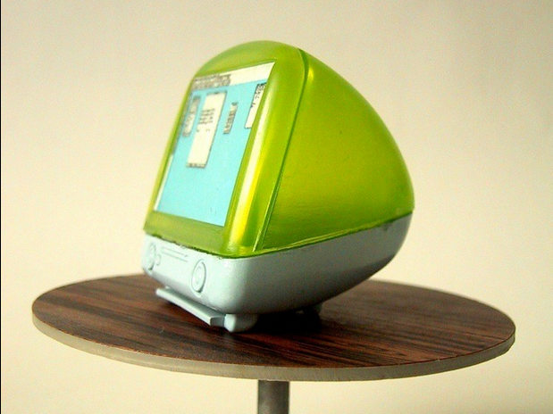
Rip, Mix, Burn

Slide 33
Business innovators protected by fair use
Apple
  iPod, iPhone, iPad, iCloud
  iTunes
Google
  Search
  YouTube
  Google +
Dropbox
Amazon
eBay
Facebook
Akamai Technologies
Yahoo
LinkedIn
US 1 Trillion capitalisation

Slide 35
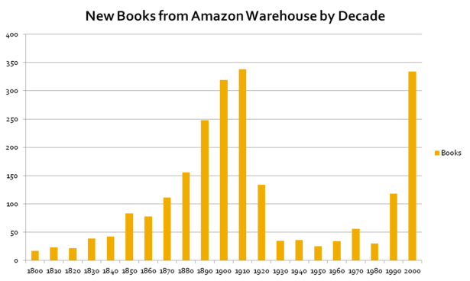
http://www.theatlantic.com/technology/archive/2012/03/the-missing-20th-century-how-copyright-protection-makes-books-vanish/255282/#.T3dP4kT9WRc.twitter

Slide 36
Digital services degraded or not offered in Australia
Amazon Prime
Tivo
Pandora

