Slide 1
Australia’s bad drug deal:
High pharmaceutical prices
Stephen Duckett
March 2013

Slide 2
Agenda
Pharmaceutical Benefits Scheme (PBS) costs and prices
Grattan analyses
How pharmaceutical pricing works now
A better way to purchase
Responding to potential concerns

Slide 3
Australia’s total spending on the Pharmaceutical Benefits Scheme is increasing in real terms

Slide 4
Although our prices were cheaper than UK and Europe five years ago, they’re not now
Australia’s pharmaceutical price ranking against selected countries, 2007-2011
Source: Grattan Institute analysis of OHE data

Slide 5
The market has two distinct submarkets
Patented drugs
  Sole supplier arrangements
  No patient choice
  The (relevant) policy issues are whether the incremental benefits of listing this drug is worth it and what should the subsidised price be?
Off-patent drugs
  Potential for multiple suppliers
  Low marginal cost of production
  The (relevant) policy issue is what should the subsidised price be?

Slide 6
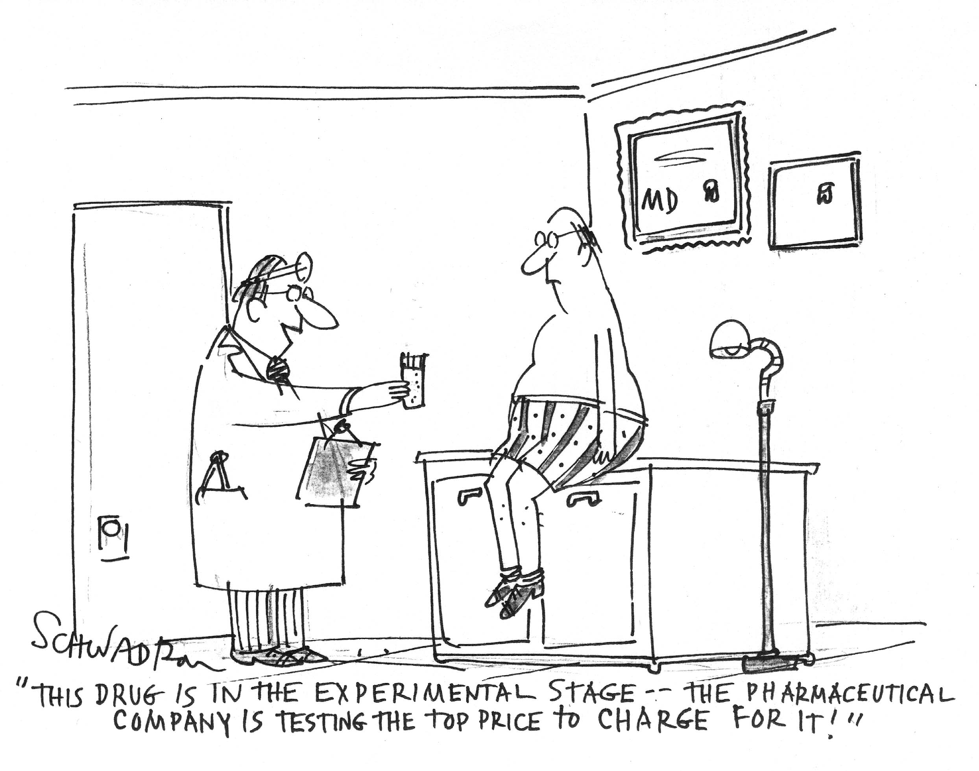
Our study was about pricing

Slide 7
Grattan analyses
Identified the 50 drug-dose combinations that are highest volume on PBS and the 50 that are highest expenditure on PBS
Combined into list of 75
Compared prices of these drugs-doses with prices paid by PHARMAC, the New Zealand purchaser
          62 identical
          11 substitutes
          2 not matched
  Compared prices paid by public hospitals in two states
          One unnamed state: 59 identical drugs
          Western Australia: 39 identical drugs

Slide 8
PBS prices are far higher than the comparators we studied – often by more than an order of magnitude
Source of lowest price
New Zealand
Unnamed state
Western Australia
Note: chart represents the 58 identical doses for which the benchmark model was cheaper than the PBS. Only 39 drugs where the PBS cost is more than twice that of the comparator are displayed (average is for all 58 doses).
Source: Grattan Institute analysis

Slide 9
One country, many prices
Estimated savings for generic and patented drugs
Source: Grattan Institute

Slide 10
Our performance is worst when it matters most
Ex-manufacturer prices for identical drugs as multiples of NZ prices, by total cost (left) and volume (right), 2011-12
Multiples of NZ prices
Multiples of NZ prices
Drug-dose combinations (groups of 10)
Drug-dose combinations (groups of 10)
High total cost
Low total cost
High volume
Low volume
Source: Grattan Institute analysis

Slide 11
The Atorvastatin story
$700 million expenditure in 2011-12 (Pfizer brand name: Lipitor); $570m by government
If Australia paid the NZ price with current pharmacy mark-ups, the price would plummet to $14.10, a savings to consumers of $22 per prescription.
On current prescription volumes, and across the most commonly prescribed forms of Atorvastatin, these higher prices (compared to NZ) amount to excess costs to government of over $1.4 million every day
If patients in Perth could buy Atorvastatin at the same price as their local public hospital, they’d save $19 per prescription
* At our reference date, October 2012
Australian price
30 X 40mg tablets
$51.59*
New Zealand price
90 X 40mg tablets
AU$5.80

Slide 12
Lower prices would mean big savings for patients
Patient savings per pack (non-concessional patients), based on benchmark prices, selected doses, 2011-12
Source: Grattan Institute

Slide 13
The problems of the process
‘Expanded and accelerated price disclosure’
Embedded politics
Framework agreement (MOU)
Timid price cuts on new generics

Slide 14
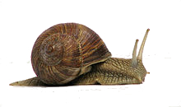
The current price disclosure process
Minimum 12 months
Brand becomes subject to Expanded and Accelerated Price Disclosure
Drug company collects price disclosure data
Drug company submits price disclosure data for the reporting period
Minimum 6 months
Service provider (working for the Department) calculates average disclosed price
Service provider notifies the Department of price outcome
Department makes a determination
Scheduled reduction

Slide 15
Current efforts to reduce prices don’t go far enough
Current prices for drugs targeted for price disclosure
Price in 2011-12
Source: Grattan Institute analysis. Note: “Amoxycillin +” is amoxycillin with clavulanic acid.

Slide 16
Current efforts to reduce prices don’t go far enough
Price disclosure brings some drug prices down....
Price in 2011-12
Price after April 2013 reduction
Source: Grattan Institute analysis. Note: “Amoxycillin +” is amoxycillin with clavulanic acid.

Slide 17
Current efforts to reduce prices don’t go far enough
But benchmarking would save a lot more money
Price in 2011-12
Price after April 2013 reduction
Benchmark price
Source: Grattan Institute analysis. Note: “Amoxycillin +” is amoxycillin with clavulanic acid.

Slide 18
The current flawed process - 1
The pricing authority is an internal committee of Department of Health and Ageing comprised of ‘representatives’ (Medicines Australia, generics manufacturers, consumers)
The Minister (and possibly Cabinet) have a say at the end of the whole process

Slide 19
The current flawed process - 2
The whole framework is governed by a political accommodation: a memorandum of understanding between Medicines Australia and government:
The Commonwealth undertakes not to implement new policy to generate price-related savings from the PBS during the period of agreement [May 2010 to July 2014], that is, measures that would change the ex-manufacturer prices of particular medicines, other than that reflected by this MOU
- Current Memorandum of Understanding between the Commonwealth and Medicines Australia

Slide 20
Other countries require tough price drops with new generics
Mandated generic price reductions, selected countries

Slide 21
Reform stage 1: get the foundations right
Independent governance
Indexed (rather than uncapped) budget to live within
Reverse the politics
All this can happen in 2013-14
Current approach
A better approach
Clinical value assessment
Political decision about total funds
Political pricing and access decisions
Pricing and access based on clinical value

Slide 22
Next stages of reform
Stage 2
At least a 50% cut for new generics
Benchmark pricing on regular basis thereafter
These changes generate savings of at least $1.3billion each year
Stage 3
Widen application of therapeutic premiums for substitute drugs
This is likely to generate a further $550 million of saving each year (indicative estimate only)

Slide 23
Benchmarking against three jurisdictions yields up to $1.86 billion in savings
Generic pharmaceuticals make up the majority of savings
Most savings come from New Zealand’s cheaper prices Percentage of drugs from each jurisdiction
$M

Slide 24
Possible phase in
Foreshadow new arrangements and establish
Pricing Board
(funded in 2013-14 Budget)
Pricing Board negotiates prices for new drugs
Annual drug expenditure set in Commonwealth Budget
Cut generics to 50% of originator prices
Generic price benchmarking
Renegotiate pre-existing prices on patented drugs
Agreement with Medicines Australia expires
June 2014
Broaden therapeutic group premium pricing
2013
2014
2015
2016
2017

Slide 25
Criticisms
“If you want a how-to guide for turning your health system into that a [sic] third-world country, this report would be it”
- Dr Brendan Shaw
CEO, Medicines Australia

Slide 26
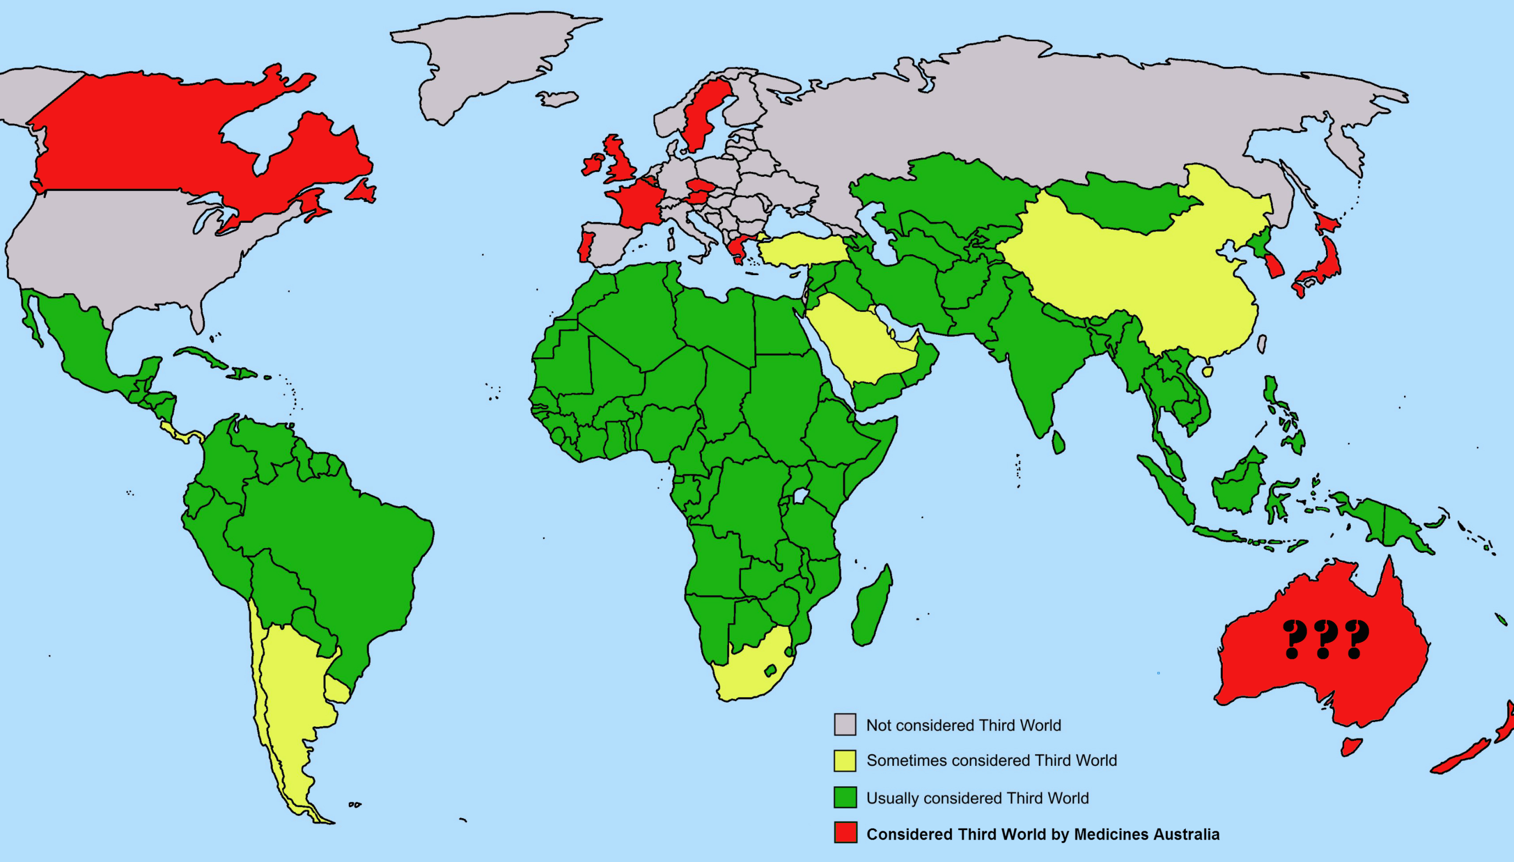

Slide 27
Criticisms – can we compare ourselves against other jurisdictions?
“The idea you can just pick and choose elements of other countries’ systems and that automatically gives us a better, stronger system…is incorrect”
- Minister Plibersek, 18 March
Considerable debate in the literature about difficulty of cross-national policy learning
We were selective in what of New Zealand (and Western Australia and other state) we picked up on

Slide 28
Criticisms – public hospitals are loss leaders?
In Australian public hospitals, “companies are happy to take a very low price…so that when [patients] go into the community, they stay on that particular brand of medicine”
- Minister Plibersek, 18 March
Little evidence that companies making a loss selling to public hospitals
This does not explain the even lower prices in New Zealand. The hospital prices are close to those.

Slide 29
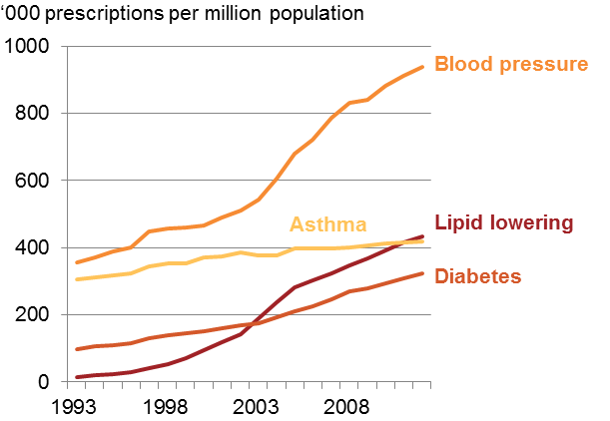
Criticisms – sole supplier/tendering process would create problems with access
“New Zealand is a basket case when it comes to access to medicines…it’s the last place health policymakers in this country should be looking to for ideas”
– Dr Brendan Shaw, CEO Medicines Australia
Only relevant to patented drugs, not relevant to our proposed generic drug pricing reforms (vast bulk of savings)
However NZ does have lower access and a lag time with getting new drugs on market, but prescription volumes for most commonly used drugs has increased while expenditure has been nearly flat

Slide 30
Criticisms – the current system is working fine
“Australian suppliers of generic medicines already sell their medicines at international world best prices due to a very competitive generic medicines industry in Australia…[Grattan’s] concerns are unfounded as [price disclosure ensures that the government benefits…”
- Kate Lynch, CEO Generic Medicines Industry Association
Similar statements from the Health Minister, Brisbane Times and Pharma in Focus

Slide 31
Criticisms - Choice
“It’s true that New Zealand does get a good price for generic medicines, but they have a great deal less choice for patients”
- Minister Plibersek, Monday 19 March
Choice by itself is not a pre-eminent value (e.g. no choice for patented medicines because of trade-off of value of choice and value of innovation and patent protection)
Choice is supposed to be part of competitive ideal and lead to savings
Our model does not propose elimination of choice (benchmarking model, not tendering)
How much should choice count against cost savings to patients?

Slide 32

Would patients prefer a choice of 13 brands, or $22 saving?

Slide 33
Other concerns – lower income for retail pharmacies
Retail pharmacy income will decline from price disclosure
  Unanticipated additional income for pharmacies from manufacturer discounts (i.e. agreed and subsidised ex-manufacturer not market price)
  Difficult to quantify discounts (largely secret), likely substantial.
Pharmacy income partly based on per cent mark-ups so impacted by price
  Report impact $20,000 per pharmacy
  May require restructure of subsidy arrangements (e.g. Rural Support Scheme)

Slide 34
Other concerns – loss of research and development in Australia
Types of pharmaceutical research and development, Australia and USA, 2008
Lower prices = lower profits in Australia will hinder in-country R&D
Little evidence in-country prices drive R&D location
Australian research is vulnerable to competition from countries that can conduct clinical trials more cheaply
Direct strategies to support R&D preferred to indirect ones
Australia
United States

Slide 35
Ending Australia’s bad drug deal
Start by getting the foundations right: independent governance and an incentive to save
Tougher rules on generic pricing
Promoting costs-effective choices
Savings
Stage 1 and 2: $1.3 billion each year (2014-15 onward)
Stage 3: around $550 million each year (2016-17 onward)
Full report available at grattan.edu.au
stephen.duckett@grattan.edu.au

