Slide 1
Budget 2012-13
Anne Holmes
Richard Webb

Slide 2
Fiscal Environment and Strategy
Anne Holmes
Director, Economics Section
Parliamentary Library

Slide 3
Fiscal policy is limited
Total Commonwealth spending in 2011-12 Budget:
      $366 billion
Increase in spending in 2011-12 Budget over 2011-12:
      $16 billion
Increase in revenue in 2011-12 Budget:
      $19 billion

Slide 4
Medium term fiscal strategy aims at...
Budget surpluses, on average, over medium term
Taxation < 23.5 per cent of GDP
Improvement in Government’s net financial worth
Return to surplus by holding real growth in outlays to 2 per cent a year

Slide 5
The fiscal situation
In 2010-11, the deficit was $49 billion, or 3.6 per cent of GDP
In the 2011-12 Budget, the deficit for 2011-12 was estimated to be $23 billion, or 1.5 per cent of GDP
In the mid-year economic and fiscal outlook, it was revised to $38.1 billion

Slide 6
The fiscal situation
Source | Year referred to | Deficit/surplus | % of GDP | Forecast GDP growth %
2011-12 Budget | 2010-11 | - $49.4 billion | -3.6 | 2.25 (actual)
2011-12 Budget | 2011-12 | - $22.6 billion | - 1.5 | 4.0
2011-12 MYEFO | 2011-12 | - $37.1 billion | - 2.5 | 3.25
2011-12 Budget | 2012-13 | + $3.5 billion | + 0.2 | 3.75
2011-12 MYEFO | 2012-13 | + $1.5 billion | + 0.1 | 3.25

Slide 7
The macroeconomic environment
Is a surplus desirable?
It depends: are the risks on the downside or the upside?
It’s a good thing to save in good times, against the possibility of bad times
The Australian economy looks to be in generally good shape
But there are some warning signs

Slide 8
Positives
Unemployment at long term average
Jobs growth healthy
GDP growing at long term average
Investment high (though non-mining investment looks weak)
Interest rates relatively low

Slide 9
Negatives - International
The US appears to be recovering
Eight European countries are in recession
    highest unemployment for 15 years
China may be precarious
    housing bubble
    local government indebtedness

Slide 10
Negatives - Domestic
Treasury revised its growth forecasts in MYEFO
    from 4 per cent to 3.25 per cent in 2011-12, and
    from 3.75 per cent to 3.25 per cent in 2012-13
RBA has also revised down
Tax take was down by $20 billion across the forward estimates
Housing prices are flat or falling, sales slow
Service and manufacturing industries showed sharp contractions in April
Many industries have been hit by the high exchange rate

Slide 11
A good time to be cautious...
...but what does caution look like?

Slide 12
Budget Concepts and Measures
Richard Webb
Senior Researcher, Economics Section
Parliamentary Library

Slide 13
1. Budget concepts and measures
1.1 Coverage
The public (whole of government) sector has three components:
    general government sector
    public financial corporations, and
    public non-financial corporations.
The Budget covers the general government sector
    the general government sector provides services that are mainly non-market in nature, mainly for the collective consumption of the community, and involve the redistribution of income. Examples of general government sector functions are defence, education, public order and safety, and the payment of ‘transfer payments’ such as disability pensions

Slide 14
Public financial corporations provide various financial functions
  examples are the Reserve Bank of Australia and Medibank Private
Public non-financial corporations are bodies that the government owns or controls and which supply various services and undertake business activities
  examples are Australia Post and the NBN
However, the Budget incorporates some transactions between the general government sector and the other two sectors
  for example, on the revenue side, the general government sector receives dividends from Australia Post and the Reserve Bank, and
  the government is injecting equity into the NBN

Slide 15
1.2 How is the Budget deficit/surplus measured?
There are three measures of the Budget outcome in the Budget Papers:
    the headline cash balance
    the underlying cash balance, and
    the fiscal balance
The first two are cash measures
    the fiscal balance is an accrual measure (explain later)
Headline cash balance
This is net cash flows, that is, cash in and cash out and the resulting net cash position
Generally not referred to much in Budget discussions

Slide 16
Underlying cash balance
The underlying cash balance is the measure that most commentators use
The underlying cash balance differs from the headline cash balance by excluding certain items from the headline balance
    the purpose in doing so is to get a better idea of ‘business as usual’
      removes net cash flows resulting from investment in and sales of financial assets (e.g. investment in the NBN and, historically, Telstra sale)
The underlying cash balance was introduced when there were major asset sales (for example, sale of Telstra and Federal airport leases)
    inclusion of the proceeds from these sales ‘distorted’ the headline cash balance
There is a reconciliation of the underlying cash balance and the headline cash balance in table 3 of statement 9 of Budget Paper No. 1
Fiscal balance (accrual)
The fiscal balance is the accrual counterpart to underlying cash balance
To explain the fiscal balance, it is necessary to explain the difference between cash and accrual accounting
    two examples: public service superannuation and asset purchases

Slide 17
Public service superannuation
Under cash accounting, the only thing that is recorded on the expenses (expenditure) side is the amount actually paid to public servants
However, the liability for superannuation is increasing every year
    cash accounting thus recognises only part of the total superannuation expense
Accrual accounting recognises both the cash outlaid, and the increase in the liability (by a book entry)
Accrual accounting thus gives a superior measure of the superannuation expense in any one year
Asset purchases
Under cash accounting, the purchase of a major asset is treated as cash out
Accrual accounting recognises that an asset may yield services over several years
    accrual accounting brings the asset onto the balance sheet and writes it off over its lifetime as depreciation
The jargon for expenditures measured in accrual terms is ‘expenses’
NOTE: most tables in the Budget papers are in accrual terms

Slide 18
The Budget contains two financial statements—in accrual terms—for the general government sector
    operating statement
    balance sheet
The fiscal balance measure of the Budget outcome appears in the operating statement
    the operating statement is in statement 9 of Budget Paper No. 1

Slide 19
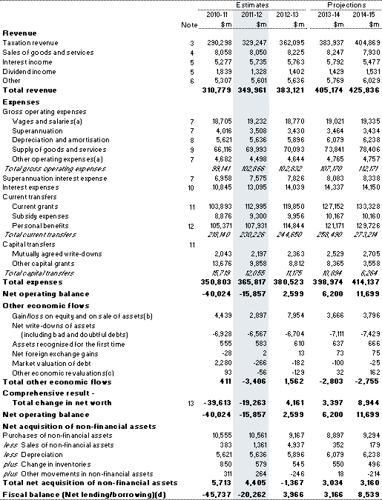

Slide 20
The fiscal balance has two components
    net operating balance, and
    net acquisition of non-financial assets (buildings, land etc)
      ‘other economic flows’ are essentially book entries and do not affect the fiscal balance

Slide 21

1.3 Budget aggregates
The Budget aggregates are the underlying cash balance and the fiscal balance
    they appear in statement 1 of Budget Paper No. 1
Note that in addition to the dollar amounts (billions), the aggregates are expressed as a percentage of gross domestic product (GDP)
    the budget outcome expressed as a percentage of GDP is often the more relevant concept in discussions of the Budget than the size of the Budget outcome in dollar terms
NOTE: you can find an historical series of the underlying cash balance in dollar terms and as a percentage of GDP in statement 10 of Budget Paper No. 1 (goes back to 1970-71)

Slide 22
1.4 Other Budget concepts
There are two other concepts that you may encounter in discussions of the Budget
    structural deficit and
    cyclical deficit
The reason I mention these two concepts is because some advocate eliminating the structural deficit as a policy objective
The structural component of the Budget is driven by policy decisions (discretionary fiscal policy)
    example of structural measure is the mining tax
The cyclical component of the budget is driven by fluctuations in economic activity
    fluctuations affect revenues and expenses
      revenue: for example, income and company tax revenue
      expenses: for example, social security expenses (for example, unemployment benefits)

Slide 23
Note that you can have situation where the Budget is in structural deficit but still be in surplus (as measured by the underlying cash balance and the fiscal balance) because the cyclical effect of increasing revenues more than offsets the structural deficit
The Budget Paper No. 1 normally does not include measures of the structural and cyclical components of a budget outcome
    but statement 4 of Budget paper No. 1 for 2009-10 did
Problem: inherently very difficult to estimate the two components

Slide 24
Finding Budget Information
Richard Webb
Senior Researcher, Economics Section
Parliamentary Library

Slide 25
2. Finding Budget information
The Budget speech
The Budget overview
The Budget Papers
    BP1: Budget Strategy and Outlook
    BP2: Budget Measures
    BP3: Australia’s Federal Relations
    BP4: Agency Resourcing
Portfolio Budget Statements
    main source of information on agency funding and activities
Other sources
    ministerial press releases and media kits

Slide 26
2.1 Budget papers
Budget Paper No. 1: Budget strategy and outlook
Contains 10 statements
    statement 1: budget overview
    statement 2: economic outlook
    statement 3: fiscal strategy and outlook
    statement 4: topic differs from year to year
    statement 5: revenue
    statement 6: expenses and net capital investment
    statement 7: asset and liability management
    statement 8: statement of risks
    statement 9: budget financial statements
    statement 10: historical Australian government data
Will look at only a few of these (based on experience of requests that the Library receives)
Statement 5: revenue
Main suggestion: look at the appendices especially Appendix A which contains details of revenue classified by source
The following table is accrual revenue

Slide 27
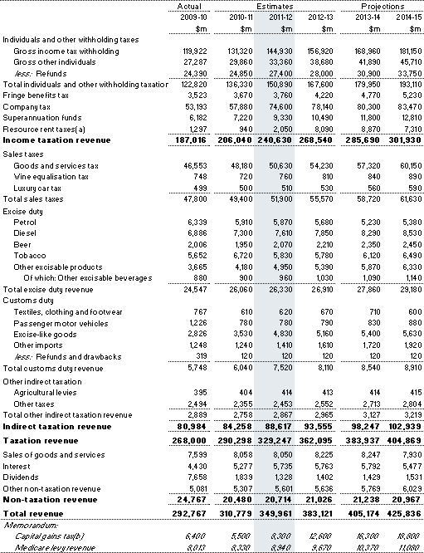

Slide 28
Statement 6: Expenses and Net Capital Investment
Statement 6 lists estimated expenses and net capital investment classified by function and sub-function
This is the contents page in Statement 6
Overview ..................................................................................................................... 6-3
General government sector expenses ..................................................................... 6-4
Reconciliation of expenses since the 2010-11 Budget ................................................ 6-4
Estimated expenses by function .................................................................................. 6-5
Major savings ............................................................................................................... 6-9
Program expenses ..................................................................................................... 6-10
General public services .............................................................................................. 6-12
Defence ...................................................................................................................... 6-15
Public order and safety .............................................................................................. 6-17
Education ................................................................................................................... 6-18
Health ......................................................................................................................... 6-21
Social security and welfare ........................................................................................ 6-26
Housing and community amenities ............................................................................ 6-31
Recreation and culture ............................................................................................... 6-33
Fuel and energy ......................................................................................................... 6-35
Agriculture, forestry and fishing .................................................................................. 6-37
Mining, manufacturing and construction .................................................................... 6-39
Transport and communication .................................................................................... 6-40
Other economic affairs ............................................................................................... 6-42
Other purposes ........................................................................................................... 6-44
General government net capital investment ......................................................... 6-46
Reconciliation of net capital investment since the 2010-11 Budget ........................... 6-46
Net capital investment estimates by function ............................................................. 6-48
Trends in Australian Government staffing .................................................................. 6-51
Appendix A: Expense by function and sub-function ................................................... 6-52
Appendix B: The Contingency Reserve ..................................................................... 6-55
Appendix C: Additional Agency Statistics .................................................................. 6-57

Slide 29
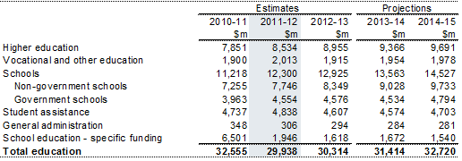
The following are the tables for education expense sub-functions
Table 7: Summary of expenses — education

Slide 30
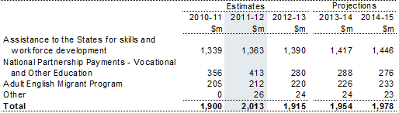
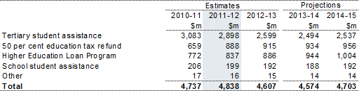
Table 7.1: Trends in the major components of vocational and other education sub‑function expenses
Table 7.2: Trends in the major components of student assistance sub‑function expenses

Slide 31
Net capital investment
The Commonwealth invests relatively little for its own purposes
    the main area of investment is defence
If newspaper articles are correct about cuts to defence expenditure, statement 6 is a good place to start
    for more information, go to the Defence portfolio budget statement
Note: Commonwealth funding for capital purposes such as schools and roads is treated as grants to the states as is thus an expense (under ‘other purposes’ function)
Statement 10: historical Australian government data
I mentioned earlier that you can find an historical series of the underlying cash balance in dollar terms and as a percentage of GDP in statement 10 of Budget Paper No. 1 (goes back to 1970-71)
Statement 10 also contains other historical data series such as net debt, interest payments and taxation receipts

Slide 32
Budget Paper No. 2: Budget measures
This contains information on measures proposed in the Budget arranged by portfolio
    covers expense, revenue and capital measures as can be seen from the contents page below
Note that BP 2 contains CHANGES to expenses, revenues and capital investment; it does not contain levels
    you can find information on levels of expenditure in the Portfolio Budget Statements

Slide 33
Part 1: Revenue Measures ........................................................................................... 1
Agriculture, Fisheries and Forestry ................................................................................. 8
Attorney-General's .......................................................................................................... 9
Climate Change and Energy Efficiency ........................................................................ 10
Education, Employment and Workplace Relations ....................................................... 11
Immigration and Citizenship .......................................................................................... 12
Treasury ........................................................................................................................ 13
Part 2: Expense Measures .......................................................................................... 53
Agriculture, Fisheries and Forestry ............................................................................... 86
Attorney-General's ........................................................................................................ 94
Broadband, Communications and the Digital Economy .............................................. 111
Climate Change and Energy Efficiency ...................................................................... 121
Cross Portfolio ............................................................................................................. 125
Defence ....................................................................................................................... 126
Education, Employment and Workplace Relations ..................................................... 131
Families, Housing, Community Services and Indigenous Affairs ............................... 177
Finance and Deregulation ........................................................................................... 199
Foreign Affairs and Trade ........................................................................................... 201
Health and Ageing ....................................................................................................... 211
Human Services .......................................................................................................... 246
Immigration and Citizenship ........................................................................................ 256
Infrastructure and Transport ........................................................................................ 266
Innovation, Industry, Science and Research .............................................................. 275
Parliament ................................................................................................................... 282
Prime Minister and Cabinet ......................................................................................... 284
Regional Australia, Regional Development and Local Government ........................... 289
Resources, Energy and Tourism ................................................................................. 298
Sustainability, Environment, Water, Population and Communities ............................. 30

Slide 34
The following is an example of an expense
Crime Stoppers Australia — continuation of funding
The Government will provide $2.0 million over four years to continue support for Crime Stoppers Australia Ltd. This funding will enable Crime Stoppers Australia to continue to provide community services including operation of the Crime Stoppers telephone hotline and initiatives to educate the community on crime reporting and prevention.
The tables show five years data
    the first column is for the past budget year
    the second column is for the current budget year,
    columns three, four and five are known as the forward years
Note: when ministers say how much will be spent on a particular program, they tend to quote four years figures, namely, for the Budget year plus the three forward years
Expense ($m)
 | 2010‑11 | 2011-12 | 2012-13 | 2013-14 | 2014-15
Attorney‑General's Department | -- | 0.5 | 0.5 | 0.5 | 0.5

Slide 35
Budget Paper No. 3: Australia’s Federal relations
BP3 contains information on payments to the states
Foreword ....................................................................................................................... iii
Executive Summary ...................................................................................................... 1
Part 1: Australia’s Federal Relations .......................................................................... 3
Overview ......................................................................................................................... 3
Major Government reforms and new developments ....................................................... 4
COAG agenda ............................................................................................................... 10
Reviews relating to Commonwealth-State relations ..................................................... 10
Total payments to the States ........................................................................................ 12
Part 2: Payments for Specific Purposes ................................................................... 17
Overview of payments ................................................................................................... 17
Health ............................................................................................................................ 22
Education ..................................................................................................................... 48
Skills and workforce development ................................................................................. 59
Community services ...................................................................................................... 63
Affordable housing ........................................................................................................ 70
Infrastructure ................................................................................................................. 74
Environment .................................................................................................................. 87
Contingent payments .................................................................................................... 92
Other national partnership payments ............................................................................ 94
Financial assistance grants to local government ........................................................ 101
Part 3: General Revenue Assistance ...................................................................... 103
Overview of payments ................................................................................................. 103
GST payments to States ............................................................................................. 103
Other general revenue assistance .............................................................................. 110
Mirror tax arrangements .............................................................................................. 112
Part 4: Developments in the Consolidated Non-financial Public Sector ............ 113
Introduction .................................................................................................................. 113
Net operating balance ................................................................................................. 114
Fiscal and cash balances ............................................................................................ 115
Net debt ....................................................................................................................... 117
Net interest payments ................................................................................................. 118
The Australian Loan Council ....................................................................................... 119

Slide 36
Payments to the states (and territories and local governments) take two forms:
    specific purpose payments and
    general revenue assistance
Specific purpose payments
These are payments made to fund a variety of activities that the states undertake such as health and education
    a feature of specific purpose payments (SPPs) is that the states must spend the money on the purposes for which funds are allocated
There are several categories of SPPs as shown in the following summary table for health

Slide 37
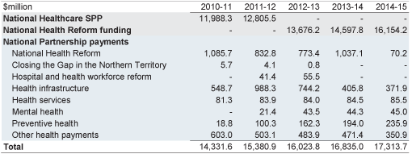

Table 2.3: Payments to support state health services
There are many more detailed tables about particular initiatives such as the following
Four hour national access target for emergency departments — capital funding component

Slide 38
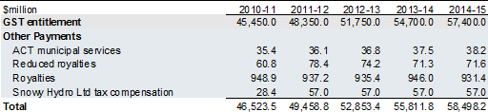
General revenue assistance
The following table shows general revenue assistance
    a feature of general revenue assistance is that unlike SPPs, the states can spend the funds as they wish
GST is the main component of general revenue assistance
Table 3.1: General revenue assistance

Slide 39

The following table shows each state’s GST entitlement
Table 3.9: Distribution of the GST entitlement pool over budget year and forward estimates

Slide 40
Budget Paper No. 4: agency resourcing
Contains
    an introduction
    summary of special appropriations
    summary of special accounts, and
    agency resourcing
      that’s another way of saying the sources of funding for each agency and how it will be spent
I STRONGLY RECOMMEND READING THE INTRODUCTION
    it summarises how the system of appropriations operates and explains the terminology used, for example, annual appropriations, special appropriations, and departmental and administered expenses
I will talk about special appropriations and special accounts in the next section which deals with portfolio budget statements

Slide 41
2.2 Portfolio Budget Statements (PBS)
The PBS contains information on the budget of each agency, that is, where the money comes from and where it goes
The PBS contain a summary of the budget for each agency
    called the agency resource statement
2.2.1 Where does the money come from?
Two broad categories of revenue
    revenue from government
    and own-source income
Dealing with own-source income first: broadly falls into two categories
    sale of goods and services
      an example is Department of Immigration passport fees
    other (for example, rents, insurance)
Revenue from government: three main sources
    annual appropriations
    special appropriations
      special accounts

Slide 42
Annual appropriations
Annual appropriations account for probably less than 20 per cent of total Budget funding
Constitutional requirements that there be two annual appropriation Bills
    section 53 provides that the Senate may not amend proposed laws appropriating money for the ordinary annual services of the government
    under section 54, a proposed law appropriating money for the ordinary annual services of the government can deal only with such appropriations.
Hence the annual appropriations are split into two Bills that provide for (a) the ordinary annual services of the government and (b) ‘other’ services
    payments for ordinary annual services are authorised under Appropriation Bill (No. 1)
    payments for other services are authorised under Appropriation Bill (No. 2)
Nobody really knows what ordinary annual services are but essentially they are for on-going programs not authorised by special appropriations
    most of the ordinary annual services funding is for departmental expenses (I’ll explain this term later)
    but some programs are funded under Appropriation Bill (No. 1)
    examples are the Bass Strait passenger vehicle subsidy scheme and the LPG conversion scheme for cars

Slide 43
Examples of ‘other’ services under Appropriation Bill (No. 2) include
    so-called 'non‑operating' costs such as an equity injections into agencies to allow them to buy major assets
    administered expenses (I’ll explain later) for new outcomes
      after a new outcome has been financed once under Appropriation Bill (No. 2), it is financed under Appropriation Bill (No. 1), that is, it becomes an ordinary annual service
Special appropriations
The great majority of spending is authorised by special appropriations (perhaps about 80 per cent)
    a special appropriation is a provision within an Act that provides authority to spend money for particular purposes, for example, to finance a particular project or to make social security payments
Most special appropriations are limited by criteria/entitlement
    examples are most social welfare payments such as age and disability pensions and most payments to the states
    such appropriations are open-ended in the sense that the amounts are not limited
    note that as a consequence, most of the figures in the Budget are estimates and depend on assumptions of growth, unemployment, inflation etc

Slide 44
Special accounts
A special account is an appropriation mechanism that sets aside an amount to be expended for a specific purpose
    examples are the national cattle disease eradication account, the international marketing of education account, and the Murray-Darling basin account
All monies received and paid for the specific purpose pass through the special account
The money that goes into special accounts comes from annual and special appropriations
I will illustrate the above using the Department of Resources agency resource statement in a minute
But before I do that, I need to introduce two terms
    departmental expenses and
    administered expenses
Departmental expenses are the costs of running programs
    examples are employee benefits, supplies, and depreciation
      a feature of departmental expenses is that any unspent amounts can be carried over into future years
      this can happen, for example, if there are delays in implementing programs

Slide 45
Administered expenses are the payments made under the programs
    examples are age and disability support pensions
Now turn to the Department of Resources agency resource statement

Slide 47
2.2.2 Where does the money go?
Expenses are classified by outcomes
    outcomes consist of programs and sub-programs
For example, the Department of Immigration has six outcomes
    outcome 1 deals with migration
      program 1.1 (visa and migration) is a program
      there are several sub-programs such as 1.1.1 (visa and migration-service delivery)
Expenses incurred for outcomes/programs/sub-programs fall into two categories:
    departmental
    Administered
Departmental expenses are the costs of running programs
Administered expenses are the payments made under the programs
Departmental and administered expenses are allocated to each outcome/program/sub-program so that each is fully costed

Slide 48
The following example is the expenses for program two (resources-related initiatives and management) for the Department of Resources

