Slide 1
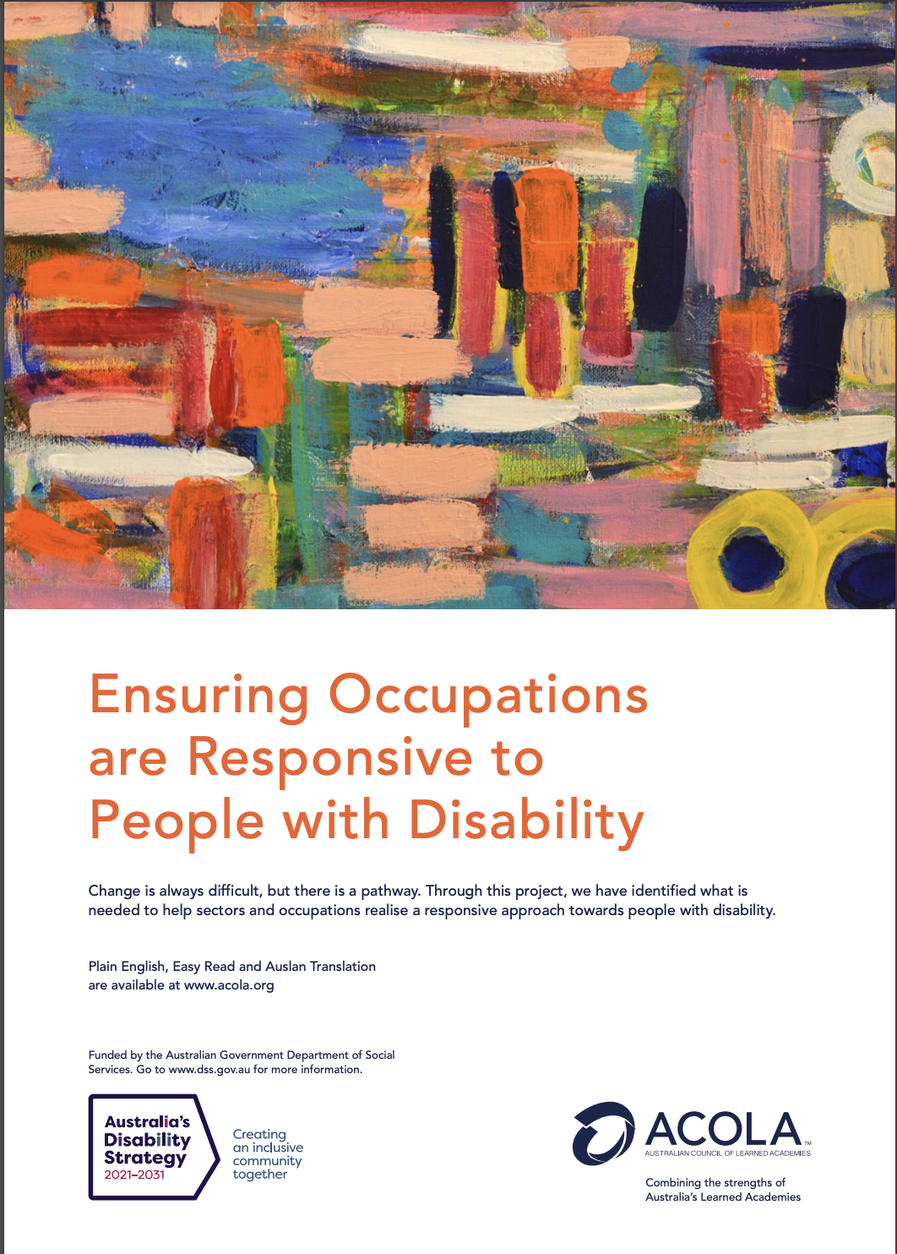
Making occupations responsive to people with disability Role of education and professional development
Professor Iva Strnadová and Professor Karen Fisher FASSA
Notes:
Iva and Karen

Slide 2
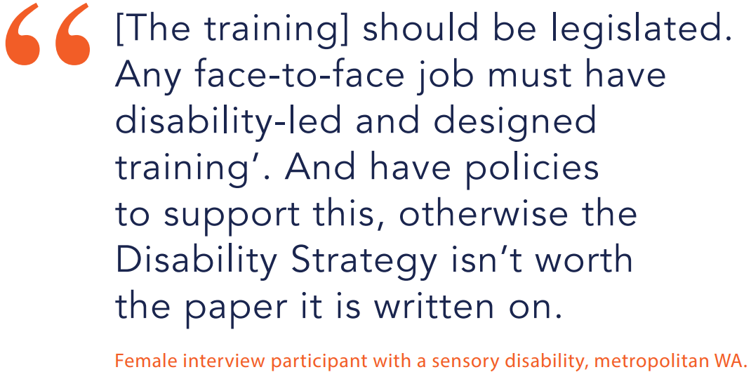
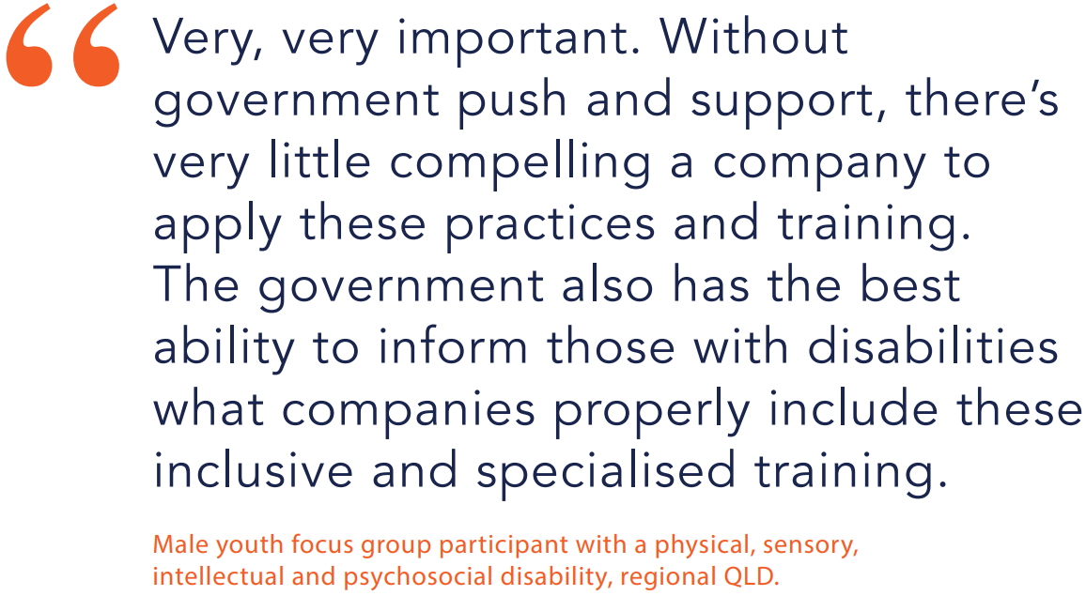
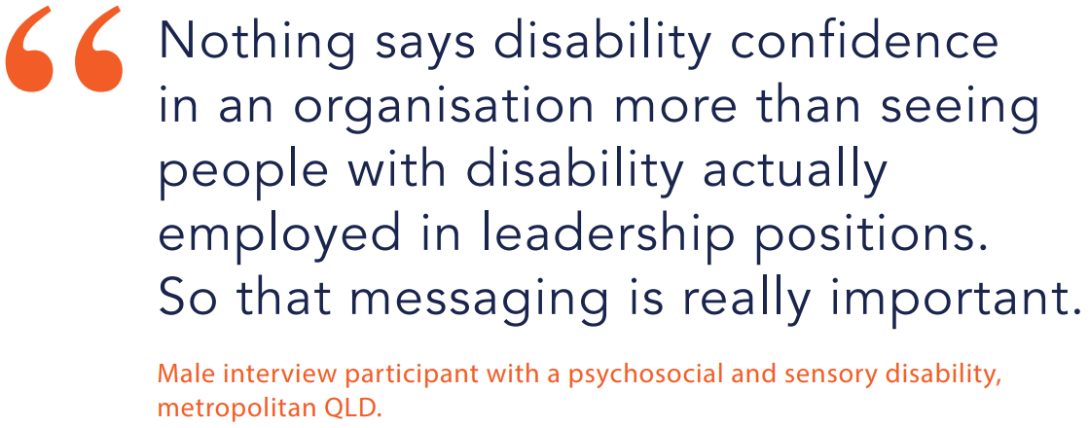
Notes:
Iva

Slide 3
Context of disability in Australia
Most people: experience disability at some point
18% Australians are people with disability
Australians with disability: 77% physical disability. Others have cognitive, sensory or psychosocial disability.
Disability rates higher in rural and remote areas (23%), major cities (16%)
People with disability: increasing (demographic trends and chronic health conditions)
People with disability: highly diverse
Other aspects of identity (age, gender, culture, …) often unrecognised
Organisations, business and local community groups must become disability responsive
Tailored approaches are needed to respond to the range of experiences and preferences of people with disability
Other aspects of identity – age, gender, ethnicity, sexual orientation, disability and class – magnify discrimination and marginalisation of people with disability
Notes:
Karen
In contrast to ”disability confidence”, “disability awareness”
Ryan’s point: It would be important to note that this discussion comes as part of wider reviews and improvements in disability services and responses, e.g NDIS, DRC, Disability Service Act refresh etc

Slide 4
Disability responsiveness – definitions
Disability
Disability encompasses any kind of impairment, whether existing at birth or acquired through illness, accident or the ageing process, including physical, cognitive, sensory and psychosocial disability
(United Nations 2022)
Responsiveness
“Disability responsiveness” and “inclusion” address needs and preferences of people with disability:
Incorporate attitudinal, behavioural, practice and systemic aspects of including people with disability
Focus on workers’ attitudinal and behavioural changes, and organisational capacities and systems change
Related terms: disability awareness, disability confidence, competence, equality
Notes:
Karen
Our report adopts a human rights perspective to defining disability, and is informed by the United nations Convention on the Rights of Persons with Disabilities.

Slide 5
Australia’s training system
Training, education and professional development are critical to building disability responsiveness within occupations and workforces
Training role is influenced by the structure, content and delivery of courses and units
Barriers include
Ableism (disability discrimination)
Competing priorities in curriculum
Policy and program deficiencies
Lack of disability inclusion or consultation
Funding deficiencies for teaching staff
Knowledge gaps about disability
Ideology challenges
Facilitators include
Contact with people with disability
Organisational policy processes
Tailored programs and initiatives for professions
Collaborating, communicating and networking with disability stakeholders
Considered education and training content
Disability education and training
Technology
Involving people with disability in the design and delivery
of education, training and courses is a key facilitator of effective education and training
Notes:
Iva
Ryan’s point: Outline at a high level what we know from the community attitudes study about experiences with services + Layering in the story about what has happened before and worked and not work, and how do we improve training and not make it an extra burden or straw that breaks the back for some professions, such as teachers.

Slide 6
Current state of occupations
Key findings
Occupations seek to provide good services. Case study occupations: a lack of training about disability
Where disability training is incorporated: often not standardised
Training is often short and not presented or co-designed with people with disability who have lived experience of relevant sectors
Often administrative and support staff are the first point of interaction for people with disability. These staff often receive no formal training about disability.
Case study occupations
Sector | Occupation
Education | Teachers and principals Teacher aides Early childhood education & care workers
Healthcare | Nurses Physiotherapists General practitioners
Justice | Police officers Correctional officers Solicitors
Social services | Social workers (including child protection officers) Community sector workers
Notes:
Iva

Slide 7
Theory of change
Unresponsive
Reaching beyond comfort zone
Broadening own perspective
Disability responsiveness
Lack of disability awareness
Behaviours and attitudes are discriminatory, stigmatising and ableist
Lack of self-awareness
Lack of comfort with own skills
Better understanding of lived experience of people with disability
Awareness of negative attitudes and perceptions
Understands and challenges stigma and stereotypes
Minimises personal bias
Focuses on ability
Improved understanding of disability and its impacts
Enables a supportive and inclusive environment
Challenges to legal and social norms
Takes action in partnership to meet the needs of people with disability
Notes:
Karen

Slide 8
Six key principles for disability responsiveness training
Capability areas
Experiential learning
Addressing bias
Fit for purpose
Quantum
Nothing about us without us
Notes:
Iva

Slide 9
Action Plan
Five key areas for action to drive improvements in training:
Active participation
Sector planning and actions
Training packages
Knowledge collection
Government leadership
Notes:
Iva and Karen
Five key areas for action to drive improvements in training:
Active participation: People with disability play a clear, visible and valued role in the leadership of the training
Sector planning and actions: The training of occupations is tailored, timely and focused on the needs of workers and the community they serve, especially people with disability
Training packages: People with disability have confidence in skills and capabilities of all professionals to support them
Knowledge collection: Australia has the knowledge to better include people with disability, monitor developments and progress to address disability responsiveness
Government leadership: Australian governments share a collaborative approach to progressing an inclusive society

